Slide 1
Anne Herbert: A Life in the Wars of the Roses
Ian Dawson
www.thinkinghistory.co.uk

Slide 2
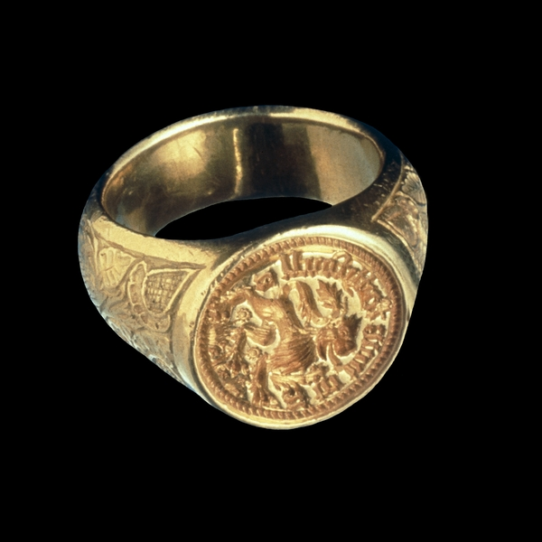
What kind of relationship did Ann have with William?

Slide 3
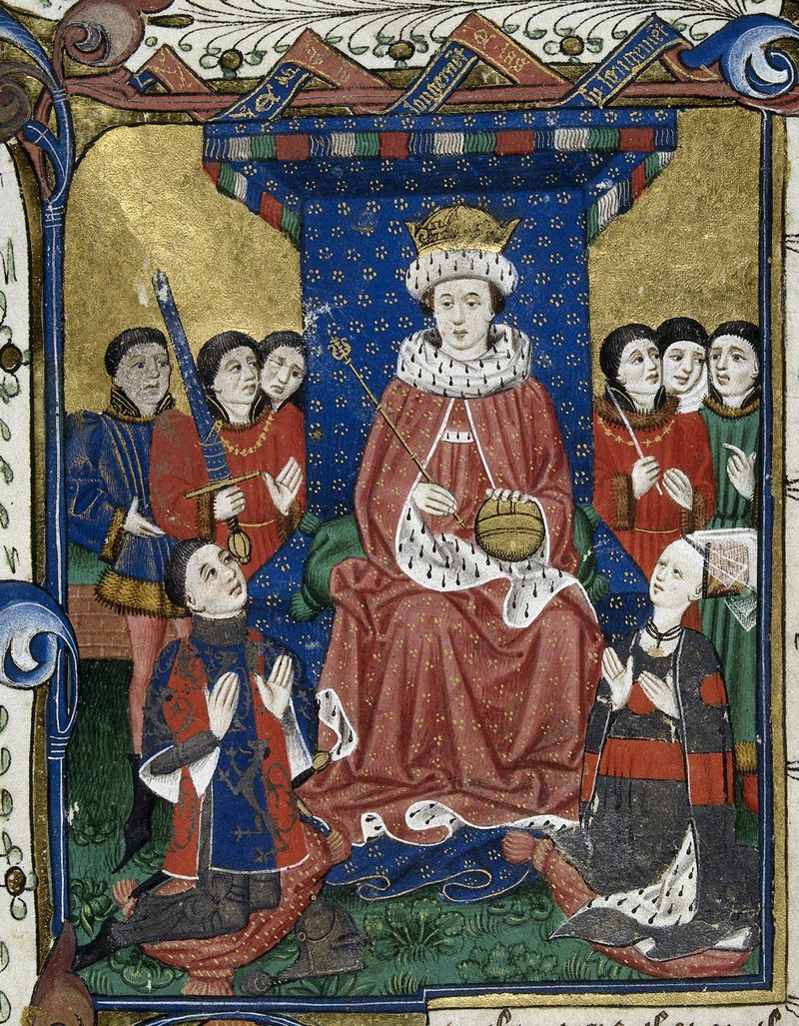

Slide 4
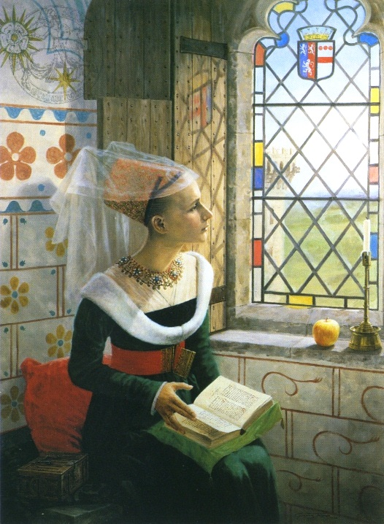
Reverie
© Graham Turner
www.studio88.co.uk

Slide 5
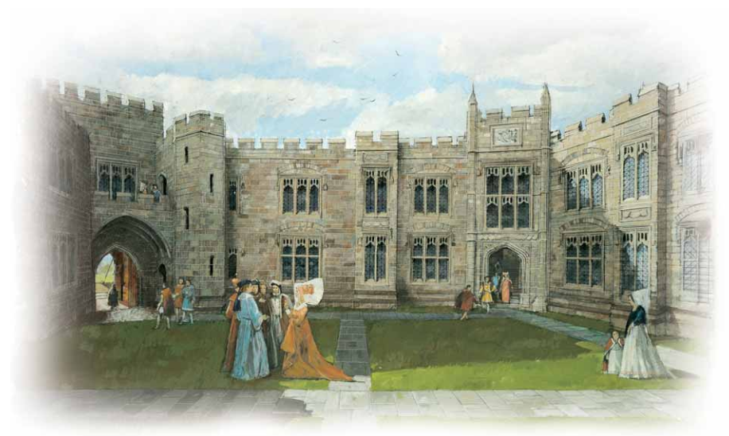
© CADW

Slide 6
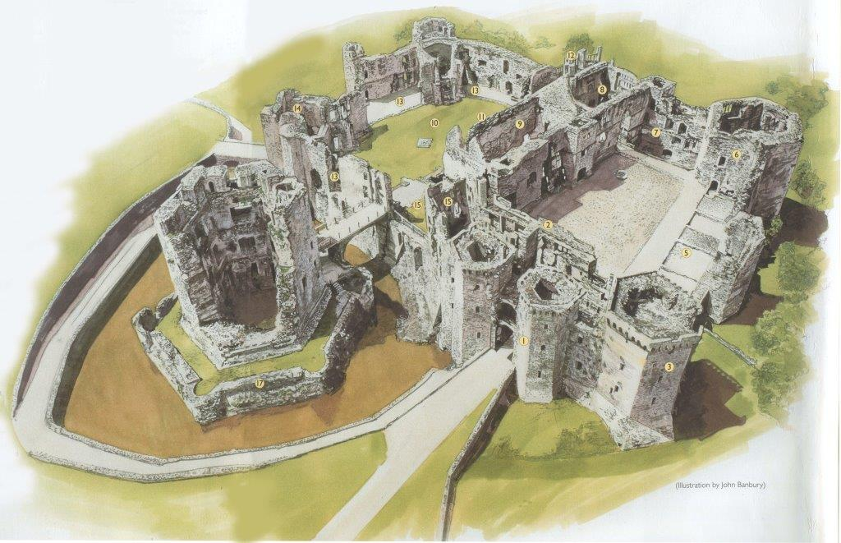
Raglan Castle
© John Banbury

Slide 7
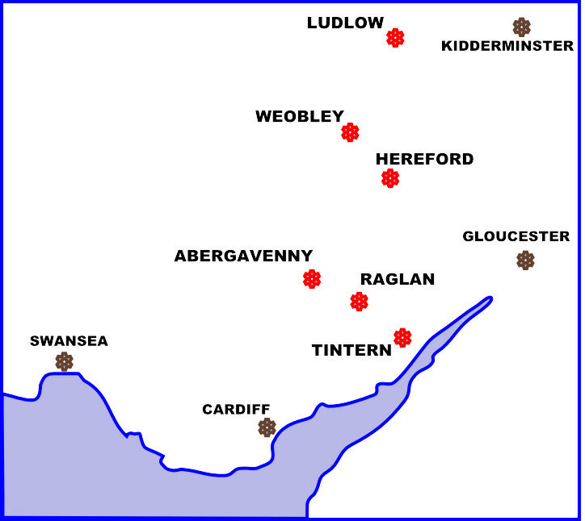
Richard,
Duke of York
based
at Ludlow

Slide 8
Anne’s Immediate Family Tree
WALTER DEVEREUX
1411-1459
m.
c.1432
ELIZABETH MERBURY
1412-1438
WALTER
b. c.1432
ANNE
b. c.1433
KATHERINE
b. 1438

