Slide 1
Nineteenth Century Portsmouth
1811 - Portsmouth gained its first piped water supply, but you had to pay to be connected and only the rich and middle class could afford it.
1820 - The Portsea Improvement Commissioners installed gas street lighting. Old Portsmouth followed in 1823.
During the 19th century Portsmouth spread across the whole od Portsea Island. By the 1790s a new suburb was growing up around Commercial Road and Charlotte Street. It became known as Landport after the Landport gate. By 1871 the population of Portsmouth had grown to 100,000.
What impact, positive and negative, might a larger population have?

Slide 2
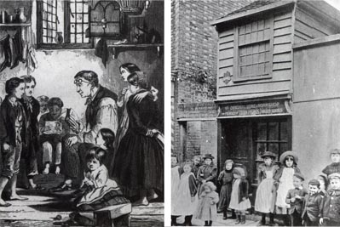
1818 - John Pounds was born in St Mary‟s Street in 1766. He worked in the Dockyard until he was crippled in an accident. He then set up as a cobbler. In about 1818 he established a school to educate poor children in his shop thereby starting the Ragged Schools movement which gained impetus elsewhere after 1844. Hundreds of children in Portsmouth relied on John Pounds for clothing and food. John Pounds died in 1839.
1802 Marc Isambard Brunel, the father of famed Portsmouth engineer Isambard Kingdom Brunel, established the world's first mass production line at the Portsmouth Block Mills. At its height the Dockyard was the largest industrial site in the world.
1835-1860 Southsea begins to grow. A prominent architect during this period was Thomas Ellis Owen who built properties in Kent Road, Queen’s Terrace, Sussex Terrace, Beach Road, Grove Road South, Clarendon Road, Osborne Road and Portland Terrace.
1840 Horse drawn buses start to run in Portsmouth
1847 The railway reaches Portsmouth
1860 HMS Warrior launched

Slide 3
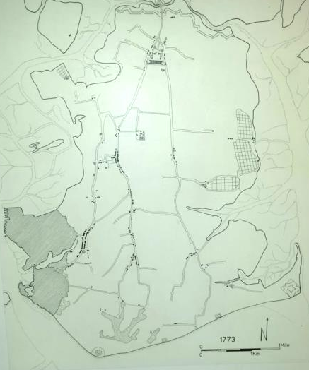
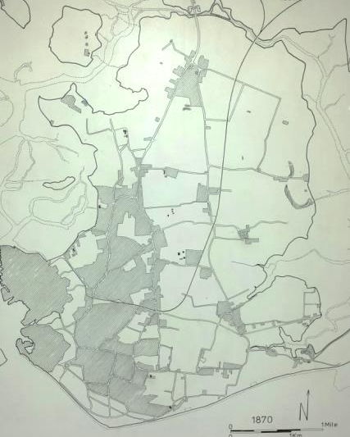
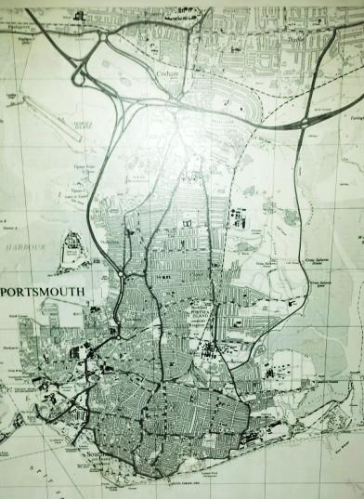

1773
1847
1900
Rapid expansion of Portsmouth across Portsea Island
Portsmouth Football Club was founded in 1898 and the club have always played at Fratton Park.

Slide 4
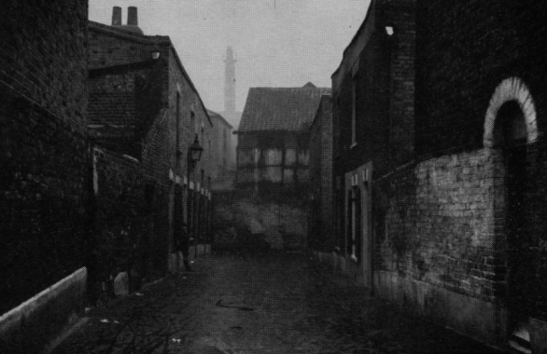
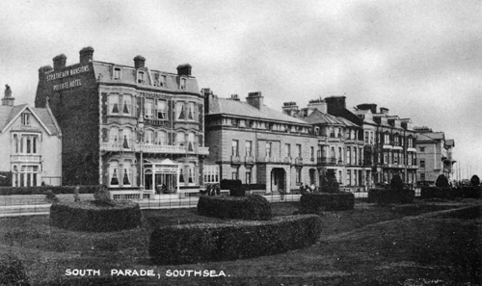
“The wages of the majority of the people in regular employment were so small that they lived in constant poverty; the larger parts had no settled wages at all, many of them being hawkers, green-grocers with a capital of five shillings, window cleaners in a district where no one wanted their windows cleaned, old pensioners past work with a shilling to eightpence a day, sailors' wives with three or four children living upon £2 a month, and soldiers wives married off the strength with no pay at all”.
Robert R. Dolling, Ten Years in a Portsmouth Slum,; p20
With such vast differences in the condition of housing between the working class who lived in areas such as Landport, Portsea and Fratton and the middle class who lived in Southsea, Rev. Dolling said it was hard to create a “united city”. There was deep class antagonism throughout the century, the most famous outburst of tension was the Battle of Southsea.

Slide 5

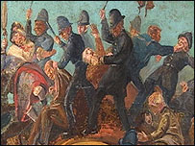
Battle of Southsea 1874
In May 1874 the Pier Company, which was headed by wealthy citizens, “put a stop to the mingling of the classes around its premises, and erected a barrier” between the Pier and Bathing Rooms. The result was predictable, especially after the authorities failed to bring down the barrier with bickering among the council; the crowd riot. Large crowds of ordinary workmen and women gathered to fight with the authorities, all for a “few square yards” of the Common. The eventual result was that the barrier was torn down. The riot lasted for four days, which is very rare in the history of rioting.

Slide 6
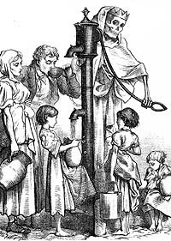
1846 - First electric telegraph cable laid between Portsmouth and Gosport. Mr. Hay, a chemist in the High Street, of Old Portsmouth, devoted much attention to electricity and lectured on the subject in and around Portsmouth; he was appointed Electrical Referee and lecturer in the Dockyard.
1849 - Cholera strikes the town during the summer months. The town records state that there were 800 internments at Kingston Churchyard and St. Thomas's Churchyard; they were buried in batches. 26th September was set aside as a day of prayer.
The Dockyard and other Government establishments in the area were closed. By 15th November the plague had disappeared and general thanksgiving services were held throughout the town of Portsmouth.

Slide 7
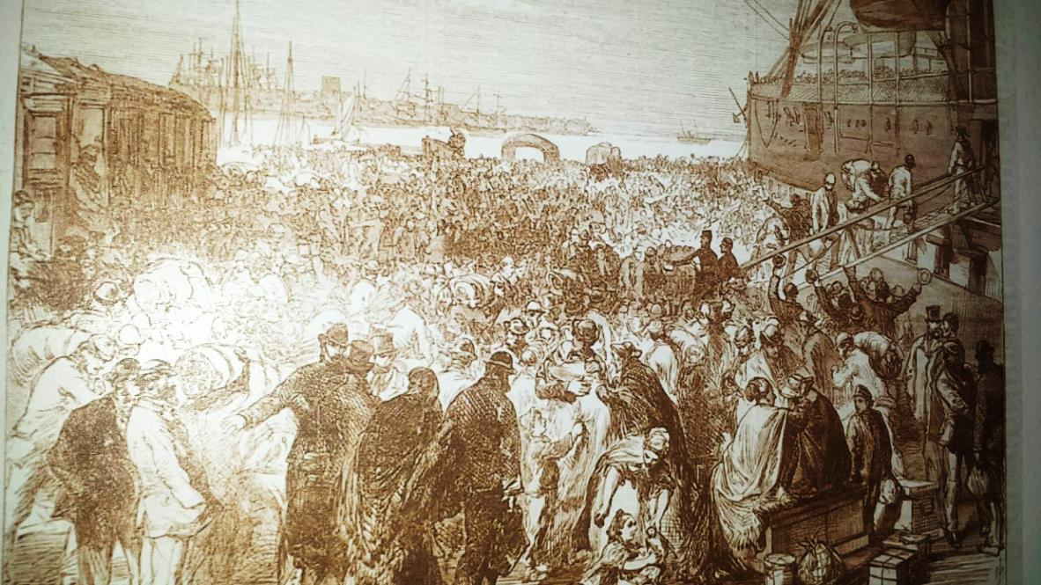
1869 April - Great gloom hung over the town as discharged Dockyard men and their families emigrated to Canada. With the advancement in steam power meant the need for rope greatly diminished, resulting in job losses. 391 men, women and children of whom 175 belonged to Portsmouth sailed in the Troopship Crocodile that the Admiralty allowed for the passage. On 1st May another 776 left in the Troopship Serapis. It was said that most did well and prospered in the new world.
Drawing depicting the redundant dockyard men boarding ships to Canada 1869.

Slide 8
1870 – Rise in employment in dockyard because of the Franco-Prussian War. 700 extra men employed in the dockyard.
1874 Disastrous Fire - No.11 Store House (Now the Naval Museum) was completely gutted by fire down to the ground floor. However massive walls remained in tacked and in 1879 the building was restored to its original state.
In the previous 12 months 4,000 dockyard men were treated at the dockyard surgery for minor injuries. 1,000 men and boys incapacitated. Compared to the previous 10 years the number had trebled.

Slide 9
Improvements in the Nineteenth Century
The second half of the 19th century saw major improvements. After 1857 the piped water supply became more widely available, and in 1864 the Council started building a mains drainage system. Piped water and mains drainage allowed flushing toilets to replace the old cesspits.
By-laws were also passed to improve the quality of housing. The result was an expansion of good-quality small terraced housing, of which much remains today. After 1900 the Council initiated various slum clearance schemes.
Further improvements came with the introduction of gas and electricity. In the 1890s gas became very popular. By 1914 gas was used in most houses in Portsmouth for lighting and cooking. Electricity first became available in 1894 in Portsmouth but was very expensive and only used in wealthier households.

Slide 10
All the experts sit around one table.
Safety of the People
Wealth
Employment
Housing/Living Standards
Health
My Desk
DOOR

Slide 11

All the experts sit around one table.
What evidence is there to support your judgment?
Is there a clear judgment?
Are there some periods when there is a lack of evidence?
Can you agree when it was least important?
When was the best time to live in Portsmouth according to your theme?
Think
By yourself – 40 seconds
Pair
With your group – 3 minutes
Share
With the class

Slide 12
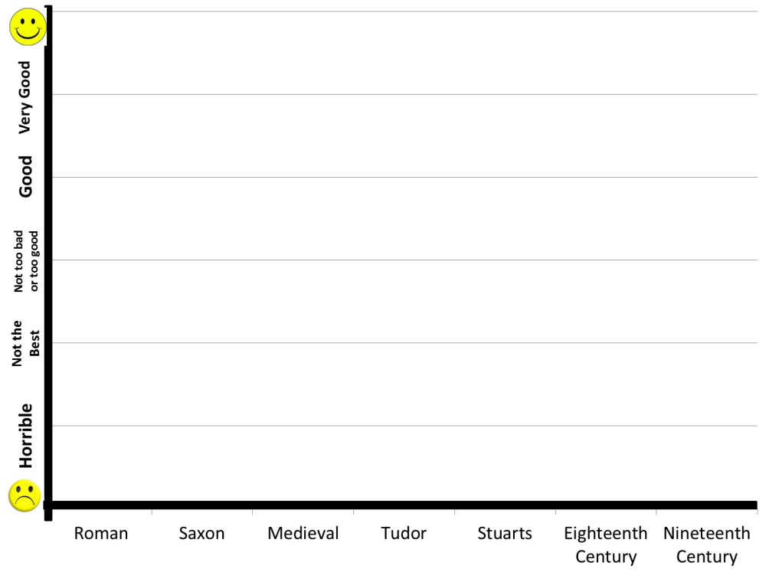
On your timeline sheets – draw a line across the periods showing when it was best.
If you have specific dates then try to be accurate with your plotting.
Annotate the highest and lowest points on your graph.
eg. 1558, 1560, 1563, the plague strikes Portsmouth..

Slide 13


Your group will now justify to the rest of the class your line graph.
Explain, describe and show your timeline to the class
Other members have to listen to each group. Plot the line in a different colour on your timeline.
You should have 5 different lines on your timeline at the end.

Slide 14


Very Good
Good
Not too bad or too good
Not the Best
Horrible

Slide 15
“The best period to live in Portsmouth was during the Eighteenth Century”
How far do you agree with this statement?

Slide 16
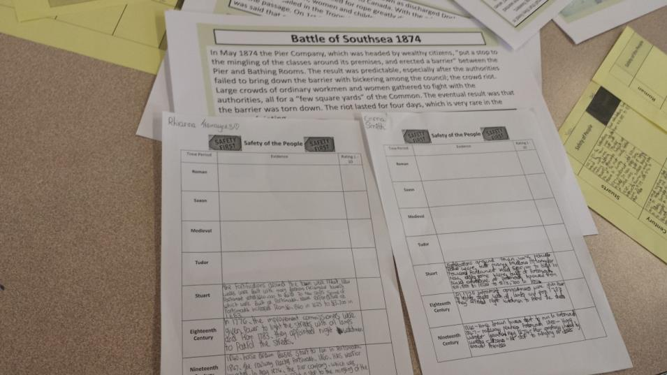
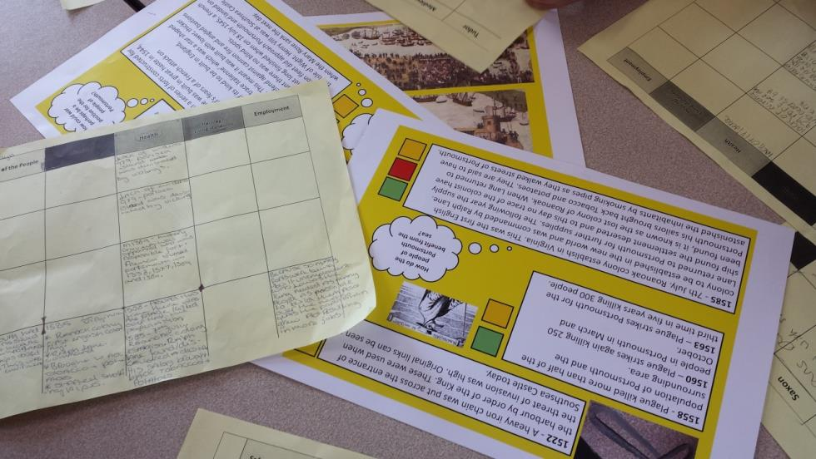

Slide 17
