Slide 1
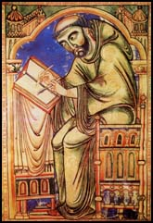
The Dissolution of our Monasteries

Slide 2
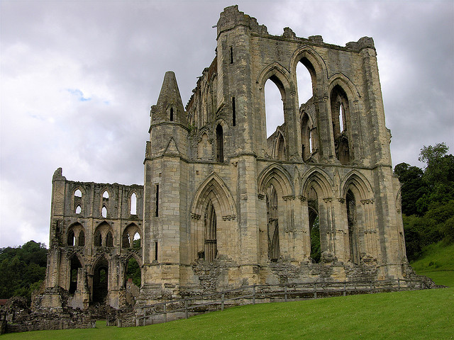
Rievaulx Abbey

Slide 3
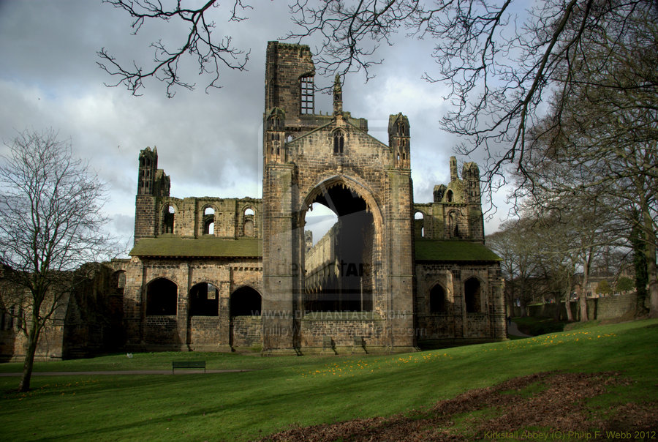
Kirkstall Abbey

Slide 4
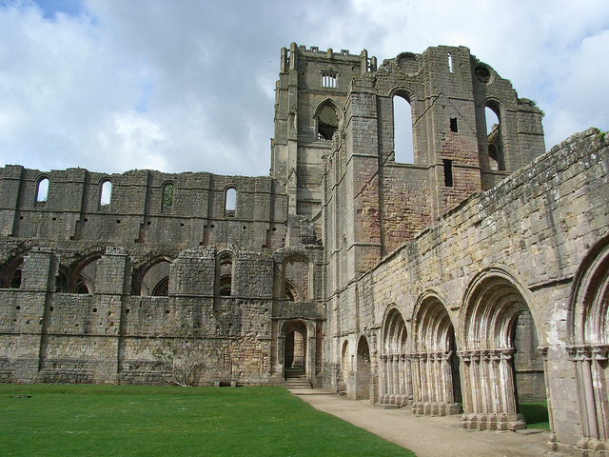
Fountains Abbey

Slide 5
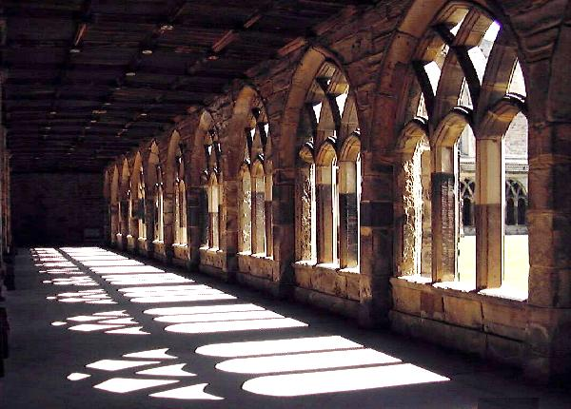
Durham Priory

Slide 6
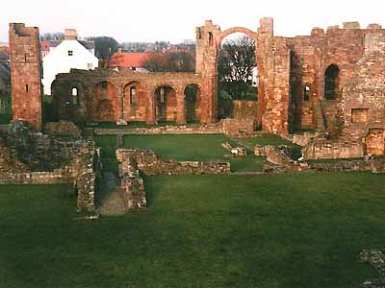
Heugh View - The Benedictine Priory
Lindisfarne Priory

Slide 7
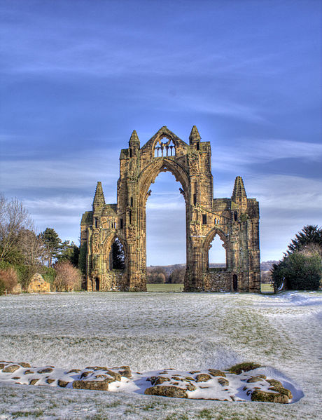
Guisborough Priory

Slide 8
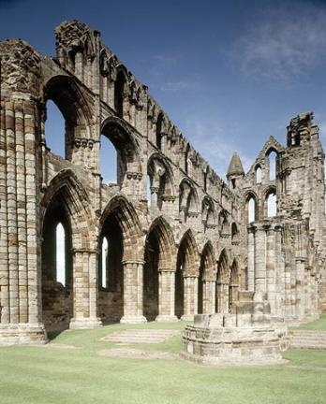
Whitby Abbey

Slide 9
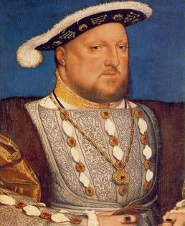
The Monastery Inspection
When Henry VIII sent his inspectors out to write a report about the monasteries in England they were told to only report on what was wrong with the monasteries
Is this fair?

Slide 10
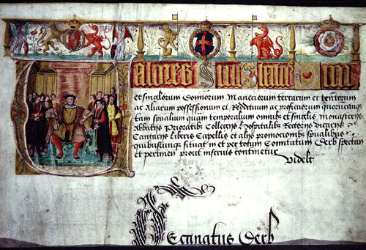
Valor Ecclesiasticus (Church Wealth)
What does this tell us?
The report was called Valor Ecclesiasticus (Church Wealth)
What did Henry really want to find out about?

Slide 11
Henry VIII was looking for reasons to close the monasteries down.
The investigation looked at the work the monasteries did so they could find reasons to close them.

Slide 12
Which Monasteries to close?
You are an advisor to King Henry VIII and have just received the inspection report on the monasteries.
Read the reports and decide which monasteries should close and which should not.
Use St Benedict’s rules to decide which rules the monks have broken.
Decide which monasteries will bring in the most money for King Henry VIII.
Dissolution of the Monasteries
Tick/cross evidence on chart
 Evidence that the monks are holy
x Evidence that the monks are corrupt
? No evidence in the report

Slide 13
St Benedict’s Rules
Live as poor people
Not to marry or have sexual relationships
Look after the poor, sick & old
Give food & shelter to travellers
Eat simply and fast regularly. No meat.
Wear simple rough clothes
Sleep in dormitories
Help to educate children
Copy out precious or rare manuscripts
Income

Slide 14
The following two examples show you how to work in pairs

Slide 15
Whitby Abbey

Slide 16
Whitby Abbey - Benedictine Order
Location: On the North Yorkshire coast – north of Scarborough
Population: 22 monks live there
Income: Around 437 crowns.
This Abbey was once famous throughout the land for its building which has now fallen into disrepair. The community was once thriving and gave generously to the poor and needy. The monks now tell the poor to go else where in order to save money. They also charge patients for using the hospital. They charge travellers for staying at the Abbey and ask for large donations to educate children.
Most of their money comes from fishing and boat building but recently there is evidence that the Abbot is allowing monks to gamble in order to raise funds for repairs. The monks eat simply and sleep in dormitories. They dress in simple, rough clothes. The monks are trying to live according to the rules under very difficult circumstance.

Slide 17
Monastic Houses | Rievaulx Abbey | Kirkstall Abbey | Fountains Abbey | Durham Priory | Lindisfarne Priory | Guisborough Priory | Whitby Abbey
St Benedict’s Rules | Cistercian Order | Cistercian Order | Cistercian Order | Benedictine Order | Benedictine Order | Augustinian Order | Benedictine Order
Live as poor people |  |  |  |  |  |  | ✓
Not to marry or have sexual relationships |  |  |  |  |  |  | ?
Look after the poor, sick & old |  |  |  |  |  |  | X
Give food & shelter to travellers |  |  |  |  |  |  | X
Eat simply and fast regularly. No meat. |  |  |  |  |  |  | ✓
Wear simple rough clothes |  |  |  |  |  |  | ✓
Sleep in dormitories |  |  |  |  |  |  | ✓
Help to educate children |  |  |  |  |  |  | x
Copy out precious or rare manuscripts |  |  |  |  |  |  | ?
Income |  |  |  |  |  |  | 437 crowns
STAY OPEN OR CLOSE DOWN |  |  |  |  |  |  | CLOSE DOWN
CLOSED DOWN IN

Slide 18
Rievaulx Abbey

Slide 19
Rievaulx Abbey - Cistercian Order
Location: By the River Rye near Helmsley in North Yorkshire.
Population: 22 monks
Income: Around 351 crowns a year.
The monks were quizzed on all aspects of life, from their food and clothing, to the observance of the Rule of St Benedict, their attendance at the Divine Services, and the administration of hospitality and charity.
The Abbey is well maintained. There is clear evidence that the original Cistercian practices of strict observance according to the letter of Saint Benedict's rule had been abandoned in favour of a more "comfortable" lifestyle. The monks have been given permission to eat meat. The monks have their own private living accommodations some of the monks bedrooms are richly decorated, and the Abbot has a substantial private household, where some of the buildings are covered in fine tapestries and jewels. The monks do not have the time to help the poor or sick.
At least one monk has been accused of immorality with women. There is also clear evidence of that the monks use superstition, holy relics, miracles and cults to dupe people into paying the Abbey large amounts of money.

Slide 20
Monastic Houses | Rievaulx Abbey | Kirkstall Abbey | Fountains Abbey | Durham Priory | Lindisfarne Priory | Guisborough Priory | Whitby Abbey
St Benedict’s Rules | Cistercian Order | Cistercian Order | Cistercian Order | Benedictine Order | Benedictine Order | Augustinian Order | Benedictine Order
Live as poor people | x
Not to marry or have sexual relationships | x
Look after the poor, sick & old | x
Give food & shelter to travellers | x
Eat simply and fast regularly. No meat. | x
Wear simple rough clothes | x
Sleep in dormitories | x
Help to educate children | ?
Copy out precious or rare manuscripts | ?
Income | 351 crowns
STAY OPEN OR CLOSE DOWN | CLOSE DOWN
CLOSED DOWN IN

Slide 21
Now work in pairs
Use St Benedict’s rules to decide which rules the monks have broken.
Decide which monasteries will bring in the most money for King Henry VIII.
Dissolution of the Monasteries
Tick/cross evidence on chart
 Evidence that the monks are holy
x Evidence that the monks are corrupt
? No evidence in the report

Slide 22
Answers

Slide 23
Monastic Houses | Rievaulx Abbey | Kirkstall Abbey | Fountains Abbey | Durham Priory | Lindisfarne Priory | Guisborough Priory | Whitby Abbey
St Benedict’s Rules | Cistercian Order | Cistercian Order | Cistercian Order | Benedictine Order | Benedictine Order | Augustinian Order | Benedictine Order
Live as poor people
Not to marry or have sexual relationships
Look after the poor, sick & old
Give food & shelter to travellers
Eat simply and fast regularly. No meat.
Wear simple rough clothes
Sleep in dormitories
Help to educate children
Copy out precious or rare manuscripts
Income
STAY OPEN OR CLOSE DOWN
CLOSED DOWN IN

Slide 24
Monastic Houses | Rievaulx Abbey | Kirkstall Abbey | Fountains Abbey | Durham Priory | Lindisfarne Priory | Guisborough Priory | Whitby Abbey
St Benedict’s Rules | Cistercian Order | Cistercian Order | Cistercian Order | Benedictine Order | Benedictine Order | Augustinian Order | Benedictine Order
Live as poor people | x
Not to marry or have sexual relationships | x
Look after the poor, sick & old | x
Give food & shelter to travellers | x
Eat simply and fast regularly. No meat. | x
Wear simple rough clothes | x
Sleep in dormitories | x
Help to educate children | ?
Copy out precious or rare manuscripts | ?
Income | 351 crowns
STAY OPEN OR CLOSE DOWN | CLOSE DOWN
CLOSED DOWN IN

Slide 25
Monastic Houses | Rievaulx Abbey | Kirkstall Abbey | Fountains Abbey | Durham Priory | Lindisfarne Priory | Guisborough Priory | Whitby Abbey
St Benedict’s Rules | Cistercian Order | Cistercian Order | Cistercian Order | Benedictine Order | Benedictine Order | Augustinian Order | Benedictine Order
Live as poor people | x | ?
Not to marry or have sexual relationships | x | ?
Look after the poor, sick & old | x | ✓
Give food & shelter to travellers | x | X
Eat simply and fast regularly. No meat. | x | ?
Wear simple rough clothes | x | ?
Sleep in dormitories | x | ?
Help to educate children | ? | ?
Copy out precious or rare manuscripts | ? | ?
Income | 351 crowns | 329 crowns
STAY OPEN OR CLOSE DOWN | CLOSE DOWN | CLOSE DOWN
CLOSED DOWN IN

Slide 26
Monastic Houses | Rievaulx Abbey | Kirkstall Abbey | Fountains Abbey | Durham Priory | Lindisfarne Priory | Guisborough Priory | Whitby Abbey
St Benedict’s Rules | Cistercian Order | Cistercian Order | Cistercian Order | Benedictine Order | Benedictine Order | Augustinian Order | Benedictine Order
Live as poor people | x | ? | ✓
Not to marry or have sexual relationships | x | ? | x
Look after the poor, sick & old | x | ✓ | ?
Give food & shelter to travellers | x | X | ?
Eat simply and fast regularly. No meat. | x | ? | ✓
Wear simple rough clothes | x | ? | ✓
Sleep in dormitories | x | ? | ?
Help to educate children | ? | ? | ?
Copy out precious or rare manuscripts | ? | ? | ?
Income | 351 crowns | 329 crowns | 1115 crowns
STAY OPEN OR CLOSE DOWN | CLOSE DOWN | CLOSE DOWN | CLOSE DOWN
CLOSED DOWN IN

Slide 27
Monastic Houses | Rievaulx Abbey | Kirkstall Abbey | Fountains Abbey | Durham Priory | Lindisfarne Priory | Guisborough Priory | Whitby Abbey
St Benedict’s Rules | Cistercian Order | Cistercian Order | Cistercian Order | Benedictine Order | Benedictine Order | Augustinian Order | Benedictine Order
Live as poor people | x | ? | ✓ | ✓
Not to marry or have sexual relationships | x | ? | x | ✓
Look after the poor, sick & old | x | ✓ | ? | ✓
Give food & shelter to travellers | x | X | ? | ✓
Eat simply and fast regularly. No meat. | x | ? | ✓ | ✓
Wear simple rough clothes | x | ? | ✓ | ✓
Sleep in dormitories | x | ? | ? | ✓
Help to educate children | ? | ? | ? | ✓
Copy out precious or rare manuscripts | ? | ? | ? | ✓
Income | 351 crowns | 329 crowns | 1115 crowns | 250 crowns
STAY OPEN OR CLOSE DOWN | CLOSE DOWN | CLOSE DOWN | CLOSE DOWN | STAY OPEN
CLOSED DOWN IN

Slide 28
Monastic Houses | Rievaulx Abbey | Kirkstall Abbey | Fountains Abbey | Durham Priory | Lindisfarne Priory | Guisborough Priory | Whitby Abbey
St Benedict’s Rules | Cistercian Order | Cistercian Order | Cistercian Order | Benedictine Order | Benedictine Order | Augustinian Order | Benedictine Order
Live as poor people | x | ? | ✓ | ✓ | ✓
Not to marry or have sexual relationships | x | ? | x | ✓ | ?
Look after the poor, sick & old | x | ✓ | ? | ✓ | ?
Give food & shelter to travellers | x | X | ? | ✓ | ✓
Eat simply and fast regularly. No meat. | x | ? | ✓ | ✓ | ?
Wear simple rough clothes | x | ? | ✓ | ✓ | ✓
Sleep in dormitories | x | ? | ? | ✓ | ✓
Help to educate children | ? | ? | ? | ✓ | ✓
Copy out precious or rare manuscripts | ? | ? | ? | ✓ | ✓
Income | 351 crowns | 329 crowns | 1115 crowns | 250 crowns | 200 crowns
STAY OPEN OR CLOSE DOWN | CLOSE DOWN | CLOSE DOWN | CLOSE DOWN | STAY OPEN | STAY OPEN
CLOSED DOWN IN

Slide 29
Monastic Houses | Rievaulx Abbey | Kirkstall Abbey | Fountains Abbey | Durham Priory | Lindisfarne Priory | Guisborough Priory | Whitby Abbey
St Benedict’s Rules | Cistercian Order | Cistercian Order | Cistercian Order | Benedictine Order | Benedictine Order | Augustinian Order | Benedictine Order
Live as poor people | x | ? | ✓ | ✓ | ✓ | ✓
Not to marry or have sexual relationships | x | ? | x | ✓ | ? | ✓
Look after the poor, sick & old | x | ✓ | ? | ✓ | ? | ✓
Give food & shelter to travellers | x | X | ? | ✓ | ✓ | ✓
Eat simply and fast regularly. No meat. | x | ? | ✓ | ✓ | ? | ✓
Wear simple rough clothes | x | ? | ✓ | ✓ | ✓ | ✓
Sleep in dormitories | x | ? | ? | ✓ | ✓ | ✓
Help to educate children | ? | ? | ? | ✓ | ✓ | ✓
Copy out precious or rare manuscripts | ? | ? | ? | ✓ | ✓ | ✓
Income | 351 crowns | 329 crowns | 1115 crowns | 250 crowns | 200 crowns | 500 crowns
STAY OPEN OR CLOSE DOWN | CLOSE DOWN | CLOSE DOWN | CLOSE DOWN | STAY OPEN | STAY OPEN | STAY OPEN
CLOSED DOWN IN

Slide 30
Monastic Houses | Rievaulx Abbey | Kirkstall Abbey | Fountains Abbey | Durham Priory | Lindisfarne Priory | Guisborough Priory | Whitby Abbey
St Benedict’s Rules | Cistercian Order | Cistercian Order | Cistercian Order | Benedictine Order | Benedictine Order | Augustinian Order | Benedictine Order
Live as poor people | x | ? | ✓ | ✓ | ✓ | ✓ | ✓
Not to marry or have sexual relationships | x | ? | x | ✓ | ? | ✓ | ?
Look after the poor, sick & old | x | ✓ | ? | ✓ | ? | ✓ | X
Give food & shelter to travellers | x | X | ? | ✓ | ✓ | ✓ | X
Eat simply and fast regularly. No meat. | x | ? | ✓ | ✓ | ? | ✓ | ✓
Wear simple rough clothes | x | ? | ✓ | ✓ | ✓ | ✓ | ✓
Sleep in dormitories | x | ? | ? | ✓ | ✓ | ✓ | ✓
Help to educate children | ? | ? | ? | ✓ | ✓ | ✓ | x
Copy out precious or rare manuscripts | ? | ? | ? | ✓ | ✓ | ✓ | ?
Income | 351 crowns | 329 crowns | 1115 crowns | 250 crowns | 200 crowns | 500 crowns | 437 crowns
STAY OPEN OR CLOSE DOWN | CLOSE DOWN | CLOSE DOWN | CLOSE DOWN | STAY OPEN | STAY OPEN | STAY OPEN | CLOSE DOWN
CLOSED DOWN IN

Slide 31
Choose ONE task
Choose one monastery that you think is holy and should stay open. Write a pleading letter to Henry VIII to save this monastery of your choice, give lots of reasons why this local monastery is holy and should stay open. Use St Benedict’s rules to support your argument. (Level 4 to 5)
Choose one monastery that you think is corrupt and should close. Write a letter to Henry VIII to recommend this monastery for closure, give lots of reasons why this local monastery is corrupt/dishonest/not holy and should close. Use St Benedict’s rules to support your argument. (Level 4 to 5)
Choose two local monasteries one that is corrupt and one that is holy. Write a letter to Henry VIII to recommend one monastery for closure and one holy monastery to save. Use St Benedict’s rules to support your argument. (Level 5 to 6)

Slide 32
Dear Henry VIII
I recommend that you close __________ because… (give reasons)
However I recommend that you keep the holy monastery of __________ open because… (give reasons)
Yours Sincerely
Choose two local monasteries one that is corrupt and one that is holy. Write a letter to Henry VIII to recommend one monastery for closure and one holy monastery to save. Use St Benedict’s rules to support your argument

Slide 33
Plenary
The real result of the inspection is coming soon.
In pairs share your thoughts about the Dissolution of the Monasteries.
Henry decides to…

Slide 34
Monastic Houses | Rievaulx Abbey | Kirkstall Abbey | Fountains Abbey | Durham Priory | Lindisfarne Priory | Guisborough Priory | Whitby Abbey
St Benedict’s Rules | Cistercian Order | Cistercian Order | Cistercian Order | Benedictine Order | Benedictine Order | Augustinian Order | Benedictine Order
Live as poor people | x | ? | ✓ | ✓ | ✓ | ✓ | ✓
Not to marry or have sexual relationships | x | ? | x | ✓ | ? | ✓ | ?
Look after the poor, sick & old | x | ✓ | ? | ✓ | ? | ✓ | X
Give food & shelter to travellers | x | X | ? | ✓ | ✓ | ✓ | X
Eat simply and fast regularly. No meat. | x | ? | ✓ | ✓ | ? | ✓ | ✓
Wear simple rough clothes | x | ? | ✓ | ✓ | ✓ | ✓ | ✓
Sleep in dormitories | x | ? | ? | ✓ | ✓ | ✓ | ✓
Help to educate children | ? | ? | ? | ✓ | ✓ | ✓ | x
Copy out precious or rare manuscripts | ? | ? | ? | ✓ | ✓ | ✓ | ?
Income | 351 crowns | 329 crowns | 1115 crowns | 250 crowns | 200 crowns | 500 crowns | 437 crowns
STAY OPEN OR CLOSE DOWN | CLOSE DOWN | CLOSE DOWN | CLOSE DOWN | STAY OPEN | STAY OPEN | STAY OPEN | CLOSE DOWN
CLOSED DOWN IN | 1538 | 1539 | 1539 | 1539 | 1536 | 1539 | 1540

Slide 35
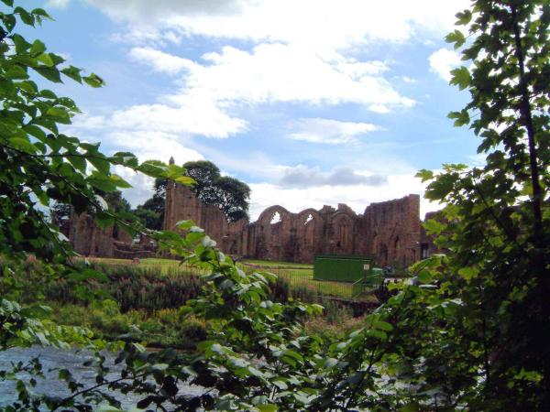
How could you make people care about this ruined Abbey?
8. Was the closure of the monasteries a significant event in history and why?
9. What did you think about the importance of monasteries before you did this activity? How have your ideas changed?
Heritage Work

Slide 36
Finchale Abbey
How could you make people care about this ruined Abbey?
8. Was the closure of the monasteries a significant event in history and why?
9. What did you think about the importance of monasteries before you did this activity? How have your ideas changed?
Heritage Work

