Slide 1
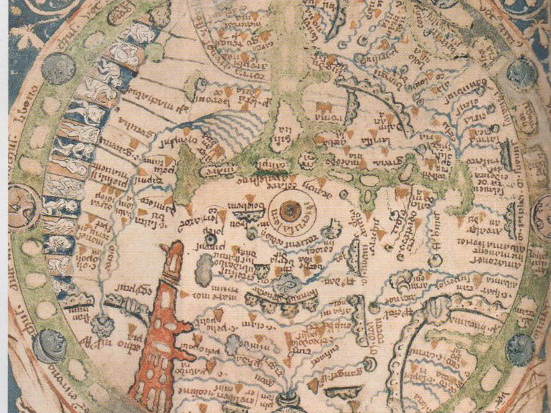
Remind yourself why you are going on Crusade:

Slide 2
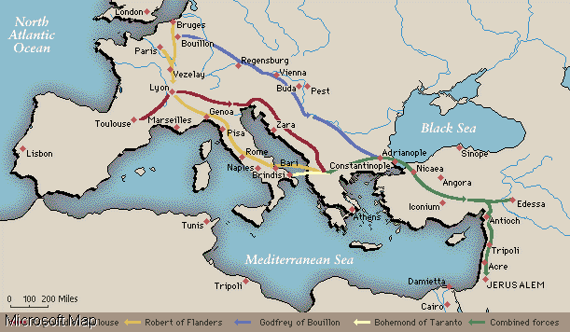
Crusade starts here!
Constantinople
Nicaea
Dorylaeum
Edessa
Antioch
Jerusalem

Slide 3
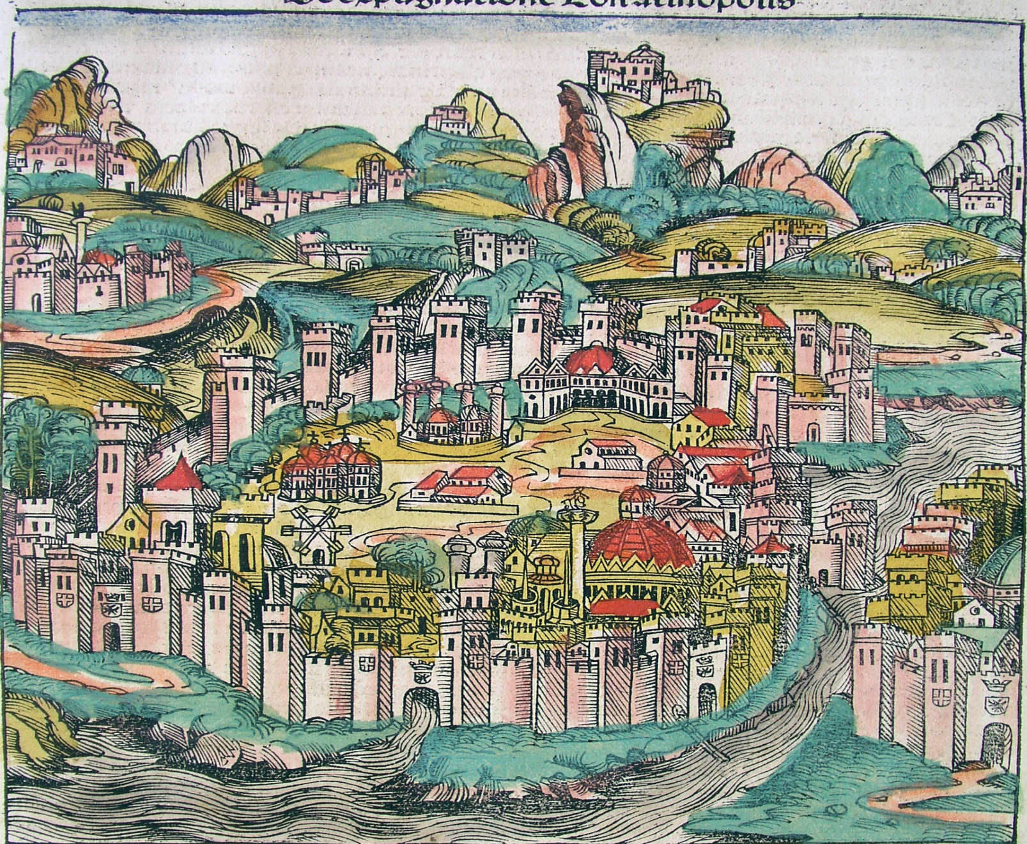
Byzantium

Slide 4
The Oath
I, (state your name), swear that all territories which had belonged to Byzantium before the Turkish invasions will be restored to you, Alexius.

Slide 5
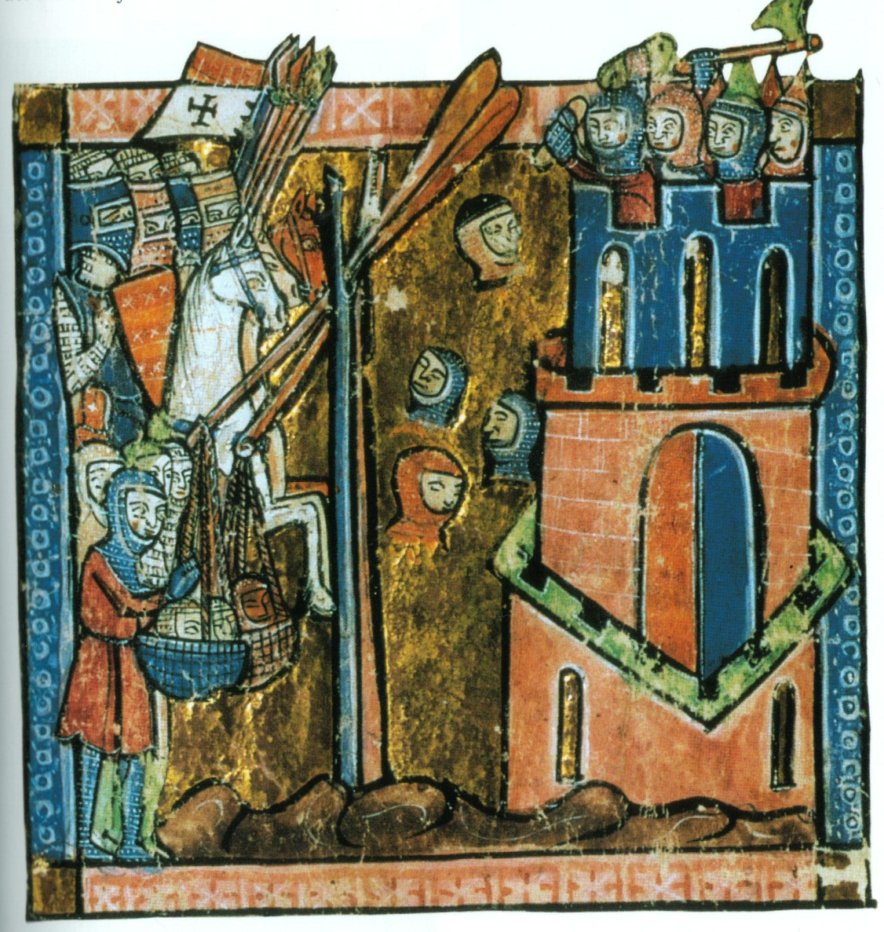
Nicaea

Slide 6
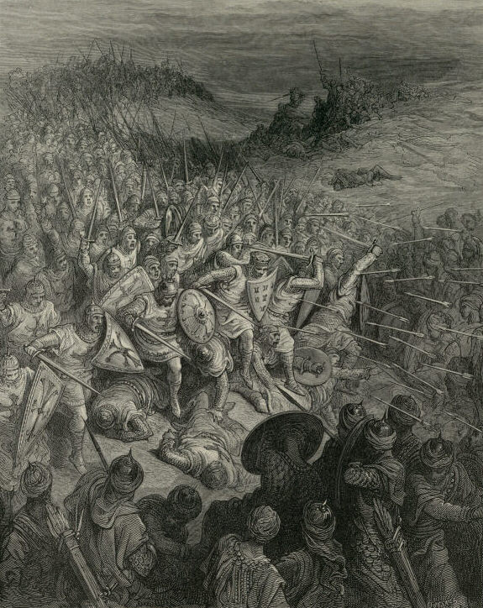
Dorylaeum

Slide 7
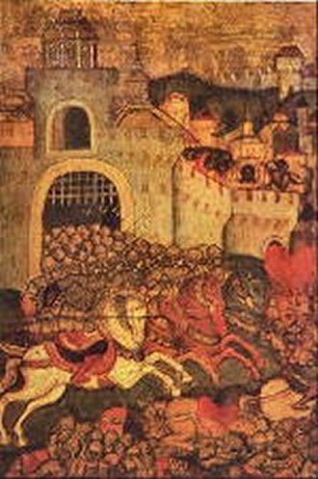
City of Edessa

Slide 8
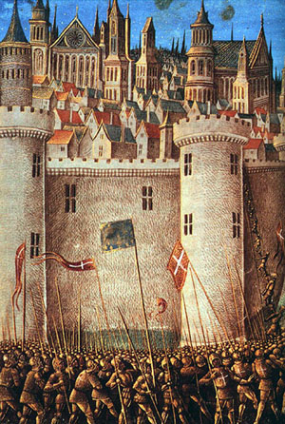
Antioch

Slide 9
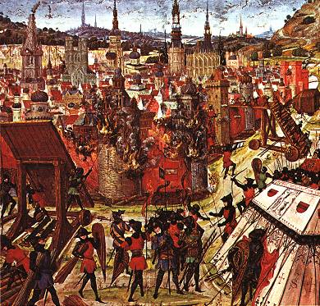
Jerusalem

