Slide 1
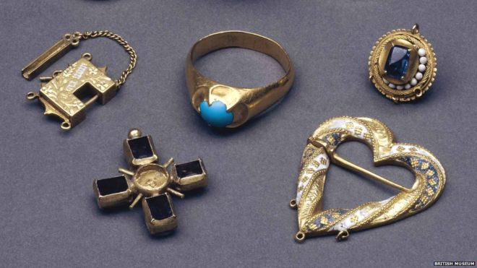
The Fishpool Hoard

Slide 2
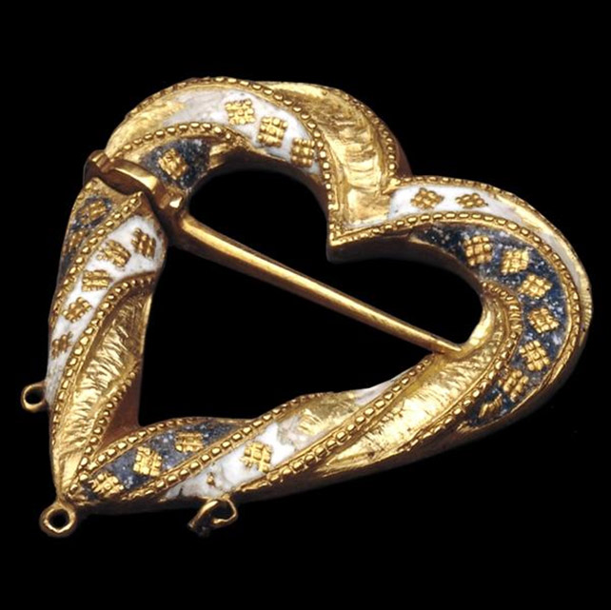
The Fishpool Hoard

Slide 3
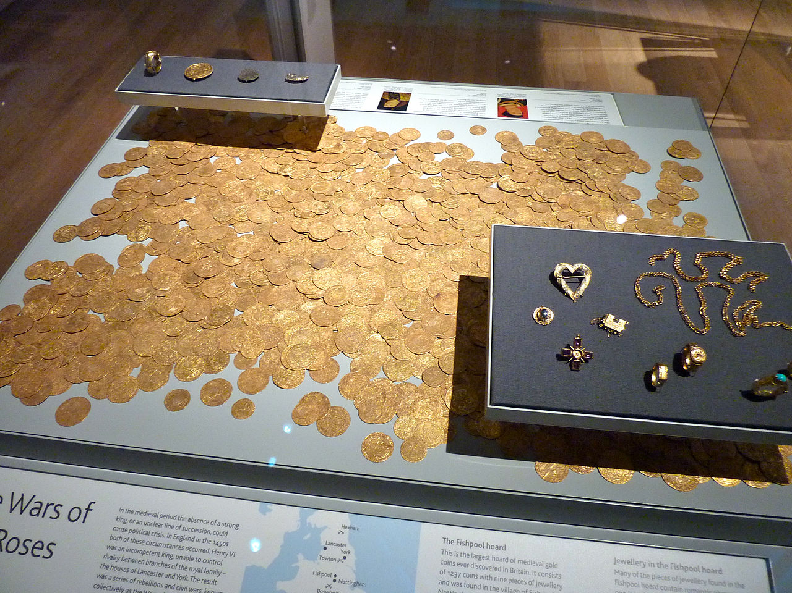
The Fishpool Hoard
By Andy Flatman from Ipswich, UK - British Museum

