Slide 1
Match the name to the correct description
1. Queen Elizabeth (Woodville)
2. Edward V
3. Prince Richard
4. Richard, Duke of Gloucester
5. Anthony Woodville, Earl Rivers
6. Sir Thomas Grey, Marquess of Dorset
7. Lord Hastings
8. Duke of Buckingham
9. Sir Richard Grey
A. Younger brother of the new king- aged 9
B. Elizabeth Woodville’s second son from her first marriage
C. Edward IV’s closest friend and Chamberlain (security)
D. Elizabeth Woodville’s first son from her first marriage
E. Edward IV’s widow- mother to the new king
F. The new king- aged 12
G. Senior magnate denied power under Edward IV
H. Loyal younger brother of Edward IV who ruled the north
I. The new king’s Guardian and Queen Elizabeth’s brother
Highlight Queen Elizabeth Woodville and her blood relatives.
Notes:
Print slides 1, 3, 5-10. Two-sided and two pages on one = 2 double sided sheets each

Slide 2
9 April 1483
King Edward IV died
Put each person in the correct starting position next to the correct speech bubble.
North of England
My brother wanted me to be Lord Protector for his son. I am the obvious man for the job!
As Edward’s uncle and guardian, I can expect to be one of his key advisors when he is crowned king. Edward is old enough to rule with wise advice.
If the Woodvilles have young Edward crowned king they will rule through him. What will happen to my power? Richard must be made Protector.
My son Edward is old enough to rule. England does not need a Lord Protector. As king he will have his family to advise him.
Welsh marches (border)
With my half-brother as king I can expect more power and influence.
London
I am now king. My Woodville relatives want me to be crowned quickly and to rule with their advice.
R.I.P
After my half-brother Edward is crowned his Woodville relatives will advise him. We can manage without Richard as Lord Protector. I can expect more power and influence.
I have been denied the power my status deserves. I will support Richard against the Woodvilles.
I am 9 years old.

Slide 3
4 May 1483
Duke Richard and Buckingham arrived in London with young King Edward, who was placed in the Tower of London. Edward’s coronation was postponed for 7 weeks with the royal council declaring Duke Richard as Protector until then.
Write where each person was on this date | Duke of Buckingham | Richard, Duke of Gloucester | Sir Richard Grey | Sir Thomas Grey, Marquess of Dorset | Prince Richard
 | Earl Rivers (Anthony Woodville) | King Edward IV | Lord Hastings | Queen Elizabeth (Woodville) | Young King Edward V
Imprisoned
(one of Richard’s castles)
London
(Seat of power)
Tower of London
(Palace/Fortress)
Dead
R.I.P
Westminster Abbey
(Sanctuary)

Slide 4
13 June 1483
Duke Richard had Lord Hastings arrested and murdered during a council meeting.
Write where each person was on this date | Duke of Buckingham | Richard, Duke of Gloucester | Sir Richard Grey | Sir Thomas Grey, Marquess of Dorset | Prince Richard
 | Earl Rivers (Anthony Woodville) | King Edward IV | Lord Hastings | Queen Elizabeth (Woodville) | Young King Edward V
Imprisoned
(one of Richard’s castles)
London
(Seat of power)
Tower of London
(Palace/Fortress)
Dead
R.I.P
Westminster Abbey
(Sanctuary)

Slide 5
16 June 1483
Queen Elizabeth handed over Prince Richard who joined his brother in the Tower.
Write where each person was on this date | Duke of Buckingham | Richard, Duke of Gloucester | Sir Richard Grey | Sir Thomas Grey, Marquess of Dorset | Prince Richard
 | Earl Rivers (Anthony Woodville) | King Edward IV | Lord Hastings | Queen Elizabeth (Woodville) | Young King Edward V
Imprisoned
(one of Richard’s castles)
London
(Seat of power)
Tower of London
(Palace/Fortress)
Dead
R.I.P
Westminster Abbey
(Sanctuary)

Slide 6
25 June 1483
Duke Richard ordered his Woodville prisoners to be executed, then a northern army marched south to London to support him.
Write where each person was on this date | Duke of Buckingham | Richard, Duke of Gloucester | Sir Richard Grey | Sir Thomas Grey, Marquess of Dorset | Prince Richard
 | Earl Rivers (Anthony Woodville) | King Edward IV | Lord Hastings | Queen Elizabeth (Woodville) | Young King Edward V
Imprisoned
(one of Richard’s castles)
London
(Seat of power)
Tower of London
(Palace/Fortress)
Dead
R.I.P
Westminster Abbey
(Sanctuary)

Slide 7
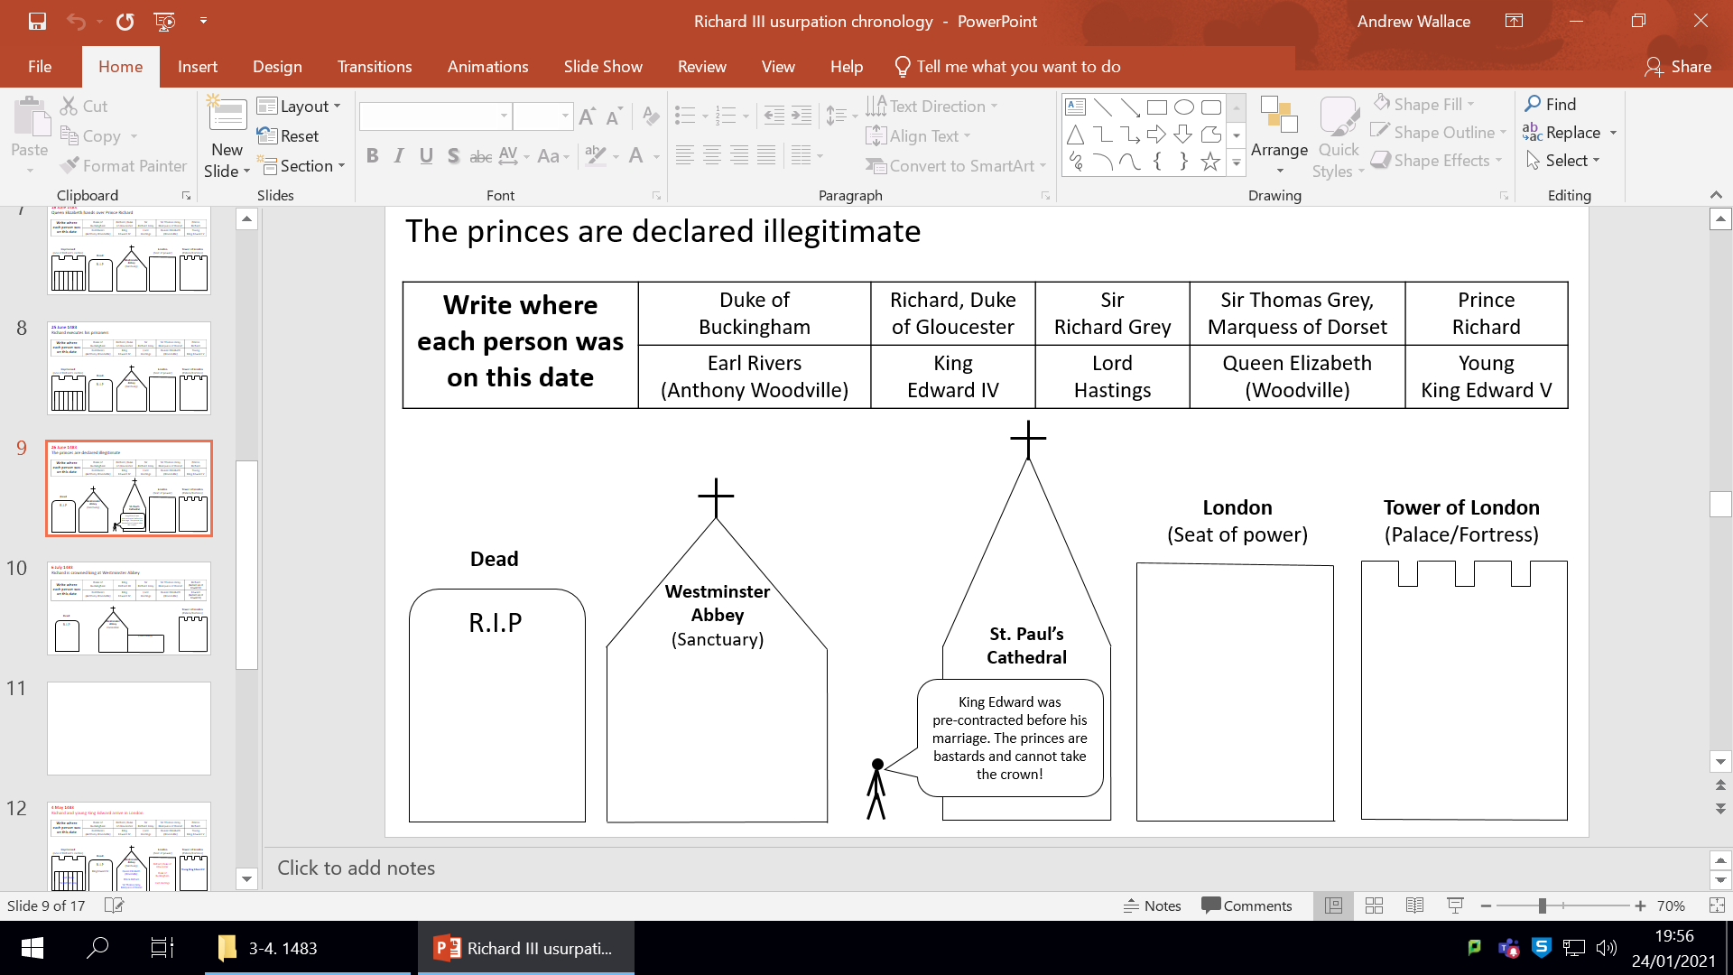
26 June 1483
The princes were declared illegitimate.

Slide 8
6 July 1483
Duke Richard was crowned King Richard III at Westminster Abbey.
Write where each person was on this date | Duke of Buckingham | King Richard III | Sir Richard Grey | Sir Thomas Grey, Marquess of Dorset | Richard (bastard son of Edward IV)
 | Earl Rivers (Anthony Woodville) | King Edward IV | Lord Hastings | Queen Elizabeth (Woodville) | Edward (bastard son of Edward IV)
Tower of London
(Palace/Fortress)
Dead
R.I.P
Westminster Abbey
Coronation
(Sanctuary)

