Slide 1
Match the name to the correct description
1. Queen Elizabeth (Woodville)
2. Edward V
3. Prince Richard
4. Richard, Duke of Gloucester
5. Anthony Woodville, Earl Rivers
6. Sir Thomas Grey, Marquess of Dorset
7. Lord Hastings
8. Duke of Buckingham
9. Sir Richard Grey
A. Younger brother of the new king- aged 9
B. Elizabeth Woodville’s second son from her first marriage
C. Edward IV’s closest friend and Chamberlain (security)
D. Elizabeth Woodville’s first son from her first marriage
E. Edward IV’s widow- mother to the new king
F. The new king- aged 12
G. Senior magnate denied power under Edward IV
H. Loyal younger brother of Edward IV who ruled the north
I. The new king’s Guardian and Queen Elizabeth’s brother
Highlight Queen Elizabeth Woodville and her blood relatives.

Slide 2
Answers
1. Queen Elizabeth (Woodville)
2. Edward V
3. Prince Richard
4. Richard, Duke of Gloucester
5. Anthony Woodville, Earl Rivers
6. Sir Thomas Grey, Marquess of Dorset
7. Lord Hastings
8. Duke of Buckingham
9. Sir Richard Grey
E. Edward IV’s widow- mother to the new king
F. The new king- aged 12
A. Younger brother of the new king- aged 9
H. Loyal younger brother of Edward IV who ruled the north
I. The new king’s Guardian and Queen Elizabeth’s brother
D. Elizabeth Woodville’s first son from her first marriage
C. Edward IV’s closest friend and Chamberlain (security)
G. Senior magnate denied power under Edward IV
B. Elizabeth Woodville’s second son from her first marriage
Highlight Queen Elizabeth Woodville and her blood relatives.

Slide 3
9 April 1483
King Edward IV died
Put each person, including Edward IV, in the correct starting position next to the correct speech bubble.
North of England
My brother wanted me to be Lord Protector for his son. I am the obvious man for the job!
As Edward’s uncle and guardian, I can expect to be one of his key advisors when he is crowned king. Edward is old enough to rule with wise advice.
If the Woodvilles have young Edward crowned king they will rule through him. What will happen to my power? Richard must be made Protector.
My son Edward is old enough to rule. England does not need a Lord Protector. As king he will have his family to advise him.
Welsh marches (border)
With my half-brother as king I can expect more power and influence.
London
I am now king. My Woodville relatives want me to be crowned quickly and to rule with their advice.
R.I.P
After my half-brother Edward is crowned his Woodville relatives will advise him. We can manage without Richard as Lord Protector. I can expect more power and influence.
I have been denied the power my status deserves. I will support Richard against the Woodvilles.
I am 9 years old.

Slide 4
9 April 1483
King Edward IV died
Put each person, including Edward IV, in the correct starting position next to the correct speech bubble.
North of England
My brother wanted me to be Lord Protector for his son. I am the obvious man for the job!
Richard, Duke of Gloucester
As Edward’s uncle and guardian, I can expect to be one of his key advisors when he is crowned king. Edward is old enough to rule with wise advice.
If the Woodvilles have young Edward crowned king they will rule through him. What will happen to my power? Richard must be made Protector.
My son Edward is old enough to rule. England does not need a Lord Protector. As king he will have his family to advise him.
Welsh marches (border)
Earl Rivers
With my half-brother as king I can expect more power and influence.
Sir Richard Grey
London
Young King Edward V
I am now king. My Woodville relatives want me to be crowned quickly and to rule with their advice.
Lord Hastings
Queen Elizabeth (Woodville)
R
R.I.P
After my half-brother Edward is crowned his Woodville relatives will advise him. We can manage without Richard as Lord Protector. I can expect more power and influence.
I have been denied the power my status deserves. I will support Richard against the Woodvilles.
King Edward IV
I am 9 years old.
Duke of Buckingham
Sir Thomas Grey, Marquess of Dorset
Prince Richard

Slide 5
North of England
Richard, Duke of Gloucester
Where did everyone need to be for young Edward’s coronation?
Welsh marches (border)
Earl Rivers
Sir Richard Grey
London
Young King Edward V
Lord Hastings
Queen Elizabeth (Woodville)
R
R.I.P
King Edward IV
I am 9 years old.
Duke of Buckingham
Sir Thomas Grey, Marquess of Dorset
Prince Richard

Slide 6
30 April 1483
At Northampton, Richard, Duke of Gloucester and the Duke of Buckingham arrested Earl Rivers and Sir Richard Grey and took control of young King Edward. When news reached Queen Elizabeth in London, she fled into sanctuary with her two sons Richard and Thomas (and her daughters) at Westminster Abbey.
Northampton
Your majesty, I have had to arrest your uncle Earl Rivers and your half-brother Sir Richard Grey. The Woodville family was responsible for the death of your father by encouraging his wild behaviour, so I will take you under my protection.
Richard, Duke of Gloucester
Earl Rivers
Sir Richard Grey
Duke of Buckingham
Young King Edward V
London
Lord Hastings
Queen Elizabeth (Woodville)
R
R.I.P
King Edward IV
Sir Thomas Grey, Marquess of Dorset
Prince Richard

Slide 7
4 May 1483
Duke Richard and Buckingham arrived in London with young King Edward, who was placed in the Tower of London. Edward’s coronation was postponed for 7 weeks with the royal council declaring Duke Richard as Protector until then.
Write where each person was on this date | Duke of Buckingham | Richard, Duke of Gloucester | Sir Richard Grey | Sir Thomas Grey, Marquess of Dorset | Prince Richard
 | Earl Rivers (Anthony Woodville) | King Edward IV | Lord Hastings | Queen Elizabeth (Woodville) | Young King Edward V
Imprisoned
(one of Richard’s castles)
London
(Seat of power)
Tower of London
(Palace/Fortress)
Dead
R.I.P
Westminster Abbey
(Sanctuary)

Slide 8
4 May 1483
Duke Richard and Buckingham arrived in London with young King Edward, who was placed in the Tower of London. Edward’s coronation was postponed for 7 weeks with the royal council declaring Duke Richard as Protector until then.
Write where each person was on this date | Duke of Buckingham | Richard, Duke of Gloucester | Sir Richard Grey | Sir Thomas Grey, Marquess of Dorset | Prince Richard
 | Earl Rivers (Anthony Woodville) | King Edward IV | Lord Hastings | Queen Elizabeth (Woodville) | Young King Edward V
Imprisoned
(one of Richard’s castles)
London
(Seat of power)
Tower of London
(Palace/Fortress)
Dead
R.I.P
Westminster Abbey
(Sanctuary)
Richard, Duke of Gloucester
King Edward IV
Young King Edward V
Queen Elizabeth (Woodville)
Duke of Buckingham
Earl Rivers
Prince Richard
Sir Richard Grey
Lord Hastings
Sir Thomas Grey, Marquess of Dorset

Slide 9
13 June 1483
Duke Richard had Lord Hastings arrested and murdered during a council meeting.
Write where each person was on this date | Duke of Buckingham | Richard, Duke of Gloucester | Sir Richard Grey | Sir Thomas Grey, Marquess of Dorset | Prince Richard
 | Earl Rivers (Anthony Woodville) | King Edward IV | Lord Hastings | Queen Elizabeth (Woodville) | Young King Edward V
Imprisoned
(one of Richard’s castles)
London
(Seat of power)
Tower of London
(Palace/Fortress)
Dead
R.I.P
Westminster Abbey
(Sanctuary)

Slide 10
16 June 1483
Queen Elizabeth handed over Prince Richard who joined his brother in the Tower.
Write where each person was on this date | Duke of Buckingham | Richard, Duke of Gloucester | Sir Richard Grey | Sir Thomas Grey, Marquess of Dorset | Prince Richard
 | Earl Rivers (Anthony Woodville) | King Edward IV | Lord Hastings | Queen Elizabeth (Woodville) | Young King Edward V
Imprisoned
(one of Richard’s castles)
London
(Seat of power)
Tower of London
(Palace/Fortress)
Dead
R.I.P
Westminster Abbey
(Sanctuary)

Slide 11
25 June 1483
Duke Richard ordered his Woodville prisoners to be executed, then a northern army marched south to London to support him.
Write where each person was on this date | Duke of Buckingham | Richard, Duke of Gloucester | Sir Richard Grey | Sir Thomas Grey, Marquess of Dorset | Prince Richard
 | Earl Rivers (Anthony Woodville) | King Edward IV | Lord Hastings | Queen Elizabeth (Woodville) | Young King Edward V
Imprisoned
(one of Richard’s castles)
London
(Seat of power)
Tower of London
(Palace/Fortress)
Dead
R.I.P
Westminster Abbey
(Sanctuary)

Slide 12
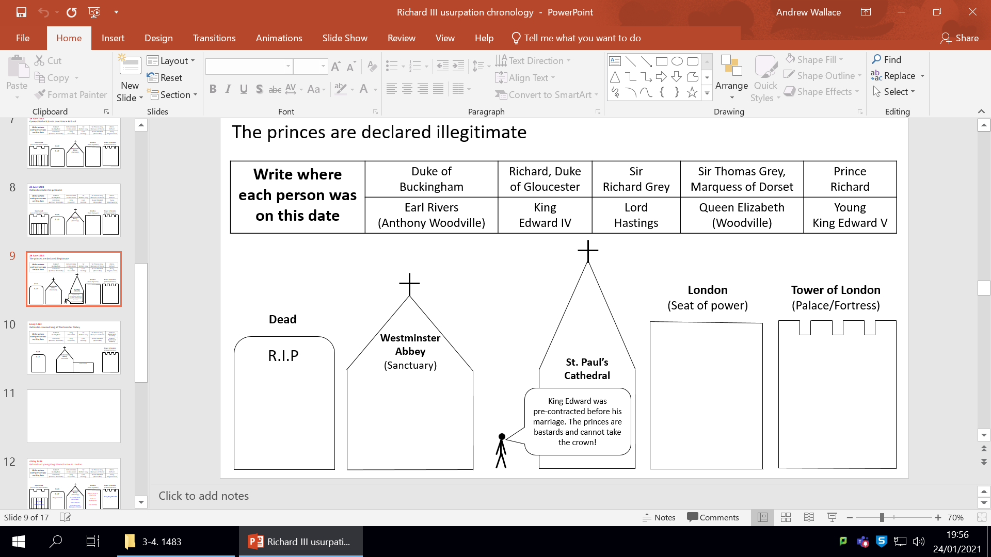
26 June 1483
The princes were declared illegitimate.

Slide 13
6 July 1483
Duke Richard was crowned King Richard III at Westminster Abbey.
Write where each person was on this date | Duke of Buckingham | King Richard III | Sir Richard Grey | Sir Thomas Grey, Marquess of Dorset | Richard (bastard son of Edward IV)
 | Earl Rivers (Anthony Woodville) | King Edward IV | Lord Hastings | Queen Elizabeth (Woodville) | Edward (bastard son of Edward IV)
Tower of London
(Palace/Fortress)
Dead
R.I.P
Westminster Abbey
Coronation
(Sanctuary)

Slide 15
13 June 1483
Duke Richard arrested and murdered Lord Hastings during a royal council meeting.
Write where each person was on this date | Duke of Buckingham | Richard, Duke of Gloucester | Sir Richard Grey | Sir Thomas Grey, Marquess of Dorset | Prince Richard
 | Earl Rivers (Anthony Woodville) | King Edward IV | Lord Hastings | Queen Elizabeth (Woodville) | Young King Edward V
Imprisoned
(one of Richard’s castles)
London
(Seat of power)
Tower of London
(Palace/Fortress)
Dead
Westminster Abbey
(Sanctuary)
R
R.I.P
Richard, Duke of Gloucester
Young King Edward V
King Edward IV
Queen Elizabeth (Woodville)
Duke of Buckingham
Earl Rivers
Lord Hastings
Prince Richard
Sir Richard Grey
Sir Thomas Grey, Marquess of Dorset

Slide 16
16 June 1483
Queen Elizabeth handed over Prince Richard who joined his brother in the Tower
Write where each person was on this date | Duke of Buckingham | Richard, Duke of Gloucester | Sir Richard Grey | Sir Thomas Grey, Marquess of Dorset | Prince Richard
 | Earl Rivers (Anthony Woodville) | King Edward IV | Lord Hastings | Queen Elizabeth (Woodville) | Young King Edward V
Imprisoned
(one of Richard’s castles)
London
(Seat of power)
Tower of London
(Palace/Fortress)
Dead
Westminster Abbey
(Sanctuary)
R
R.I.P
Richard, Duke of Gloucester
Young King Edward V
King Edward IV
Queen Elizabeth (Woodville)
Duke of Buckingham
Earl Rivers
Prince Richard
Lord Hastings
Sir Richard Grey
Sir Thomas Grey, Marquess of Dorset

Slide 17
25 June 1483
Duke Richard ordered his Woodville prisoners to be executed, then a northern army marched to London to support him.
Write where each person was on this date | Duke of Buckingham | Richard, Duke of Gloucester | Sir Richard Grey | Sir Thomas Grey, Marquess of Dorset | Prince Richard
 | Earl Rivers (Anthony Woodville) | King Edward IV | Lord Hastings | Queen Elizabeth (Woodville) | Young King Edward V
Imprisoned
(one of Richard’s castles)
London
(Seat of power)
Tower of London
(Palace/Fortress)
Dead
Westminster Abbey
(Sanctuary)
R
R.I.P
Richard, Duke of Gloucester
Young King Edward V
King Edward IV
Queen Elizabeth (Woodville)
Duke of Buckingham
Lord Hastings
Prince Richard
Earl Rivers
Sir Thomas Grey, Marquess of Dorset
Sir Richard Grey

Slide 18
26 June 1483
The princes were declared illegitimate

Slide 19
6 July 1483
Richard was crowned King Richard III at Westminster Abbey
Write where each person was on this date | Duke of Buckingham | King Richard III | Sir Richard Grey | Sir Thomas Grey, Marquess of Dorset | Richard (bastard son of Edward IV)
 | Earl Rivers (Anthony Woodville) | King Edward IV | Lord Hastings | Queen Elizabeth (Woodville) | Edward (bastard son of Edward IV)
Tower of London
(Palace/Fortress)
Dead
R
Westminster Abbey
Coronation
R.I.P
King Edward IV
Edward (bastard son of Edward IV)
Lord Hastings
King Richard III
(Sanctuary)
Richard (bastard son of Edward IV)
Earl Rivers
Queen Elizabeth (Woodville)
Duke of Buckingham
Sir Richard Grey
Sir Thomas Grey, Marquess of Dorset

