Slide 1
At what moment in 1483 did Richard, Duke of Gloucester, decide to usurp the crown?

Slide 2
Richard’s reputation before April 1483:
• loyal to Edward and followed him into exile in 1470 (unlike Clarence)
• trusted by Edward to govern the violent north of England = reputation as a fair man
• warrior who Edward put him in charge of an army that attacked the Scots the previous year
• it appears that Edward wanted Richard to be Protector of England on his death bed.

Slide 3
How were some of these people related?
Who was there tension between?
Earl Rivers
Duke of Buckingham
Elizabeth Woodville
Princes Edward and Richard
King Edward IV
Richard, Duke of Gloucester
Lord Hastings
Sir Richard Grey
Sir Thomas Grey, Marquis of Dorset

Slide 4
On 9 April 1483, Edward IV died aged 40. Within three months his brother Richard had usurped the crown from his young nephew Edward V and been crowned King Richard III.
As we go through the flowchart one row at a time, annotate the information boxes with evidence from this PowerPoint to help you decide at what moment you think Richard, Duke of Gloucester decided to usurp the crown.

Slide 5
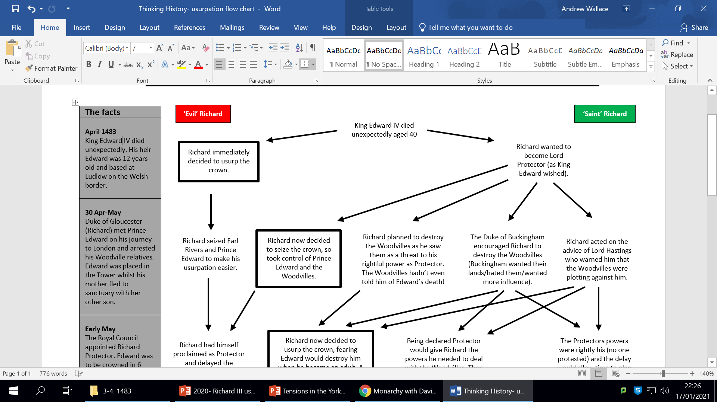
▪ Shakespeare’s play has Richard plotting his path to the throne for years before Edward’s death.
▪ Edward’s death was unexpected as he was only 40.
▪ Shakespeare was writing for a Tudor audience that was anti-Richard and made him the ultimate villain.
▪ A play is meant to entertain, it’s not serious History!
▪ Richard loyally went into exile with Edward in 1470 and had a reputation as a fair judge after a decade of successfully ruling the turbulent north.
▪ Young kings always had a protector e.g. Henry VI did until he was 16.
▪ On his death bed, Edward seems to have called for Richard to be Protector in an updated will. We don’t have the original will but other evidence suggests he wanted this.
▪ As Edward IV’s only remaining brother, Richard was the obvious choice to be Protector but Richard’s close blood relationship would not legally guarantee he would get this title.
▪ Richard wrote to the royal council, assuring them of his loyalty to the young king and that he was entitled to be named Protector due to his loyal service, the law and his brother’s desire.
▪ After death, a king’s will has no legal power.
▪ On his journey south, Richard led the nobility of the north in publicly swearing loyalty to Edward V.
▪ Richard travelled south with just 300 men- very few for an attempted usurpation.
▪ All of the royal council in London agreed to crown young Edward on 4 May.

Slide 6
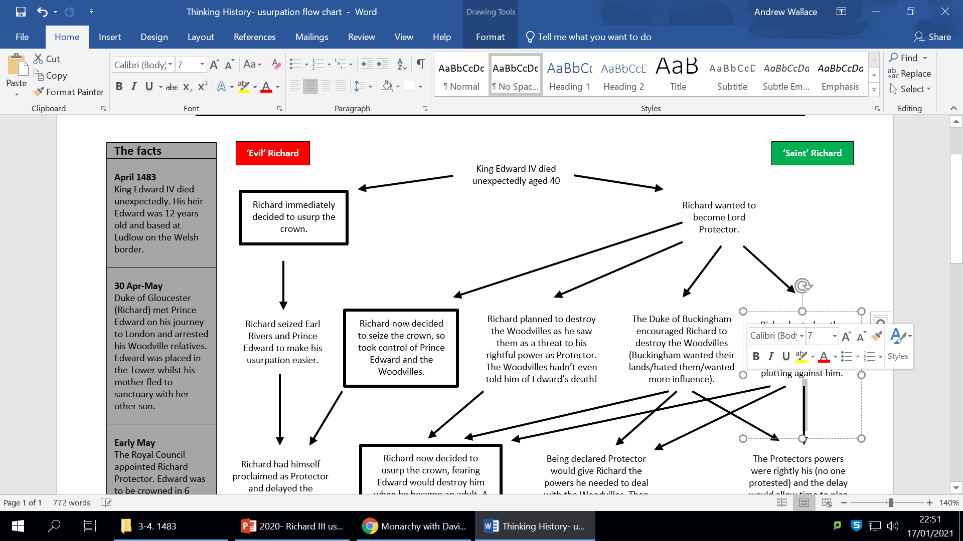
▪ The Woodvilles wanted young Edward crowned quickly and for him to rule with advice form the royal council (e.g. mostly them).
▪ Controlling the king meant you can claim to be acting in his name.
▪ Buckingham had been unhappy about his marriage to a lowly Woodville when aged 12 and his exclusion from power.
▪ Buckingham wrote a letter to Richard offering his support at York.
▪ Prince Edward had been raised by his Woodville relatives and was close to them. By arresting him, Richard was potentially creating a problem for Richard in the future.
▪ The Tower of London was a palace and it was normal for kings to stay there before their coronation.
▪ Richard brought 3 carts of weapons to London that he claimed the Woodvilles had planned to arm men with in order to kill him.
▪ Richard was on good terms with the Woodville Earl Rivers, who had asked for Richard’s help in a legal dispute earlier in 1483.

Slide 7
▪ After taking control of Edward V, Richard claimed that Edward IV’s death had been due to the young king’s Woodville relatives.
▪ Hastings threatened to leave for Calais (with a garrison of 2,000) if the Prince travelled to London with too large a retinue (as he did not want the Woodvilles taking control).
▪ Sir Thomas Grey, Marquess of Dorset was heard to say that the Woodville dominated royal council could manage without the king’s uncle (Richard)- ‘we are so important, we can make and enforce these decisions, even without the king’s uncle’. This suggested that they intended that the new government would be organised to suit the Woodvilles.
▪ Lord Hastings several letters to Richard informing of the royal council’s meetings and urging him to travel south with armed retainers.
▪ Lord Protectors were never given control of the prince as this would make them dangerously powerful.
▪ Buckingham had been given no power during Edward IV’s reign.
▪ Richard/Buckingham had a friendly meal with Earl Rivers the night before he was arrested.
▪ The new king, Earl Rivers and their advisors agreed to take a less direct route to London in order to meet with Richard at Northampton so they could arrive in London together.

Slide 8
Early May
The Royal Council appointed Richard Protector. Edward’s coronation was delayed by seven-weeks.
▪ Prince Edward had asked Richard to set his uncle free when he was told they had been arrested. Would he seek revenge on Richard in the future?
▪ Richard requested to be made Protector, which meant being the chief councillor on the royal council with responsibility for defending England. He also wanted guardianship of young Edward, but this had never been granted before as it was dangerous.
▪ The royal council voted to make Richard Protector, rather than a Regent with the powers of the king. This would mean young Edward ruling with the guidance of the royal council with Richard at its head.
▪ The royal council agreed to make Richard Protector, but this would end when Edward was crowned king on 22 June.
▪ Delaying the coronation was necessary to give time to assemble the nobility.
▪ Richard asked the royal council to charge Earl Rivers and others with treason for plotting against him. The council pointed out that it could not be treason as Richard had not been Protector until later and that he had presented insufficient evidence.
▪ Richard ordered Woodville lands to be seized, many of which were granted to Buckingham, which many on the royal council agreed to.

Slide 9
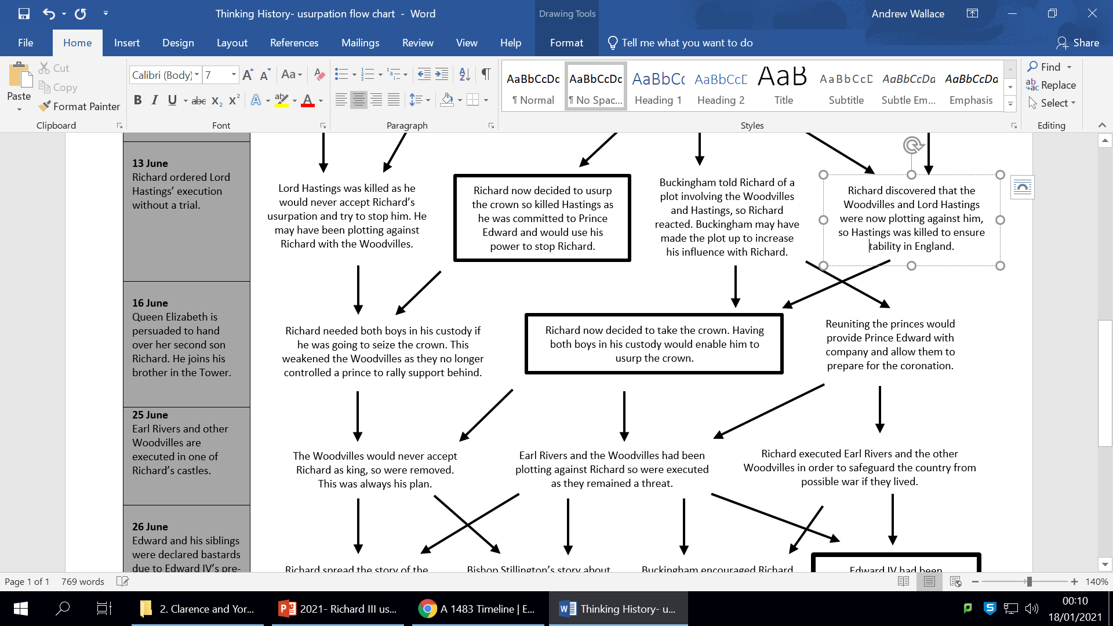
▪ The day before Richard ordered the royal council to split into two groups on the 13 June, with only a few summoned by Richard to meet in the Tower of London.
▪ Traitors usually have their bodies publicly displayed.
▪ An Act of Attainder was not used against Hastings following his death. This would have disinherited his family. His wife and heir were allowed to keep some lands and his body was returned to them.
▪ Three days before, Richard sent a letter to the city of York and his northern supporters requesting armed men as the Woodvilles were plotting to destroy him.
▪ This letter also gave orders to execute Earl Rivers and the others without permission from the royal council.
▪ An Earl had a right to a trial by his peers. Had Richard decided to take the crown now as he did not fear the consequences of this order?
▪ Lord Hastings did have a link to the Woodvilles and may have sought an alliance with them if he became suspicious of Richard’s actions and aims.
▪ Lord Hastings had fallen out with the Marquess of Dorset over land a mistress. Is it likely they would have made an alliance against Richard?
▪ Lord Hastings may have been asked to support Richard as king, but was eliminated when it was clear he would never accept Richard as king and would try to stop him.
▪ After the death of Hastings, Buckingham gained many of his lands and offices.

Slide 10
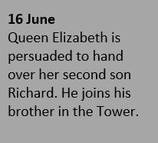
▪ The old Archbishop of Canterbury reassured her that the boys should be reunited and that Richard may order his men to take him by force if necessary.
▪ The Tower of London was the traditional place for the king to stay before the coronation. It did not at this stage have the Tudor reputation as a prison/place of execution.
▪ Later that day, Edward’s coronation was pushed back five months to November.
▪ The last recorded mention of Edward V’s reign as king was made on this date.
▪ The two princes were seen playing and shooting together in the Tower grounds.

Slide 11
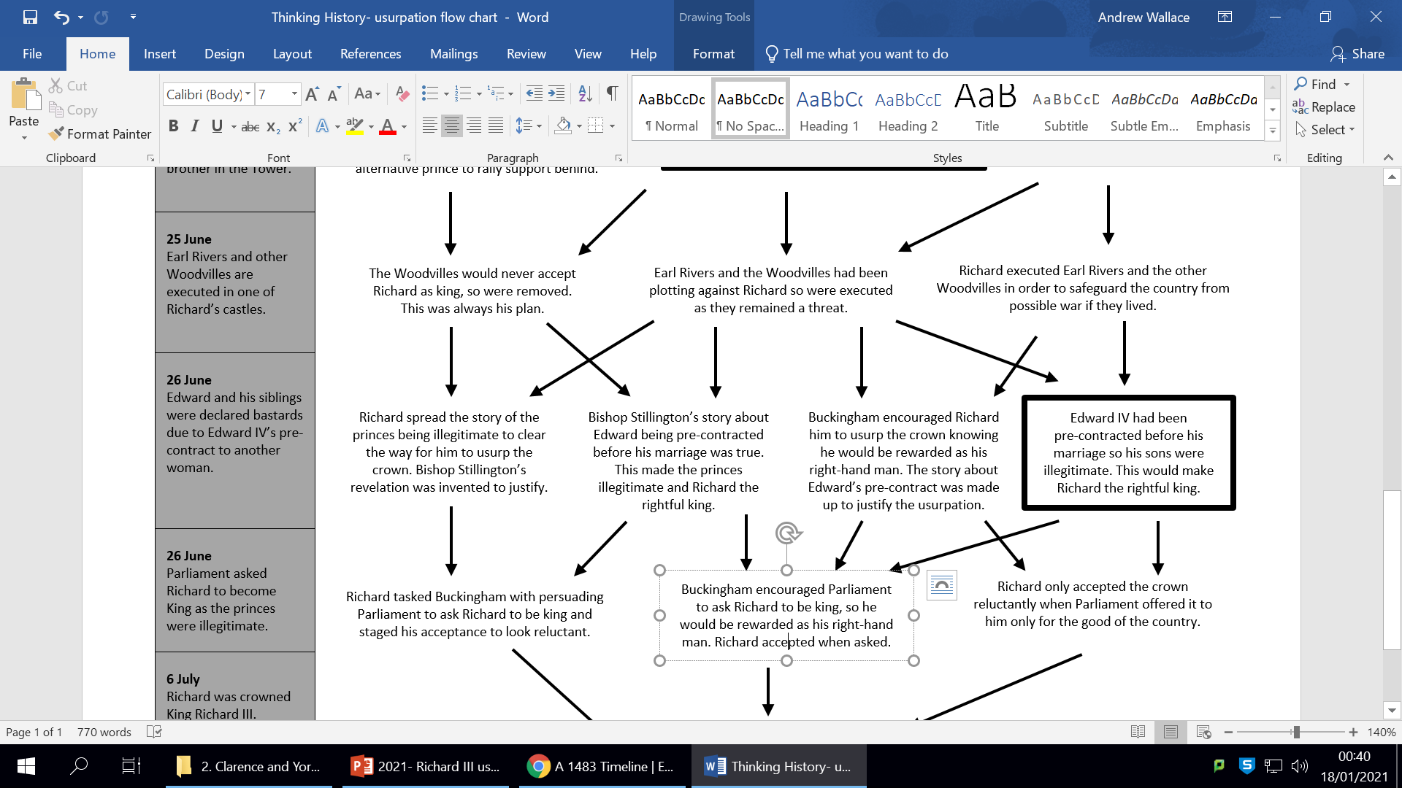
▪ Executing them without the approval of the Council suggested Richard did not worry about the consequences.
▪ Prince Edward would surely seek revenge for the death of his favoured uncle and half-brother when he took control of government in a few years. Taking the crown would protect Richard from this.
▪ They were given a show trial before their execution. They were always going to be killed.
▪ After the executions, Richard’s northern army marched south to join him in London.
▪ Growing up in the household of Warwick ‘the kingmaker’, Richard had seen the importance of eliminating rivals.

Slide 12
▪ Rumours of Edward IV’s illegitimacy had been spread in 1469-70 during Warwick and Clarence’s rebellions.
▪ Bishop Stillington claimed to have witnessed Edward IV contracting a marriage with another women (Eleanor Butler) before he married Elizabeth Woodville.
▪ Eleanor Butler was dead in 1483 so could not be spoken to.
▪ Edward had a reputation as a womaniser. He had had at least one illegitimate child in the early 1464.
▪ Bishop Stillington had been arrested in 1478 at the same time as the Duke of Clarence was imprisoned by Edward IV for spreading rumours about the legality of his marriage and therefore, the legitimacy of his children. Had he told Clarence something?
▪ The claim that Edward IV was a bastard was later dropped in 1483 when the story of Edward’s marriage contract was spread.
▪ Buckingham was well rewarded by Richard in the following months.

Slide 13
Look through your annotated flow chart.
Discuss with your partner what you think happened for each part of the chronology and which evidence best supports this.
Individually, highlight on each row what you think happened. When do you think Richard made the fateful decision?

Slide 14
Is each statement true, false or an opinion?
• Richard planned to make himself king as soon as his brother Edward IV died in April
• The Duke of Buckingham supported Richard’s usurpation
• Richard’s success was inevitable
• Richard murdered his two nephews to seize the crown
• The unpopularity of the Woodvilles contributed to Richard’s success
• The execution of Lord Hastings demonstrated that Richard now planned to usurp the crown
• Richard’s actions were surprising due to his track record of loyalty

