Slide 1
A Mystery Activity
Ian Dawson
www.thinkinghistory.co.uk

Slide 2
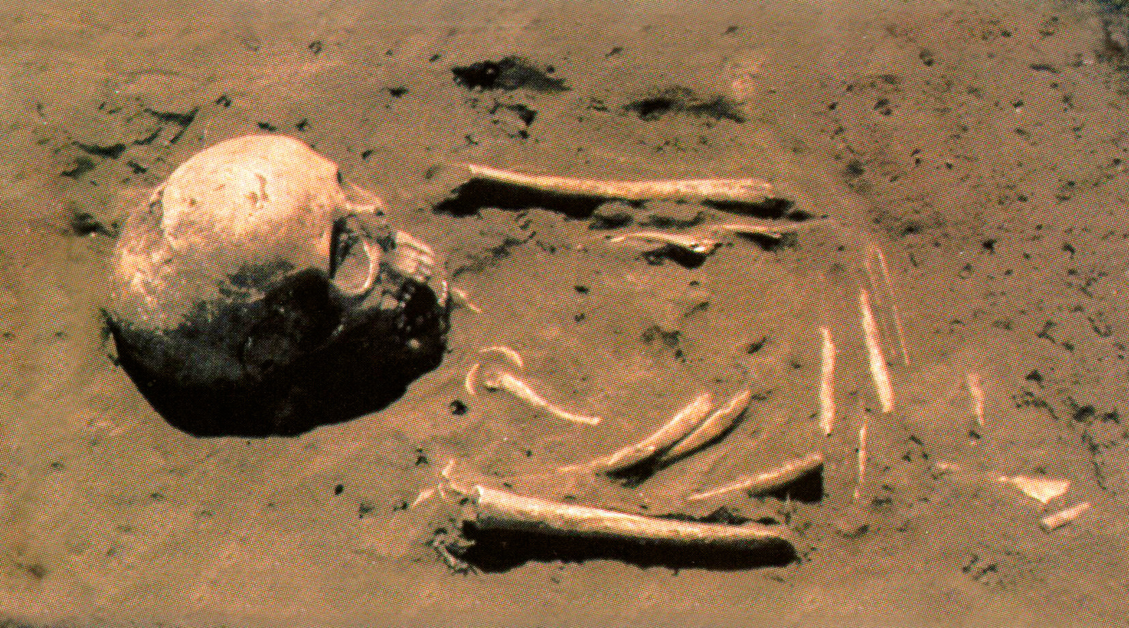
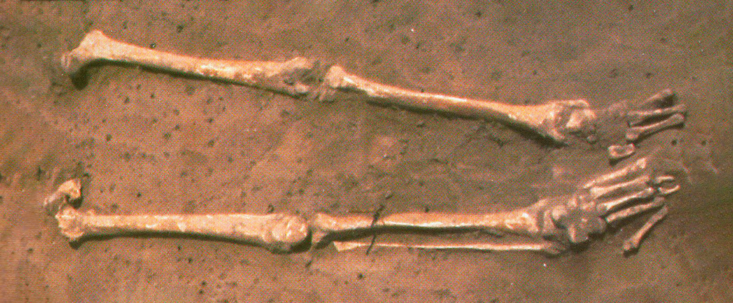
Clue A
What questions do you want to ask?

Slide 3
Additional Information
In December 1956 a farmer digging in his farm near Riccall in Yorkshire felt his spade hit something hard. He scraped away the soil and found … a human skeleton. He called the police and they then called in archaeologists who started to excavate the site despite thick fog, freezing temperatures and heavy frost.
Over the next year, the archaeologists found 39 skeletons. They couldn’t identify the sex of all of them but their first thoughts were that most of the skeletons were men but there were some women and children among them.
But that’s not the end of the story.
When the archaeologists checked back in local history books, they discovered that more skeletons had been found in the area in the 1800s though no-one knew how many.
Later, in 1976, workmen digging trenches for drains found 2 more skeletons.
Then, in 1985, 23 more skeletons were uncovered.
Overall, 64 skeletons have been found at Riccall but probably many more were found in the past.

Slide 4
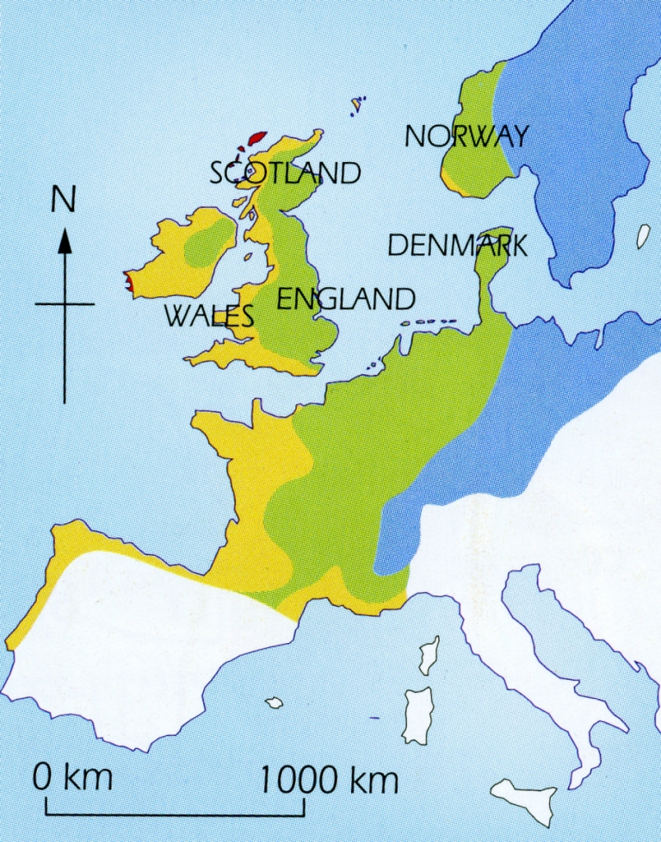
Clue H
Scientists can tell which region people grew up in.
This is because traces of the water that children drink stay in their teeth for ever.
They tested the teeth of 6 skeletons
This showed that the people grew up in the dark blue areas on the map.

Slide 5
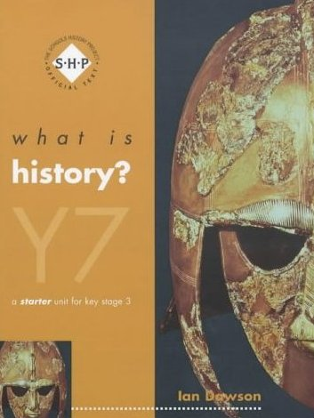
Acknowledgements
This activity was taken from:
‘What is history? Y7’
by Ian Dawson
John Murray, Hodder Headline (2003)
by permission of Hodder Education
With thanks to Dr. Claire Smith, the students of Leeds Trinity PGCE course and to Hodder Education

