Slide 1
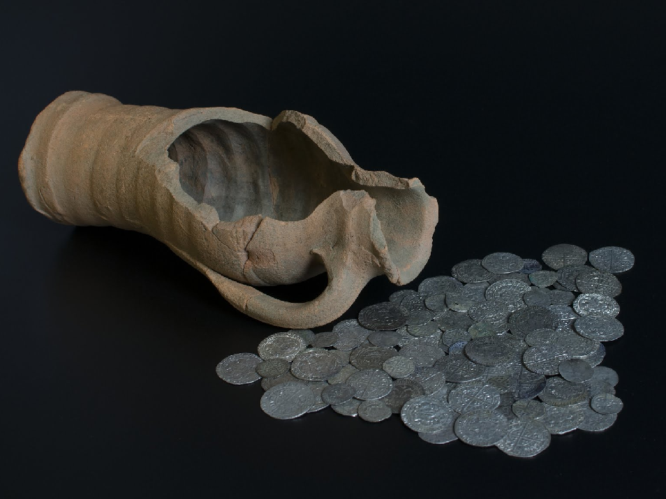
The Ryther Hoard

Slide 2
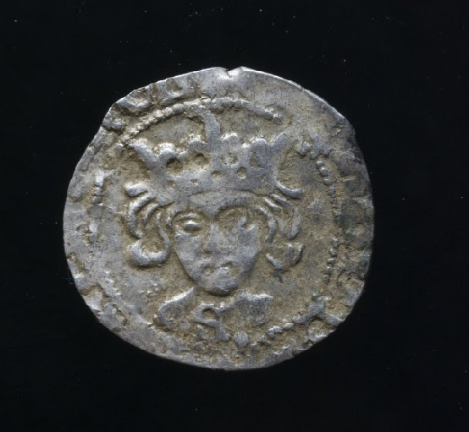
The Ryther Hoard

Slide 3
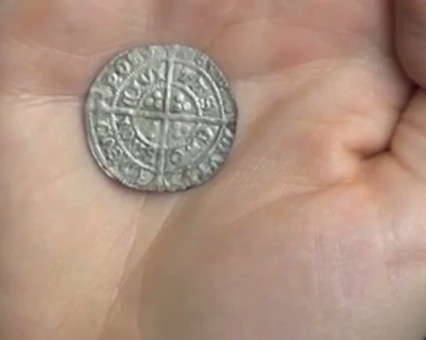
The Ryther Hoard

