Slide 1

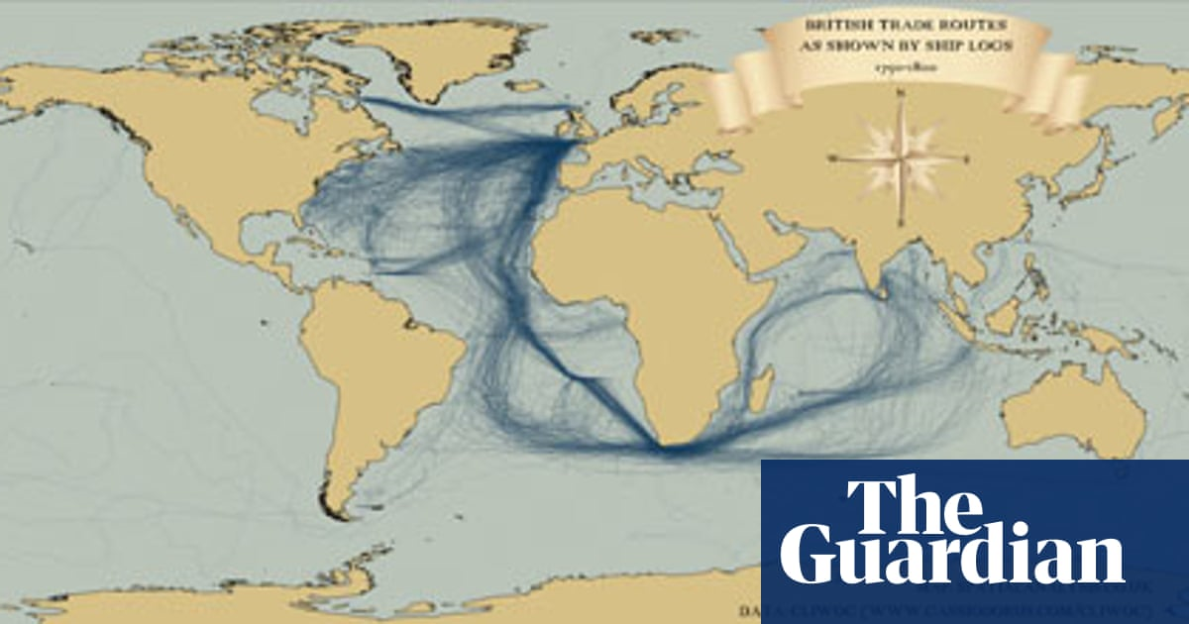

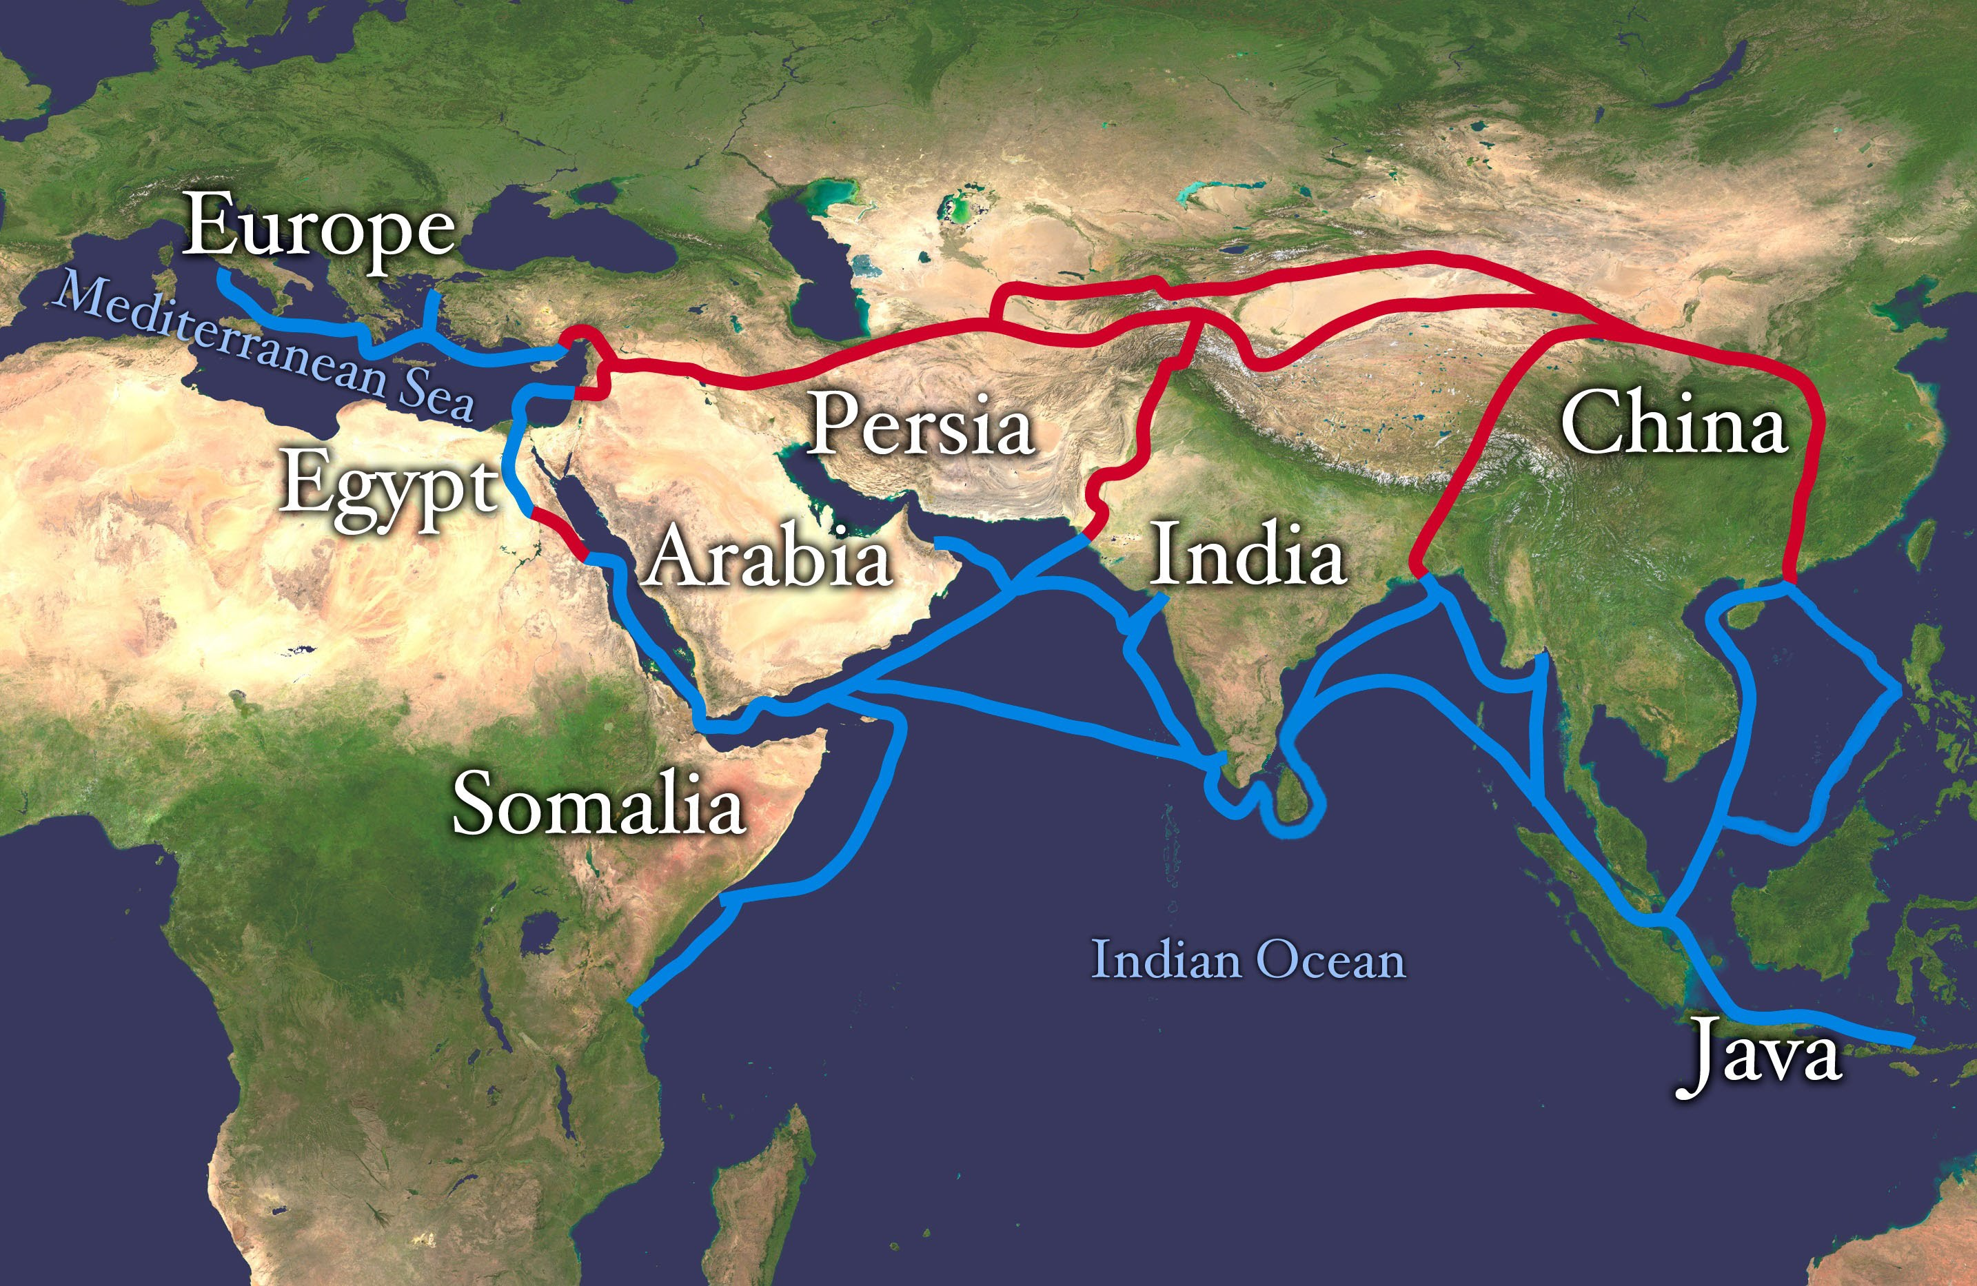
What connects these three images?

Slide 2
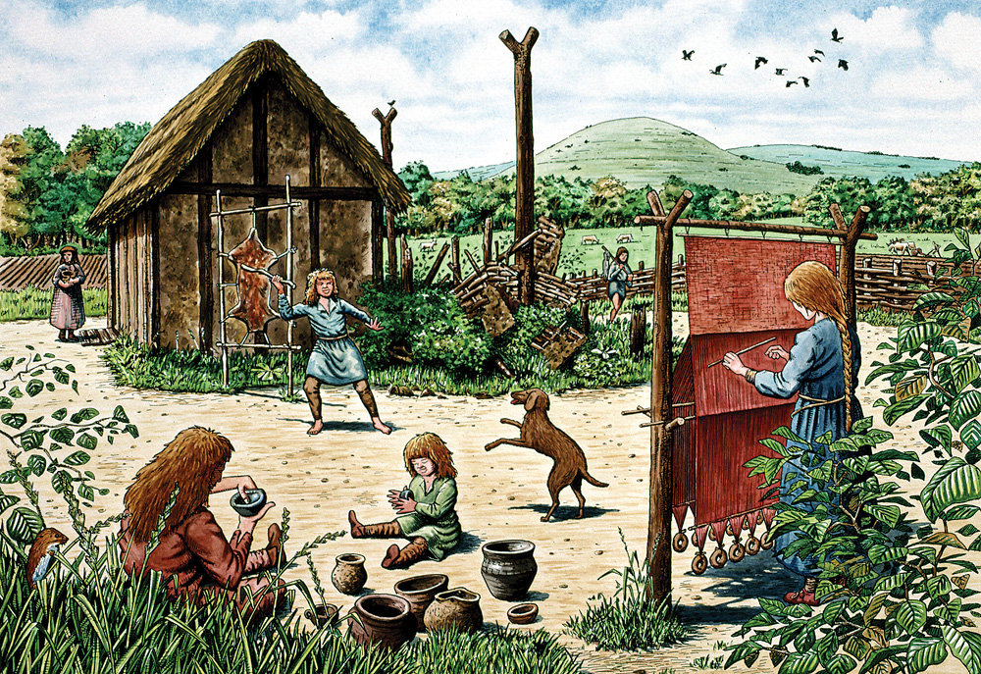
Was there a 6th Century World Wide Web?

Slide 3
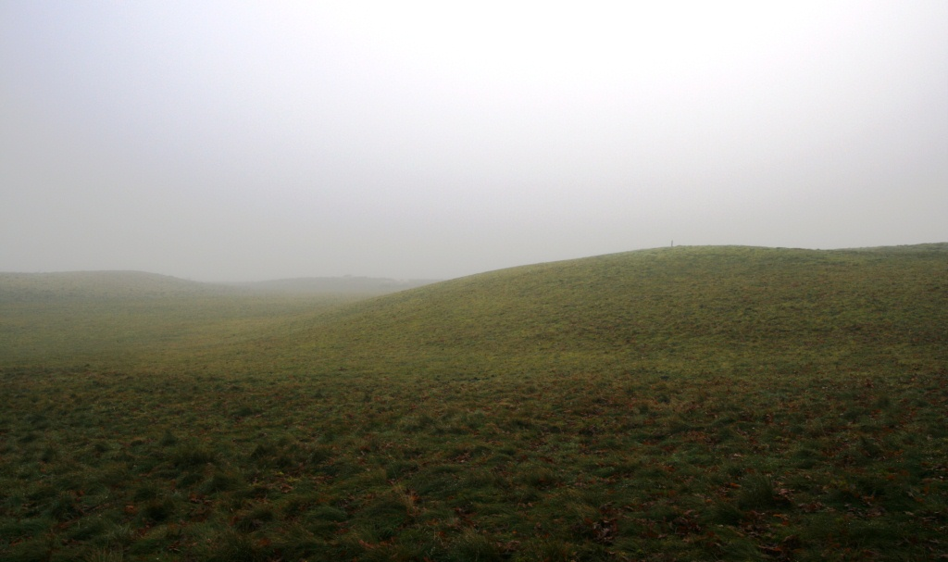
You will be shown three photographs concerning an event in 1939.
Can you work out what’s happening as the three photographs are revealed?

Slide 4
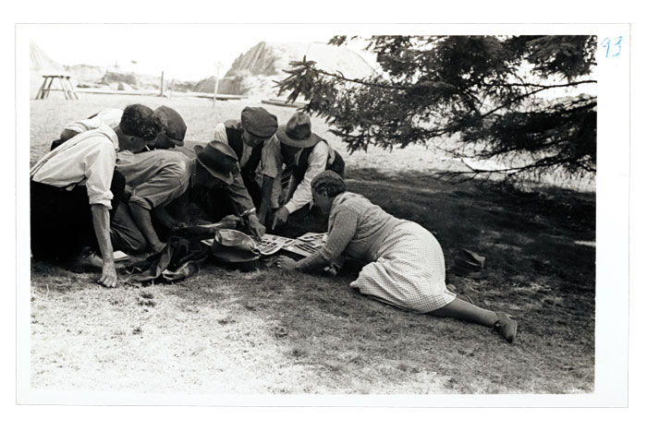
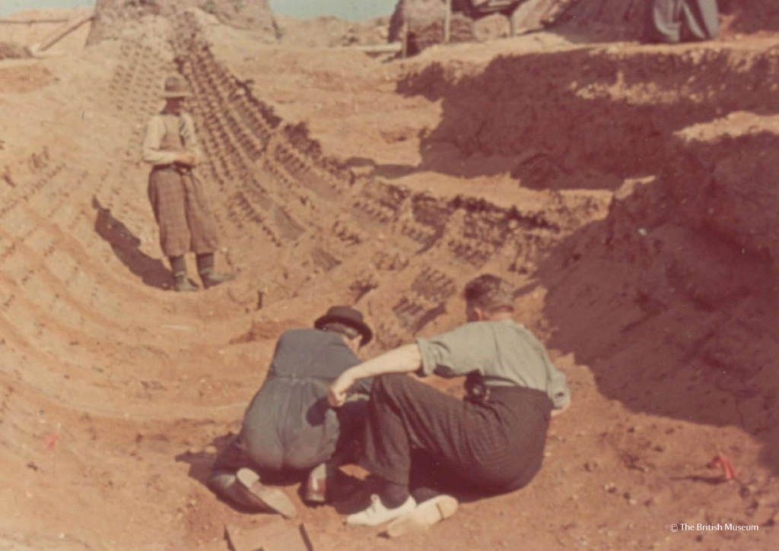
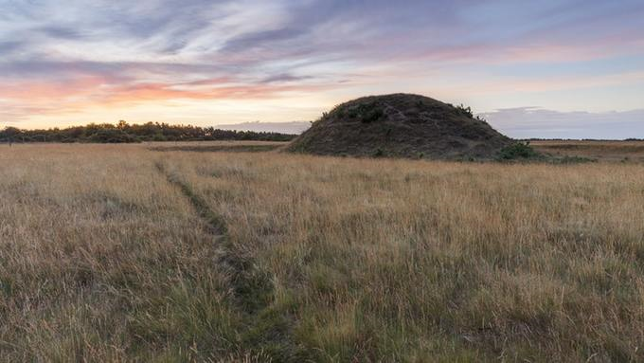
What do you think these archaeologists found?

Slide 5
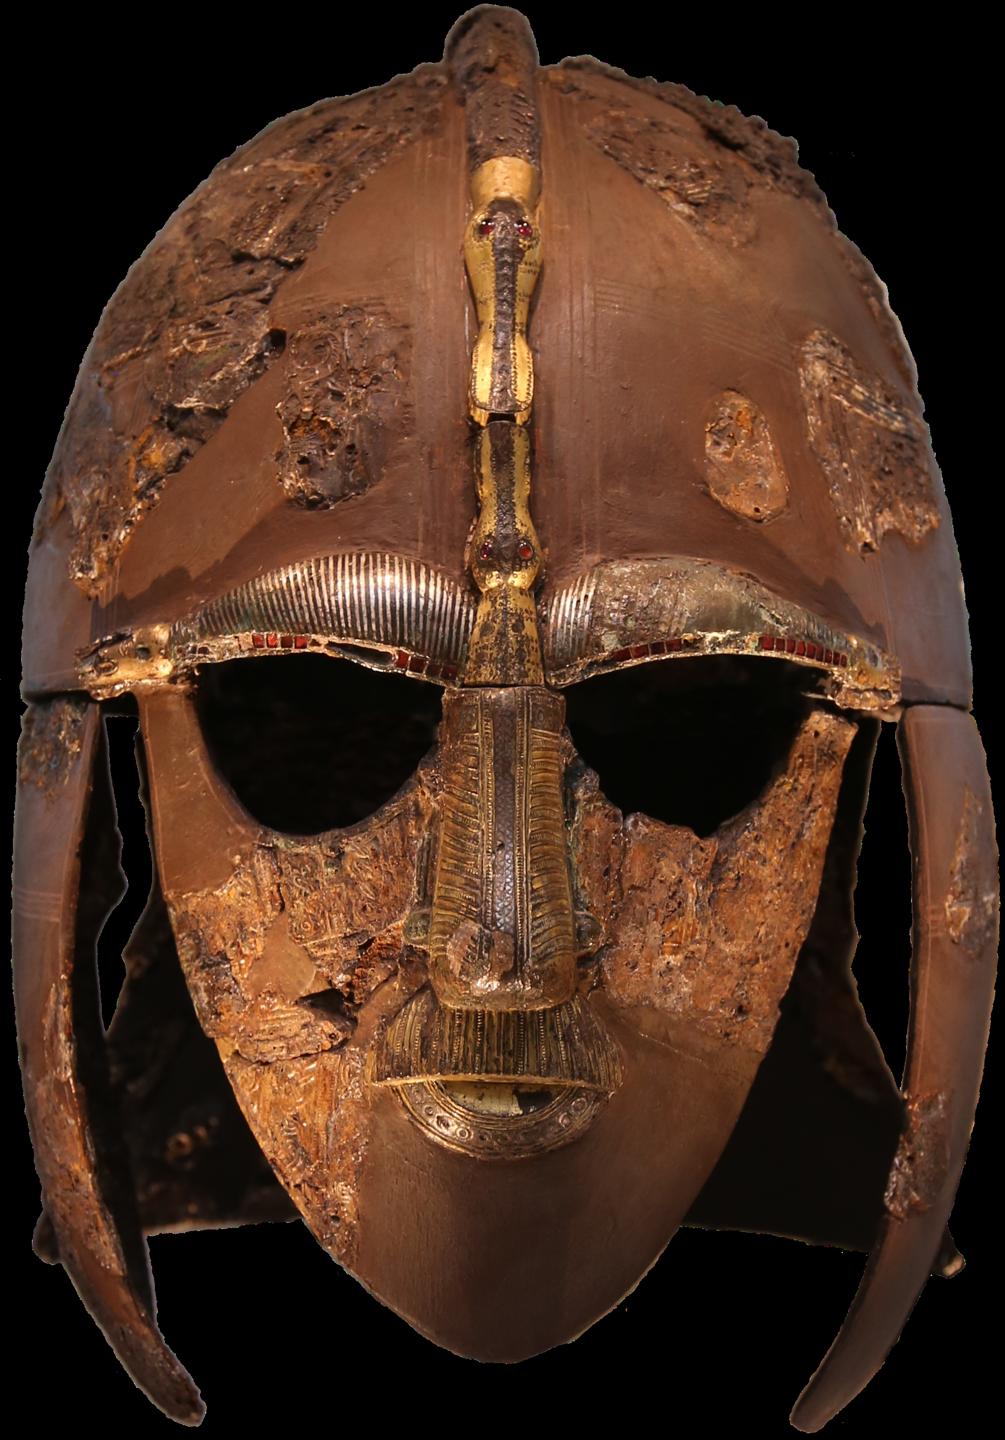

Slide 6
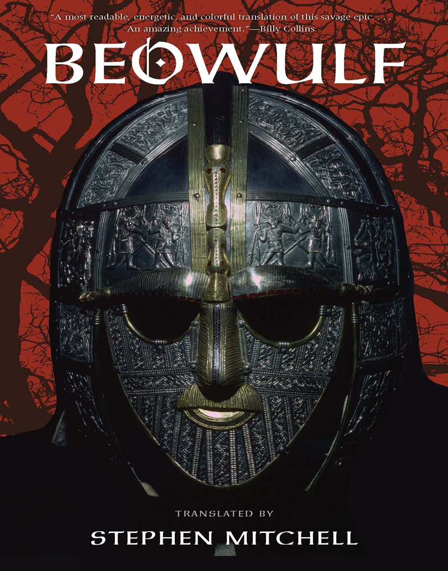
The discovery made by the archaeologists is similar to something described in the Great Saxon poem, Beowulf. This poem tells the story of a great hero coming to the aid of the King of the Danes in his battle with the monster, Grendel.
Read the extract: What is being described?

Slide 7
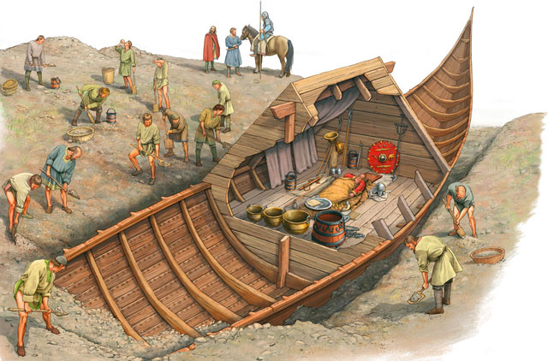
Did you guess correctly?

Slide 8
Can you predict where this 6th Century burial took place?

Slide 9
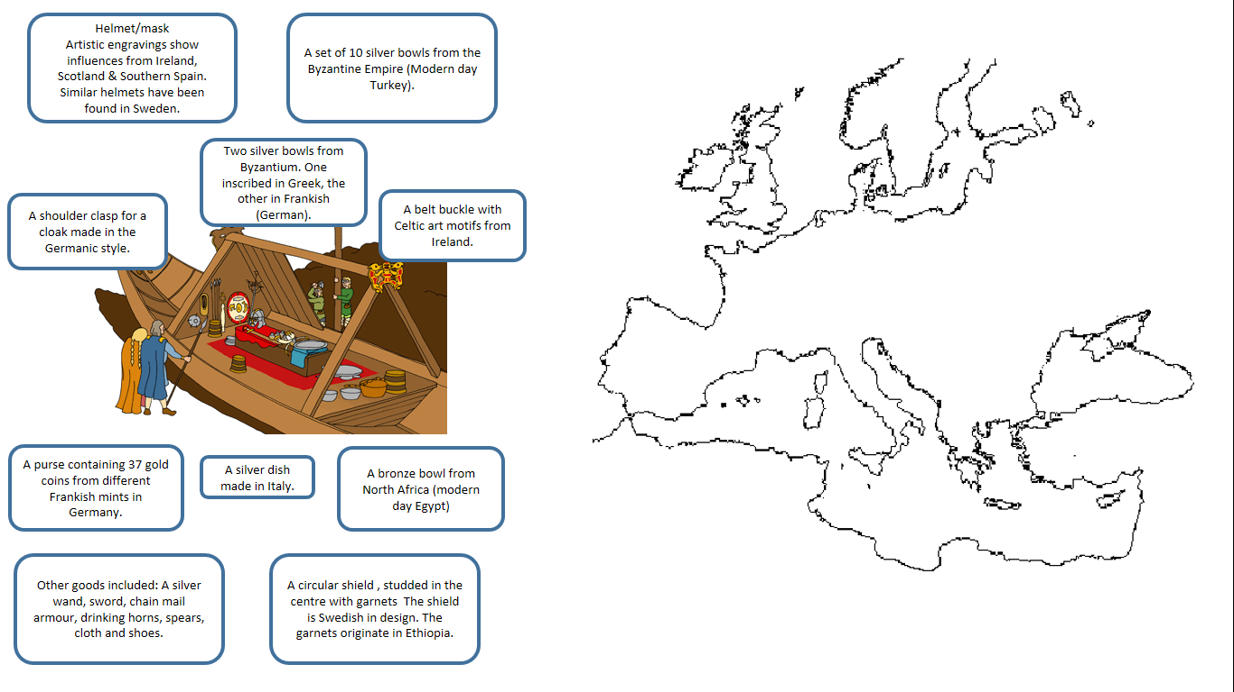
Read the information about the grave goods buried with our warrior. Using your atlas to help you, draw links to the different place in Europe & North Africa where the grave goods originated.
Based upon your completed map- can you predict where the 6th Century warrior was buried?

Slide 10
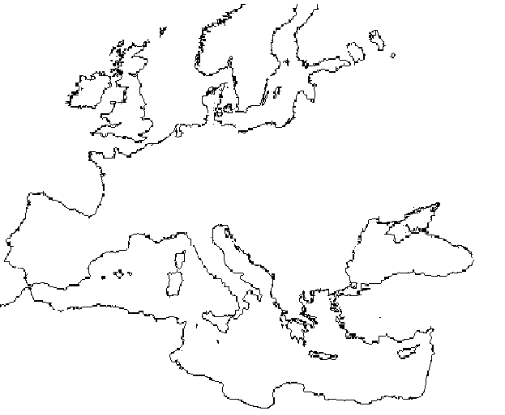
Based upon your completed map- can you predict where the 6th Century warrior was buried?
Put your name on a post-it note and place it on the map. Be prepared to justify your choice.

Slide 11
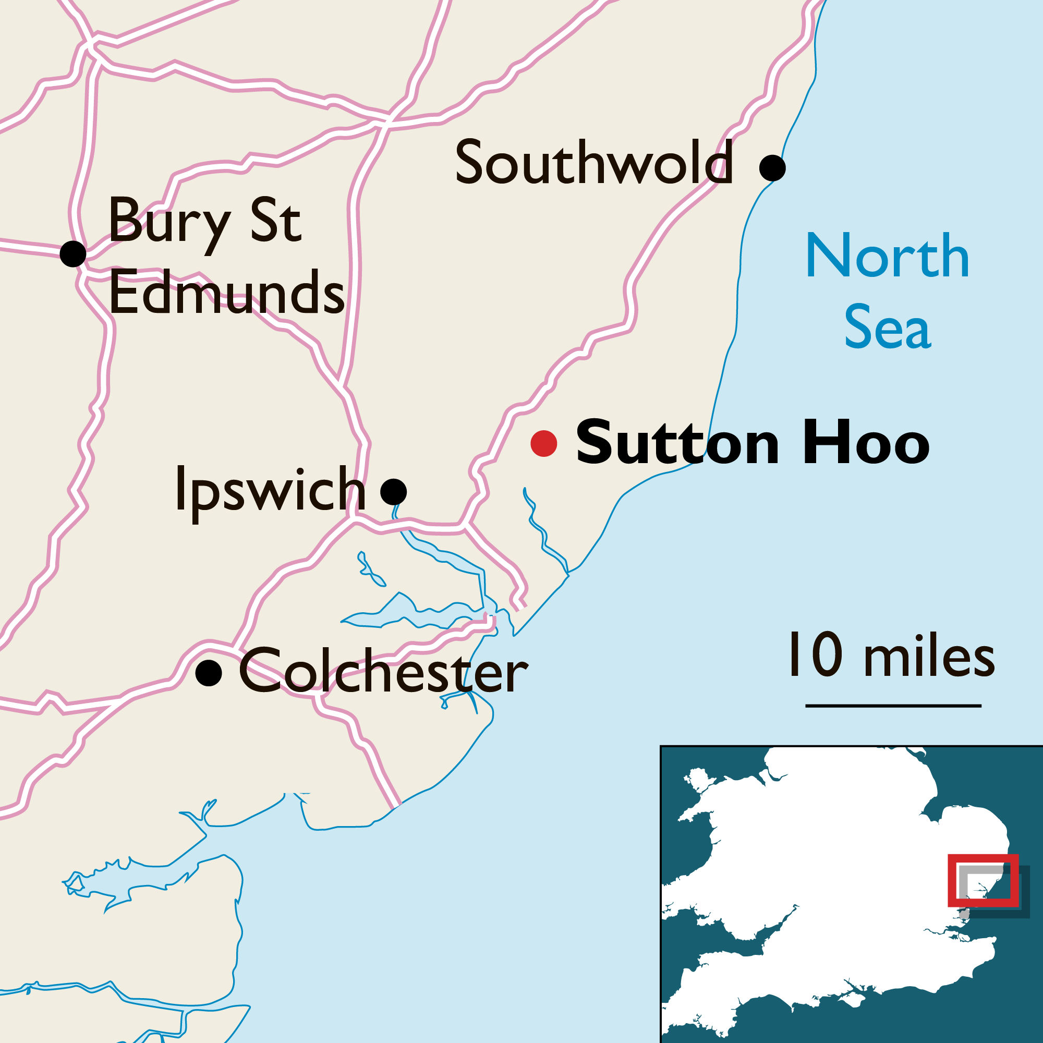
The ship burial took place at Sutton Hoo in Suffolk, Eastern England. It was the burial of an important figure from Saxon times.
Add the location of Sutton Hoo to your map.

Slide 12
Is the Sutton Hoo burial proof of a 6th Century World Wide Web?

Slide 13
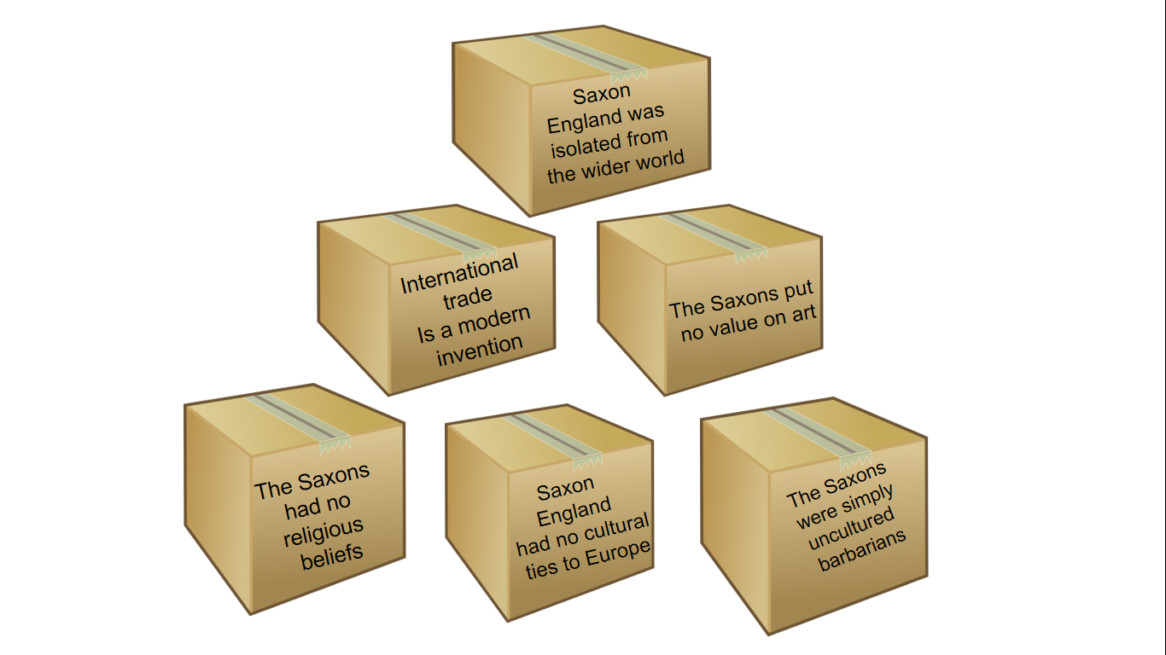
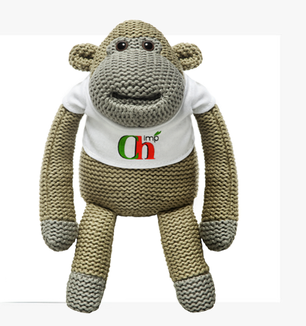
Use your knowledge to demolish the Wall of Misconceptions.
Add evidence to your post it notes to demolish the arguments.

Slide 14

Saxon
England was
isolated from
the wider world
International
trade
Is a modern
invention
The Saxons put
no value on art
The Saxons
had no
religious
beliefs
Saxon
England
had no cultural
ties to Europe
The Saxons
were simply
uncultured
barbarians

Slide 15
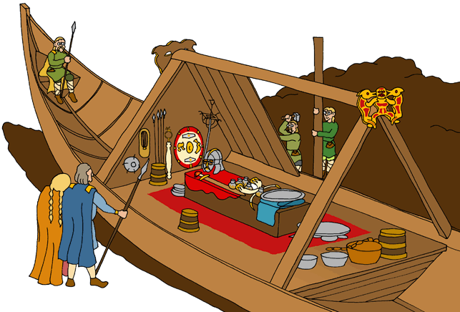
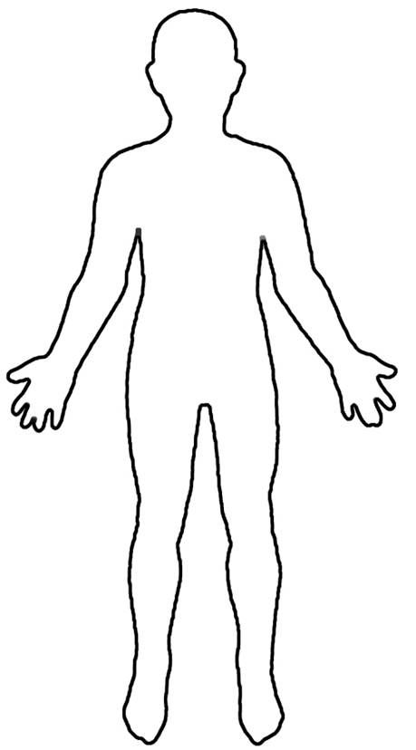
Helmet/mask
Artistic engravings show influences from Ireland, Scotland & Southern Spain. Similar helmets have been found in Sweden.
A set of 10 silver bowls from the Byzantine Empire (Modern day Turkey).
Two silver bowls from Byzantium. One inscribed in Greek, the other in Frankish (German).
A shoulder clasp for a cloak made in the Germanic style.
A belt buckle with Celtic art motifs from Ireland.
A purse containing 37 gold coins from different Frankish mints in Germany.
A silver dish made in Italy.
A bronze bowl from North Africa (modern day Egypt)
Other goods included: A silver wand, sword, chain mail armour, drinking horns, spears, cloth and shoes.
A circular shield , studded in the centre with garnets The shield is Swedish in design. The garnets originate in Ethiopia.

