Slide 1
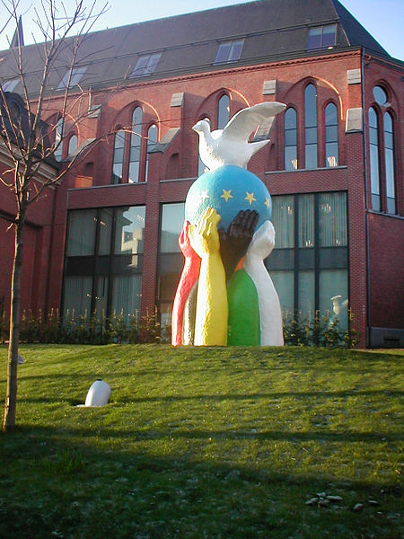
KEY QUESTION: Why is there more peace than war in Europe today?
Lesson 1: How was Europe different in 1900 than in 2000?
Lesson 2: Why was Europe more peaceful at the end than at the start of the 20th century?
https://commons.wikimedia.org/wiki/File:Statue_of_Europe-(Unity-in-Peace).jpg

Slide 2
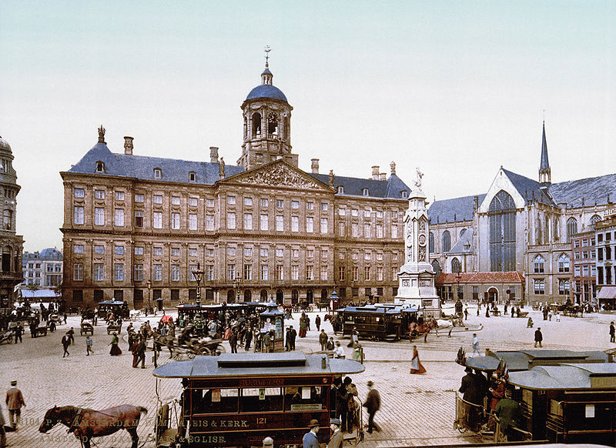
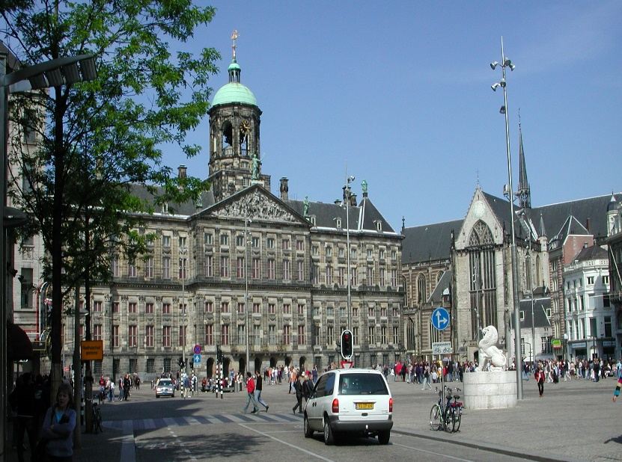
Lesson 1: How was Europe different in 1900 than in 2000?

Slide 3
Picture A: Dam Square, Amsterdam, 1900
https://en.wikipedia.org/wiki/Trams_in_Amsterdam
Picture B: Dam Square, Amsterdam, c.2000
https://en.wikipedia.org/wiki/Dam_Square
First evidence
Looking at the two photos above what are the main differences between 1900 and 2000. You have five minutes to list as many differences as you can.

Slide 4
Share your hypothesis from the first evidence.

Slide 5
Further evidence
Use the evidence in your packs to complete your worksheet about Europe in 1900 and 2000 in the following categories:
Politics
Crime
Education
Technology
Wealth
Extension:
Highlight the single biggest change that occurred in Europe between 1900 and 2000.

Slide 6
Human Factors
In your group you have five cards representing the five big changes in Europe between 1900 and 2000.
Decide what order they should go in from MOST to LEAST important change.

Slide 7
Concluding your enquiry
Answer the enquiry question as a group in LESS THAN 50 words:
How was Europe different in 1900 than in 2000?

Slide 8

Lesson 2 - Why was Europe more peaceful at the end than at the start of the 20th century?
Historical interpretations!
https://en.wikipedia.org/wiki/2012_Nobel_Peace_Prize

Slide 9
The main cause of European peace
To start:
Take a post-it note.
Don’t talk to your neighbours.
What is the first reason for European peace that has come into your head.
Write it on your post-it note.
Keep it secret – for now!

Slide 10
Why was Europe more peaceful at the end than at the start of the 20th century?
In your small groups you have a set of seven historical interpretations and a large piece of paper.
Read and discuss them. Which do you think are the most important and why? How are they connected?
Present your thinking on the paper.
Start with green, ’but we can do more!’ – do orange, no problem to do all seven – add red

Slide 11
Why was Europe more peaceful at the end than at the start of the 20th century?
Stick your presentation of the interpretations on the wall.
Read the presentations of the other groups.
Add any comments about how you disagree of agree with them by sticking post-it notes on their presentation. You can also ask them questions via post-it notes.

Slide 12
Why was Europe more peaceful at the end than at the start of the 20th century?
Final group discussion:
What do you think of the comments people have made on your presentation?
Reveal what your first idea was about the question
How has your thinking changed / developed throughout this activity?

Slide 13
KEY QUESTION: Why is there more peace than war in Europe today?
Lesson 1: How was Europe different in 1900 than in 2000?
Lesson 2: Why was Europe more peaceful at the end than at the start of the 20th century?
https://commons.wikimedia.org/wiki/File:Statue_of_Europe-(Unity-in-Peace).jpg
CHALLENGE YOURSELF!
This week, find out what other people think about this question. You could research on a news website, or ask other adults.

