Slide 1
Alsace-Lorraine was restored to ______.
Western Front of Germany

Slide 2
______-________ was restored to France.
Western Front of Germany

Slide 3
Alsace-Lorraine was restored to France.
Western Front of Germany
True or False

Slide 4
The provinces of _____ & Malmedy were given to Belgium after plebiscites.
Western Front of Germany

Slide 5
The provinces of Eupen & _______ were given to Belgium after plebiscites.
Western Front of Germany

Slide 6
The provinces of Eupen & Malmedy were given to _______ after plebiscites.
Western Front of Germany

Slide 7
The provinces of Eupen & Malmedy were given to Belgium after ___________.
Western Front of Germany

Slide 8
The provinces of Eupen & Malmedy were given to Belgium after plebiscites.
Western Front of Germany
True or False

Slide 9
Plebiscite: a ____ by the people on a question of national importance.
Western Front of Germany

Slide 10
__________: a vote by the people on a question of national importance.
Western Front of Germany

Slide 11
Mandate: the _____ to rule a country granted by the League in preparation for self-government.
Western Front of Germany

Slide 12
Mandate: the power to rule a country granted by the League in preparation for ____-government.
Western Front of Germany

Slide 13
_______: the power to rule a country granted by the League in preparation for self-government.
Western Front of Germany

Slide 14
Mandate: the power to ____ a country granted by the League in preparation for self-government.
Western Front of Germany

Slide 15
Mandate: the power to rule a country granted by the League in preparation for self-government.
Western Front of Germany
True or False

Slide 16
MISS A TURN

Slide 17
North _________ was transferred to Denmark after a plebiscite.
Western Front of Germany

Slide 18
North Schleswig was transferred to _______ after a plebiscite.
Western Front of Germany

Slide 19
North Schleswig was transferred to Denmark after a __________.
Western Front of Germany

Slide 20
North Schleswig was transferred to Denmark after a plebiscite.
Western Front of Germany
True or False

Slide 21
The ____ Coalfield was put under the control of the League of Nations for 15 years.
Western Front of Germany
France was allowed to take the coal during this time.
After 15 years there was to be a plebiscite.

Slide 22
The Saar Coalfield was put under the control of the _______ of _______ for 15 years.
Western Front of Germany
France was allowed to take the coal during this time.
After 15 years there was to be a plebiscite.

Slide 23
The Saar Coalfield was put under the control of the League of Nations for 15 years.
Western Front of Germany
______ was allowed to take the coal during this time.
After 15 years there was to be a plebiscite.

Slide 24
The Saar Coalfield was put under the control of the League of Nations for 15 years.
Western Front of Germany
France was allowed to take the ____ during this time.
After 15 years there was to be a plebiscite.

Slide 25
The Saar Coalfield was put under the control of the League of Nations for 15 years.
Western Front of Germany
France was allowed to take the coal during this time.
After __ years there was to be a plebiscite.

Slide 26
The Rhineland was declared to be a _____________ zone.
Western Front of Germany

Slide 27
The _________ was declared to be a demilitarised zone.
Western Front of Germany

Slide 28
The Rhineland was declared to be a demilitarised ____.
Western Front of Germany

Slide 29
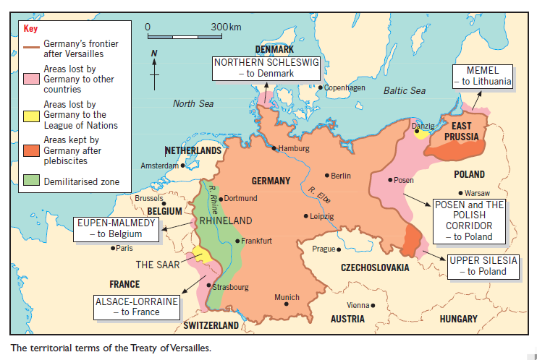

Slide 43
An independent ______ which had been destroyed in the 18th century was restored.
Eastern Front of Germany

Slide 44
An independent Poland which had been destroyed in the 18th century was ________.
Eastern Front of Germany

Slide 45
MISS A TURN

Slide 46
The port of ______ was made a free city under the control of the League of Nations.
Eastern Front of Germany
______ had a mainly German population, but Poland needed it as an outlet to the sea for trade.

Slide 47
The port of Danzig was made a ____ city under the control of the League of Nations.
Eastern Front of Germany
Danzig had a mainly German population, but Poland needed it as an outlet to the sea for trade.

Slide 48
The port of Danzig was made a free city under the control of the ______ of _______.
Eastern Front of Germany
Danzig had a mainly German population, but Poland needed it as an outlet to the sea for trade.

Slide 49
_____ Silesia was divided between Germany and Poland after a plebiscite.
Eastern Front of Germany

Slide 50
Upper Silesia was divided between Germany and _______ after a plebiscite.
Eastern Front of Germany

Slide 51
Upper Silesia was divided between Germany and Poland after a __________.
Eastern Front of Germany

Slide 52
Upper Silesia was divided between Germany and Poland after a plebiscite.
Eastern Front of Germany
True or False

Slide 53
Posen and the Polish ________ given to Poland.
Eastern Front of Germany

Slide 54
Posen and the Polish Corridor given to ______.
Eastern Front of Germany

Slide 55
_____ and the Polish Corridor given to Poland.
Eastern Front of Germany

Slide 56
Posen and the Polish Corridor given to Poland.
Eastern Front of Germany
True or False

Slide 57
The port of _____ was to be ruled by the League. It was taken by Lithuania in 1923.
Eastern Front of Germany

Slide 58
The port of Memel was to be ruled by the League. It was taken by _________ in 1923.
Eastern Front of Germany

Slide 59
The port of Memel was to be ruled by the League. It was taken by Lithuania in 1923.
Eastern Front of Germany
True or False

Slide 60
Some of the gains that Germany had made from the defeat of ______ in 1918 were given up, mainly to Poland.
Eastern Front of Germany

Slide 61
Some of the gains that Germany had made from the defeat of Russia in 1918 were given up, mainly to ______.
Eastern Front of Germany

Slide 62
_______, Latvia and Lithuania became independent states.
Eastern Front of Germany

Slide 63
Estonia, ______ and Lithuania became independent states.
Eastern Front of Germany

Slide 64
Estonia, Latvia and _________ became independent states.
Eastern Front of Germany

Slide 65
Estonia, Latvia and Lithuania became ___________ states.
Eastern Front of Germany

Slide 66
Estonia, Latvia and Lithuania became independent states.
Eastern Front of Germany
True or False

Slide 67
The union of _______ and Germany (Anschluss) was forbidden.
Eastern Front of Germany

Slide 68
The union of Austria and Germany (_________) was forbidden.
Eastern Front of Germany

Slide 69
The union of Austria and Germany (Anschluss) was _________.
Eastern Front of Germany

Slide 70
The union of Austria and Germany (Anschluss) was forbidden.
Eastern Front of Germany
True or False

Slide 71
All Germany’s ________ were surrendered and given to the victorious powers as mandates by the League of Nations.

Slide 72
All Germany’s colonies were surrendered and given to the victorious powers as __________ by the League of Nations.

Slide 73
All Germany’s colonies were surrendered and given to the victorious powers as mandates by the ______ of ________.

Slide 74
All Germany’s colonies were surrendered and given to the victorious powers as mandates by the League of Nations.
True or False

Slide 75
MISS A TURN

