Slide 1
Why was it such a surprise to have a Tudor king?

Slide 2
Astonishing
You’ve got to be joking!
Impossible
Inconceivable
Nobody expected that!
You can’t be serious!
Surprising

Slide 3
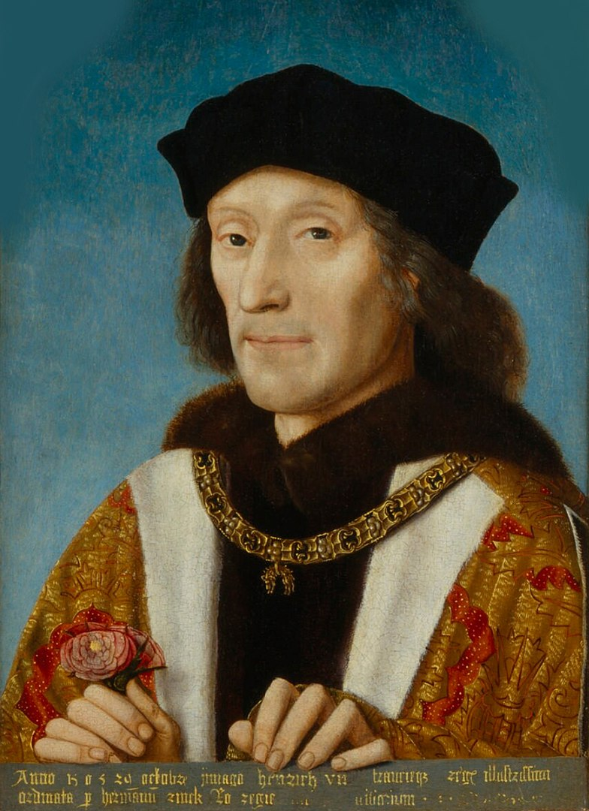

Slide 4
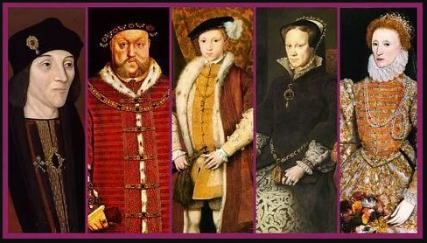

Slide 5
Why was it such a surprise to have a Tudor king?

Slide 6
A Living Graph
Key:
5. A Tudor King
4. Highly Likely
3. Possible – 50/50 chance
2. Extremely Unlikely
1. Impossible
5
4
3
2
1
July
August
1420
1450
1471
1485

Slide 7
What were the chances of having a Tudor king?
5. A Tudor King was on the throne!
4. Highly Likely the next king would be a Tudor
3. Possible – there was a 50/50 chance there would be a Tudor king
2. Extremely Unlikely there would be a Tudor king
1. Impossible – there was no chance of having a Tudor king

Slide 8
1420
In the 1200s the Tudors lived in Wales. One Tudor, Ednyfed Fychan (Ednyfed the small), was an adviser to Llewellyn, Prince of Wales - but the Tudors were not related to the King of England.
Ednyfed’s grandsons supported the English king Edward I when he conquered Wales in the 1280s but in the early 1400s the Tudors joined the Welsh rebellion led by Owain Glyndwr against the English. Rhys Tudor was executed for rebellion and the family’s lands were given to Welshmen who stayed loyal to the King of England.

Slide 9
1460
Between 1420 and 1460 the Tudors had a huge change in fortune. Owen Tudor, son of one of the rebel Tudors, met Queen Catherine, the young widow of King Henry V. Catherine and Owen married in secret and had three sons.
Queen Catherine already had a son who was King Henry VI (Henry of Lancaster) so the three Tudor boys were the king’s half-brothers. They were now wealthy but had no claim to be king.
In 1455 one of the brothers, Edmund Tudor married 12 year-old Lady Margaret Beaufort. In 1457, Margaret had a son who was also called Henry.
As Lady Margaret was part of the royal family this meant little Henry was also related to the king. However no-one thought little Henry could ever possibly be king as the King, Henry VI, had a son of his own.

Slide 10
1471
The Lancastrian king Henry VI was deposed during the Wars of the Roses. The new king was Edward of York who became Edward IV. Henry Tudor was no longer part of the royal family because he was not related to Edward of York.
In 1471 King Henry VI and his son and heir were killed. That made young Henry Tudor the leader of the Lancastrian family. In theory young Henry might become king but he was only 14 and fled abroad to live in exile. King Edward was also a very strong king with two sons to follow him as king.

Slide 11
July 1485
In 1483 the Tudor luck changed again. Edward IV died suddenly and his sons disappeared mysteriously. The new king was the boys’ uncle, Richard III. Some of Edward IV’s supporters were outraged that King Richard had used violence to take his nephew’s throne and they looked around desperately for someone else who could be king.
They chose Henry Tudor as their leader even though they didn’t know much about him as he had lived abroad for 14 years - but they were desperate to end Richard’s reign.
By July 1485 Henry Tudor was ready to invade England and fight Richard for the crown but Richard was an experienced soldier with a much larger army.

Slide 12
22 August 1485
Even when the Battle of Bosworth started Henry seemed to have little chance of becoming king. The battle was going Richard’s way. He charged straight at Henry Tudor, knocking aside his guards. Henry’s supporters expected him to be killed … but seconds later Sir William Stanley and his men charged in to help Henry.
Richard was killed – when just a minute or two earlier he appeared to be winning!
Henry Tudor was now King Henry VII

Slide 13
Having a Tudor king and dynasty was …
Astonishing
Impossible
Inconceivable
Surprising
But it happened!

Slide 14
What’s so amazing about having a Tudor king?
If …
… Owen Tudor hadn’t met Queen Catherine
… Margaret Beaufort hadn’t had a baby when she was only 14
… Richard III hadn’t taken the crown
… Sir William Stanley had arrived 30 seconds later

Slide 15
The Tudors becoming the kings and queens needn’t have happened at all. History could have been very different.
What other examples can you think of when history could have turned out very differently?

