Slide 1
The Wars of the Roses 1455‐1487

Slide 2
What are your ideas?
What ideas and images come to mind when you hear the words ‘The Wars of the Roses’?
What words do you think might describe the people of that time?
What do you think it was like to live at that time?

Slide 3
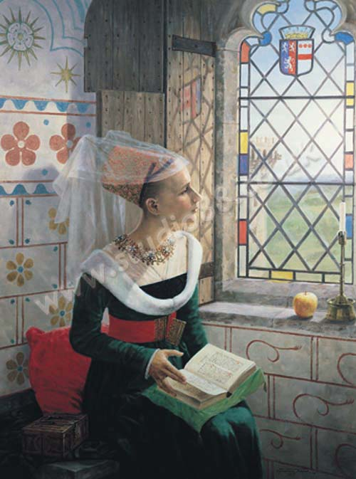
Reverie
© Graham Turner
www.studio88.co.uk

Slide 4
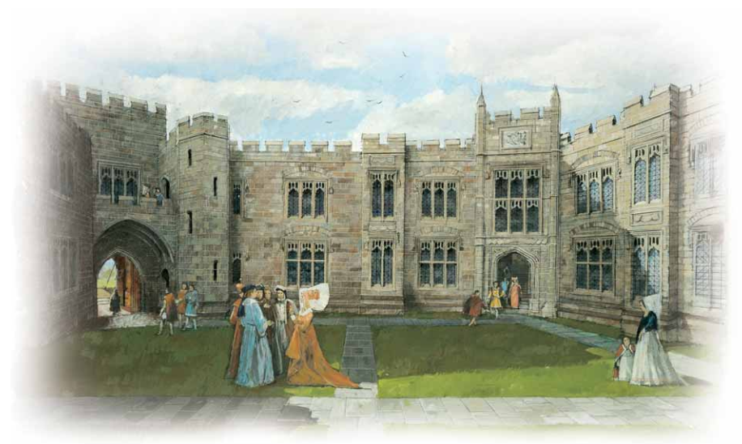
Raglan Castle in the 1460s
Reconstruction drawing of Raglan Castle © CADW

Slide 5
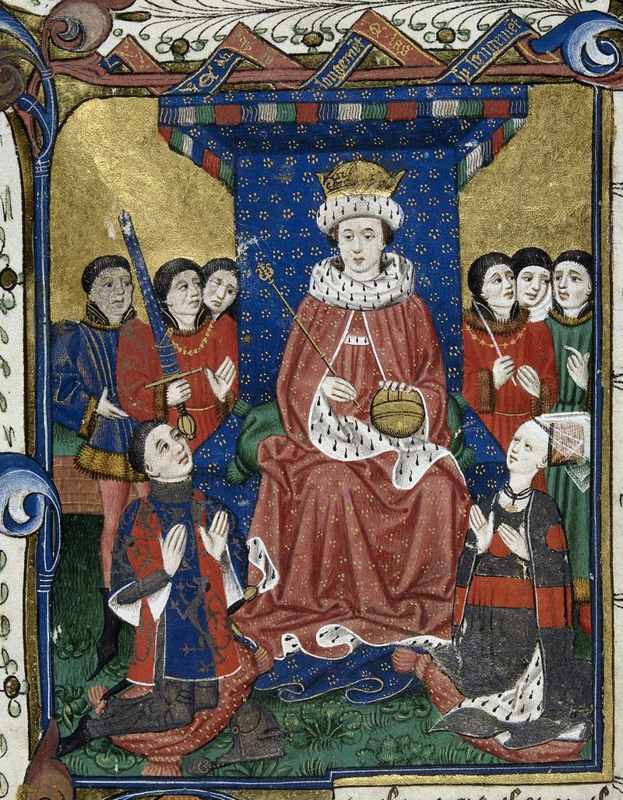
© British Library

Slide 6
After the battle of Edgecote, 1469
Poems were written in praise of some of the Welsh soldiers who died at Edgecote.
The poem for Thomas ap Roger Vaughan, said that his wife Elen:
The poem for Rhys ap Dafydd Llwyd said his wife is still waiting for his return:
Elen was weeping
Drops of dew, as drops of rain.
Margaret doesn’t believe, Rhys,
That you are not alive and well – come home to Powys!

Slide 7
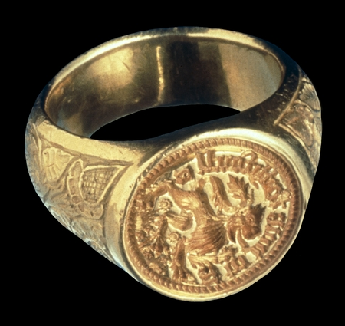
© Museum of Wales

Slide 8
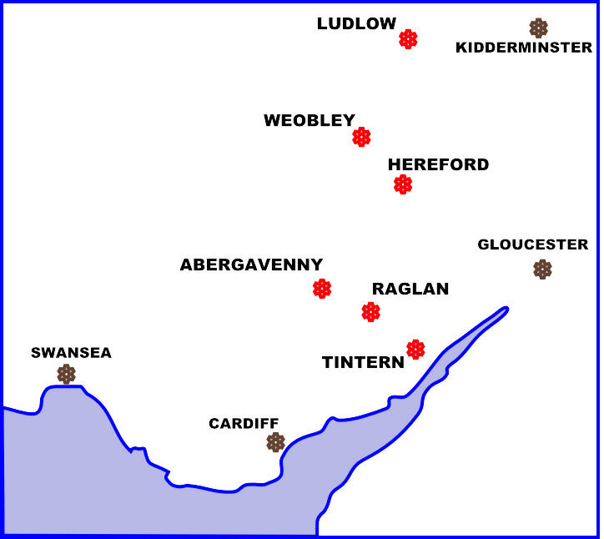

Slide 9

The Herbert Coat of Arms

Slide 10
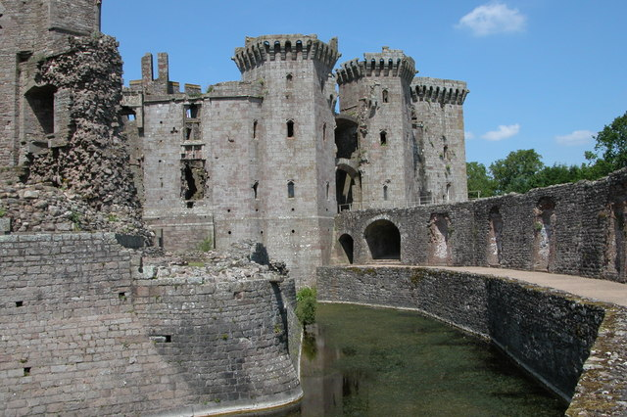
Raglan Castle Today
Raglan Castle, home to Anne and her husband William Herbert

Slide 11
The question for you to answer is:
How would you describe the people of the Wars of the Roses?

Slide 12
Building your answer
What can you find out from the following timeline to help you answer your question:
How would you describe the people of the Wars of the Roses?

Slide 13
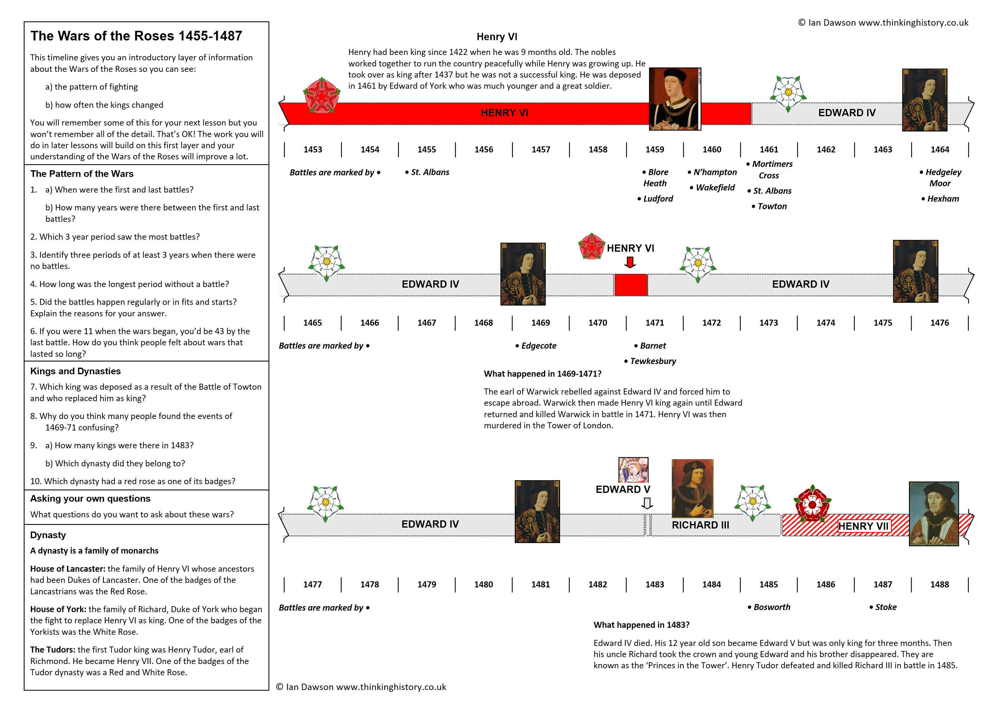

Slide 14
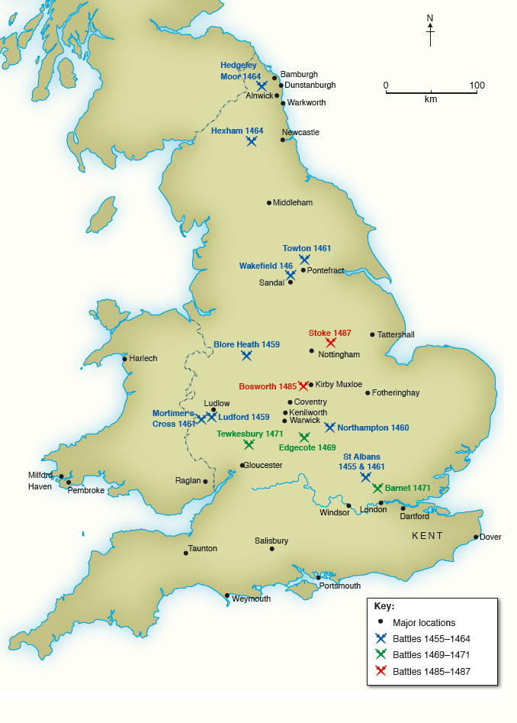
Map showing the location of the battles

Slide 15
Building your answer
What have you found out from the timeline that might help you answer your question:
How would you describe the people of the Wars of the Roses?

Slide 16
Building your answer
What can you find out from the following Myth‐Busting activity to help you answer your question:
How would you describe the people of the Wars of the Roses?

Slide 17
Myth-busting The Wars of the Roses
The soldiers all came from Yorkshire and Lancashire.
Everyone wore white or red roses as badges.

Slide 18
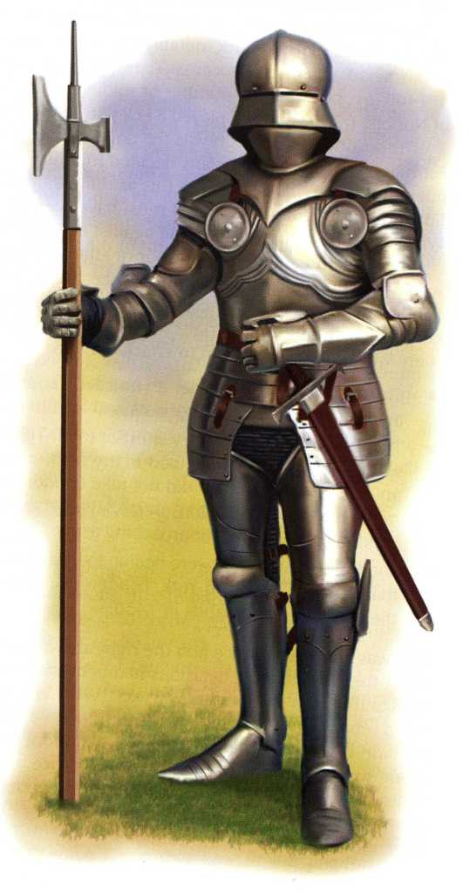
Myth-busting
A. Soldiers in full armour could move easily and quickly in battles.

Slide 19
Myth-busting
B. The armies badly disrupted people’s lives and damaged many homes during the Wars.

Slide 20
Myth-busting
C. People were violent and keen to join in the wars. They didn’t try to stop battles taking place.

Slide 21
Myth-busting
D. The nobles thought it was important to be loyal to the king. They did not change sides easily.

Slide 22
Myth-busting
E. Women played no part in the Wars of the Roses.

Slide 23
Myth-busting
F. The wars ended as soon as Henry Tudor became king in 1485.

Slide 24
Building your answer
What have you found out from the Myth-Busting activity that might help you answer your question:
How would you describe the people of the Wars of the Roses?

Slide 25
Walter Devereux’s decisions
Your task is to choose what you think is the best decision. You score points for good decisions and lose points for bad ones.
Walter’s aims are:
a) to build up his family’s lands, wealth and power.
b) to increase other people’s respect for him and his family. People respect loyalty and hard work that helps the king.
c) to help make England powerful, united and peaceful.
You begin with 10 points because the Devereux family is already well-respected, wealthy and has fought to defend the king’s lands many times.

Slide 26
1455: What should the Duke of York to do after the battle?
a) York should have Henry executed and become king himself
b) York should put Henry in prison and become king himself
c) Kneel in front of King Henry and ask for his forgiveness for fighting, then become his chief councillor
Think about:
How the rest of the nobles would react – Loyalty to the King – Can York make himself king now Prince Edward has been born?

Slide 27
1455: What should the Duke of York to do after the battle?
Nobody would have supported York if he had tried to be king - even his closest allies. Choices a and b would almost certainly have led to the execution of York and anyone who supported him.
a) Execute Henry - Lose 5 points
b) Put Henry in prison - Lose 5 points
c) Become chief councillor - Gain 3 points

Slide 28
1455-1459: What should Walter do after Ludford?
a) Ride as fast as he can to the coast and join the Duke of York in exile abroad
b) Surrender to the king, go down on his knees and beg King Henry for mercy
c) Rally his men and fight the King’s army to give York more time to escape
Think about:
His family and lands – His loyalty to the Duke of York – His loyalty to the King

Slide 29
1459: What should Walter do after Ludford?
Choice c is treason and would lead to your death – very quickly. Choice b gives you a chance of keeping your lands and escaping sever punishment – but there’s no good choice here.
a) Go into exile - Lose 5 points
b) Beg henry for mercy - Lose 2 points
c) Fight the King’s army - Lose 10 points

Slide 30
1461: Should Walter fight for Edward of York?
a) Fight for Edward of York against King Henry
b) Fight for King Henry – he will have the larger army as most nobles still support the King
c) Stay at home and see what happens
Think about:
The rewards he might get from Edward – the danger of losing and being punished – his family’s loyalties – will your choice increase people’s respect for you?

Slide 31
1461: Should Walter fight for Edward of York?
Nobody will respect you if you choose choice c. Edward is a great soldier even if he is young and has a good chance of winning – and you have always been loyal to the family of the Duke of York even if you are not loyal to King Henry. You can’t be loyal to both.
a) Fight for Edward of York - Gain 3 points
b) Fight for King Henry - Lose 1 point
c) Stay home - Lose 3 points

Slide 32
1470: What Should Walter do next?
a) Plot a rebellion and lead a rebellion of other Yorkists against Warwick and Henry VI
b) Escape abroad to join Edward IV in exile
c) Look after your lands in peace – but hope that Edward comes back
Think about:
the good of your family – what would Edward need to become king again?

Slide 33
1470: What Should Walter do next?
Choice b means you stay loyal to Edward IV but what if Edward never regains the crown – your family will have lost all its lands and wealth. Choice a is unlikely to succeed – will anyone join you if Edward is abroad and looks defeated. You have to hope Edward returns.
a) Plot a rebellion - Lose 5 points
b) Escape abroad - Lose 3 points
c) Look after your lands - Gain 1 point

Slide 34
1483: Should Walter support Richard III or rebel against him?
a) Join the rebellion – Walter had been a loyal servant of Edward IV
b) Join King Richard and help him defeat the rebels – Richard is an experienced soldier and leader
c) stay at home and wait to see what happens
Think about:
His own family’s future –Who will make the best king for England? – Who he has fought for in the past

Slide 35
1483: Should Walter support Richard III or rebel against him?
This is difficult and historians are not sure what Walter planned to do. Choice a is the most dangerous and would have lead to losing the family wealth when the rebellion failed.
a) Join the rebellion - Lose 3 points
b) Fight for King Richard - Gain 1 point
c) Stay home - Gain 1 point

Slide 36
1483-1485: Should Walter fight for Richard III or Henry Tudor?
a) Fight for Richard
b) Fight for Henry
c) stay at home and wait to see what happens
Think about:
Richard is an excellent soldier and has lots of support in the north. Richard did a good job of ruling the north while his brother was king.
Many people believe Richard killed his nephews and executed lords who might have stopped him becoming king.
Walter has known Richard III since Richard was a boy.
Walter had always been loyal to Richard, Duke of York and King Edward IV – the grandfather and father of young Edward V who had disappeared when Richard III became king.
Walter knew Henry when he was a boy being looked after by Walter’s sister, Anne
Nobody knows whether Henry will make a good king.

Slide 37
1485: Should Walter fight for Richard III or Henry Tudor?
Another difficult choice and we don’t know for certain why Walter chose to fight for Richard when his family had close links with Henry. Richard lost so supporting him meant the family would lose all its land and wealth. Choice c means whoever wins won’t trust you in future to support him but at least you’d have stayed alive!
a) Fight for Richard - Lose all your points
b) Fight for Henry - Gain 1 point
c) Stay home - Lose 1 point

Slide 38
Building your answer
What can you find out from the Consequences Cards to help you answer your question:
How would you describe the people of the Wars of the Roses?

Slide 39
The Consequences of the Wars of the Roses
1. Which cards tell you about consequences that were:
Immediate: while the Wars were taking place
Medium-term: during the next hundred years when the Tudors were monarchs
Long-term: lasted much longer than a hundred years
2. Which card tells you about topics which were not affected by the Wars
3. Have any of these consequences surprised or puzzled you?

Slide 40
Building your answer
What have you found out from the Consequences Cards that might help you answer your question:
How would you describe the people of the Wars of the Roses?

Slide 41
The Significance of the Wars
Do you think the Wars of the Roses should be part of your Y7 course?
Explain why you think they should – or not.
Use your significance criteria to support your argument.

Slide 42
Impress yourself with how much you have learned!
What ideas about the Wars of the Roses did you have before you started this work?
How have those ideas changed or developed?
What has been the most surprising thing you have learned?

Slide 43
Completing your answer
Here is the question we began with – now is the time to sum up your answer.
How would you describe the people of the Wars of the Roses?

