Slide 1
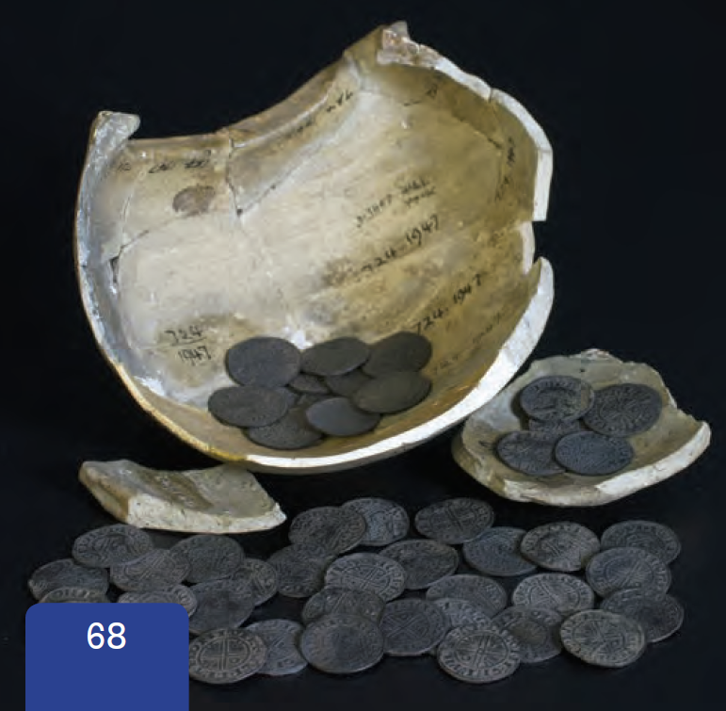
What is this picture?

Slide 2
The Bishophill-I Hoard

Slide 3
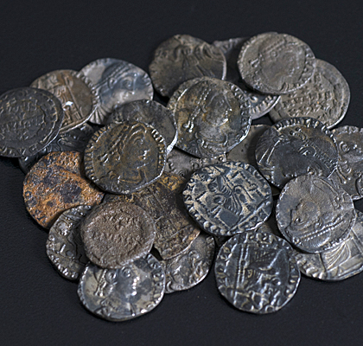
The Bishophill-I Hoard

Slide 4
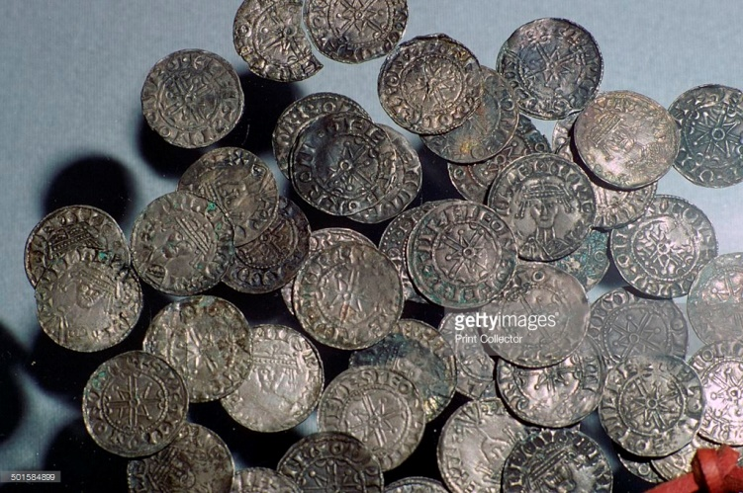
The Jubbergate Hoard

Slide 5
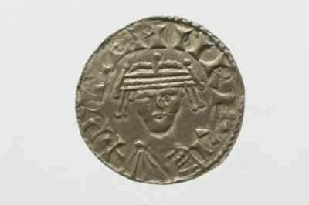
A Coin from Jubbergate

