Slide 1
What Are Your Ideas About The Middle Ages?
Medieval
Lives
Revised August 2021

Slide 2
What are your ideas about the Middle Ages?
1. Which THREE words do you think best describe ordinary people and their lives in the Middle Ages?
Clever | Dirty | Enjoyable | Violent | Comfortable
Loving | Nasty | Ambitious | Miserable | Hard-working

Slide 3
What are your ideas about the Middle Ages?
2. What kind of work did over 80% of people do in the Middle Ages?
3. How important was religion to people in the Middle Ages?
Soldiering | Farming | Being monks and priests | Making and selling clothes and shoes
Very important | Important | Quite important | Not important at all

Slide 4
What are your ideas about the Middle Ages?
4. Did people care about dirt in streets in the Middle Ages?
5. How much violence was there in the Middle Ages compared with today?
Yes | No
A great deal more | A little more | About the same | Less

Slide 5
What are your ideas about the Middle Ages?
6. Which THREE words do you think best describe kings and barons in the Middle Ages?
Intelligent | Loyal | Brave | Hard-working | Power-mad
Ruthless | Treacherous | Ambitious | Honourable

Slide 6
What are your ideas about the Middle Ages?
7. Were barons keen to rebel against the king to increase their own power and wealth?
8. Was the king expected to consult his barons and knights before taking important decisions?
As often as possible | Quite Often | Very Occasionally | No
Yes | No

Slide 7
What are your ideas about the Middle Ages?
9. How interested were working people in national political events?
10. Were people in the Middle Ages as intelligent as people today?
Very interested | Interested | Not at all interested
Yes | No

Slide 8
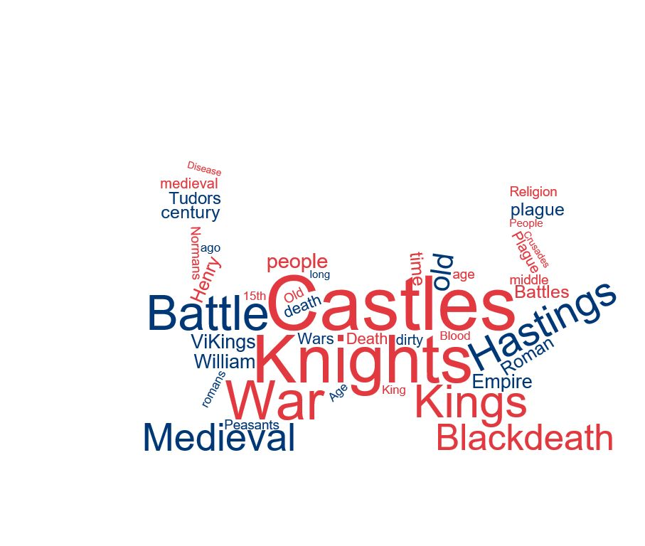
What are other students’ ideas about the Middle Ages?
Evidence A
This word cloud shows the words that school students most associated with the Middle Ages.

Slide 9
What are other students’ ideas about the Middle Ages?
Evidence B
The research into the ideas of over 900 school students showed that:
90% thought that medieval people were less intelligent than people today
92% said that medieval people did not care about dirt
95% said that religion was important or very important to people in the Middle Ages
73% said that people were not good at solving problems in the Middle Ages

Slide 10
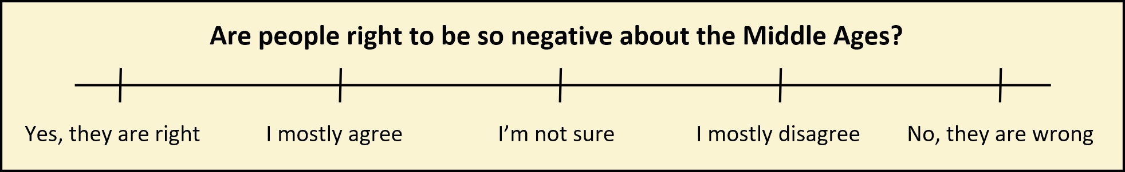
Are people right to be so negative about the Middle Ages?

Slide 11
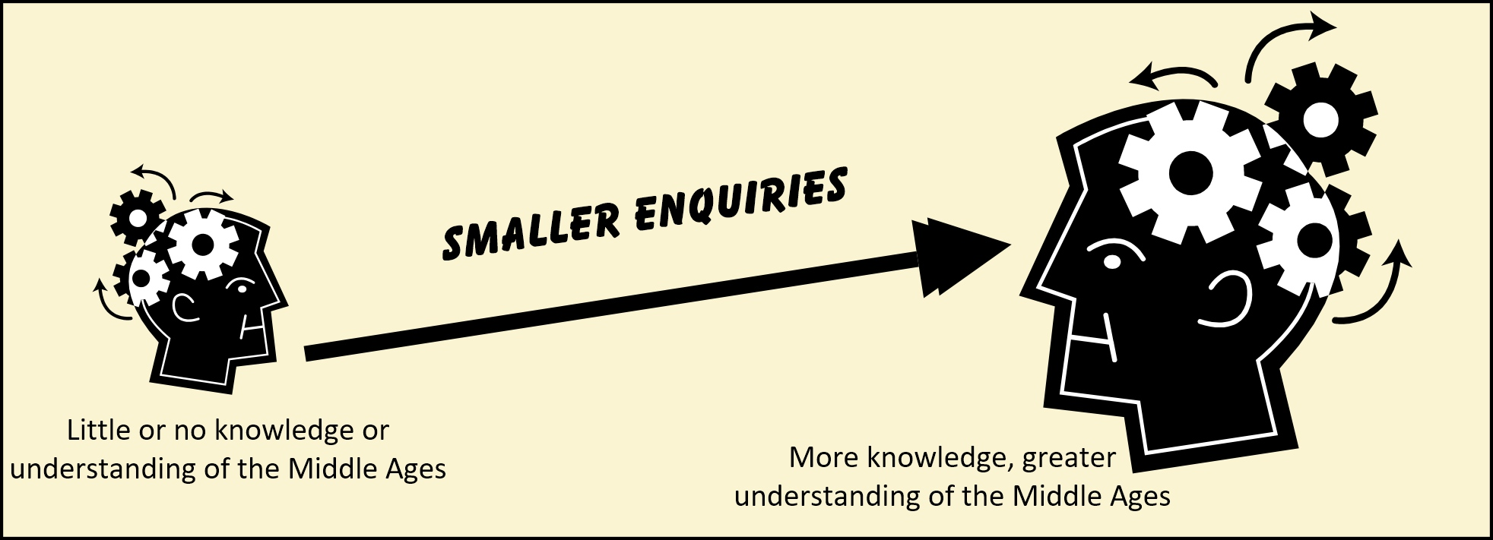
Are people right to be so negative about the Middle Ages?

