Slide 1
Were medieval people very different from us?
Medieval
Lives
Revised August 2021

Slide 2
 | Evidence to support the idea | Evidence to challenge the idea
A. Medieval people’s feelings were dominated by emotions like anger, selfishness and hatred
B. Medieval parents did not love their children

Slide 3
The idea is completely untrue
The idea is mostly true
The idea is partly true
The idea is very true
Idea A:
Emotions and feelings
Idea B:
Parents and
children

Slide 4
Six Groups of Emotions
A. Grief, sorrow, fear, worrying about people | B. Love, loyalty, friendship, kindness, generosity | C. Honour or pride
D. Anger, hatred, selfishness, greed | E. Enjoyment, happiness, having fun | F. Morality – a sense of being right and wrong. Being merciful

Slide 5
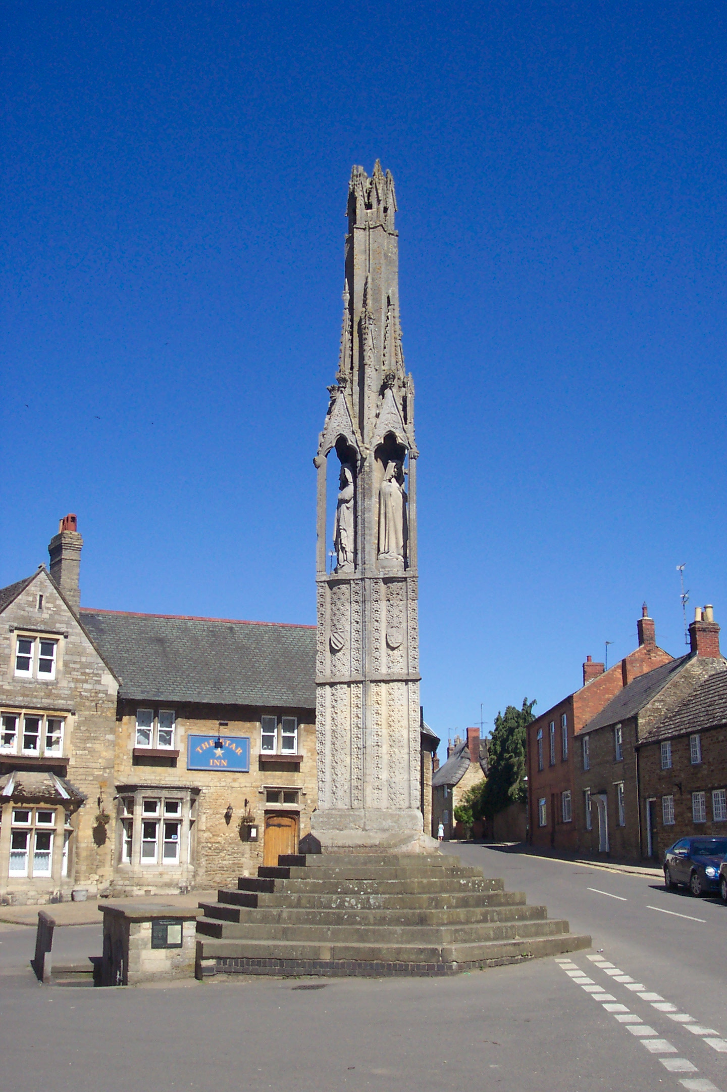
Eleanor’s Crosses
One of the 12 Eleanor Crosses built on the orders of Edward I after the death of his wife, Eleanor. The crosses were built at the places where her body spent the night on the way to Westminster for burial.
By Lofty at English Wikipedia, CC BY 2.5,
https://commons.wikimedia.org/w/index.php?curid=6078246

Slide 6
The Italian writer, Petrarch, wrote this letter to a friend in 1350 after the outbreak of the plague known as the Black Death:
“Where are our dear friends now? Where are the beloved faces? Where are the affectionate words, the relaxed and enjoyable conversations? What lightning bolt devoured them? What earthquake toppled them? There was crowd of us, now we are almost alone. We should make new friends, but how, when the human race is almost wiped out; and why, when it looks to me as if the end of the world is at hand?

Slide 7
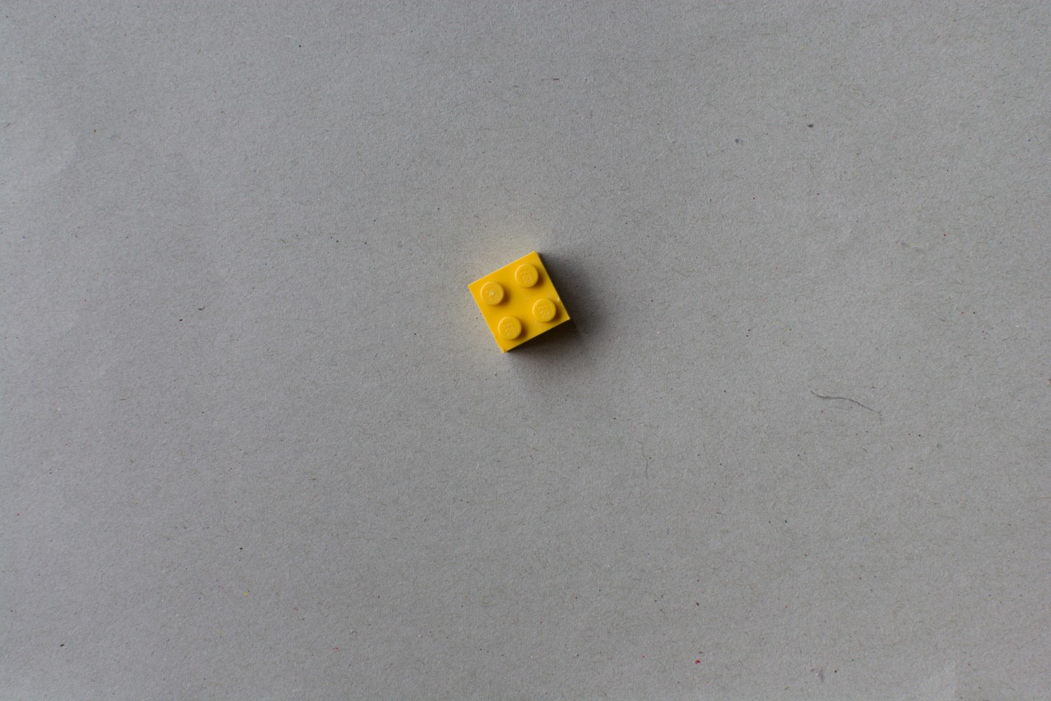
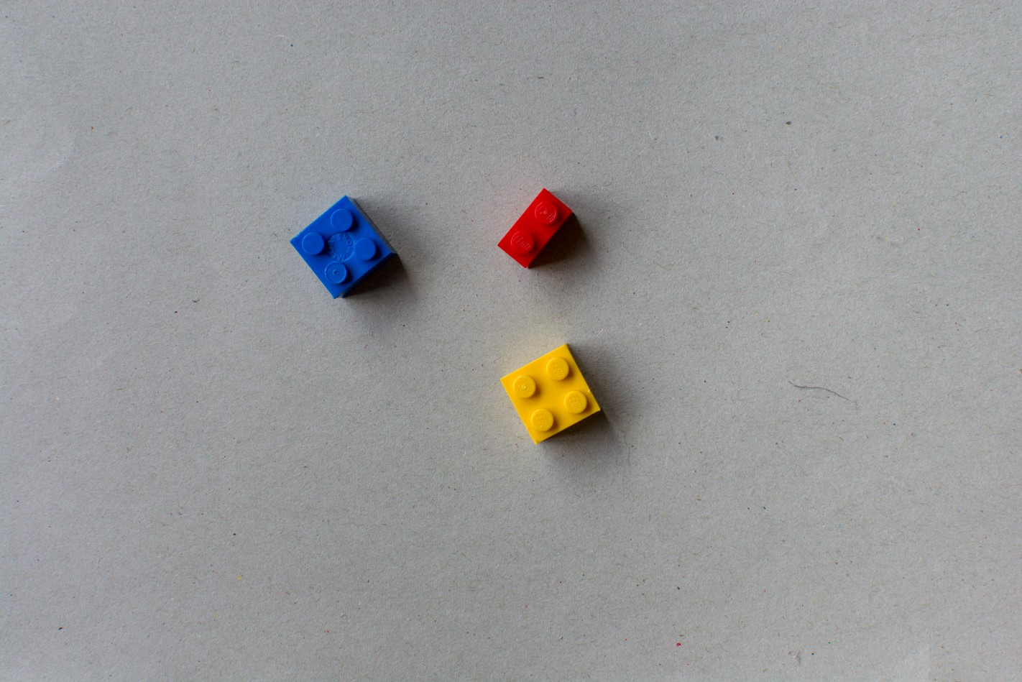
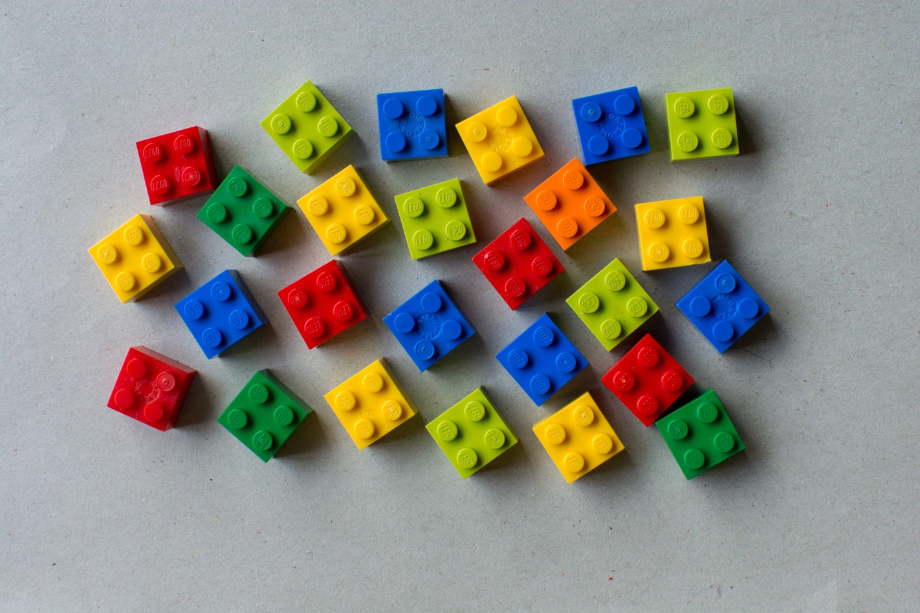
Changes in Population
Population in 1100
One brick = 2 million people
Population in 1300
Population in 1500
But after the Black Death in 1348 the population total fell back to the total in 1100
Population in 2000

Slide 8
‘It is often assumed that people of this period were vastly different from us. This is not a helpful assumption. Then, as now, individuals aimed to live the best lives possible while struggling to make ends meet …. [and] displaying emotions familiar to us: loyalty, jealousy, greed, hope, and passionate love.’
Professor Miri Rubin,
The Middle Ages: A very Short Introduction

