Slide 1
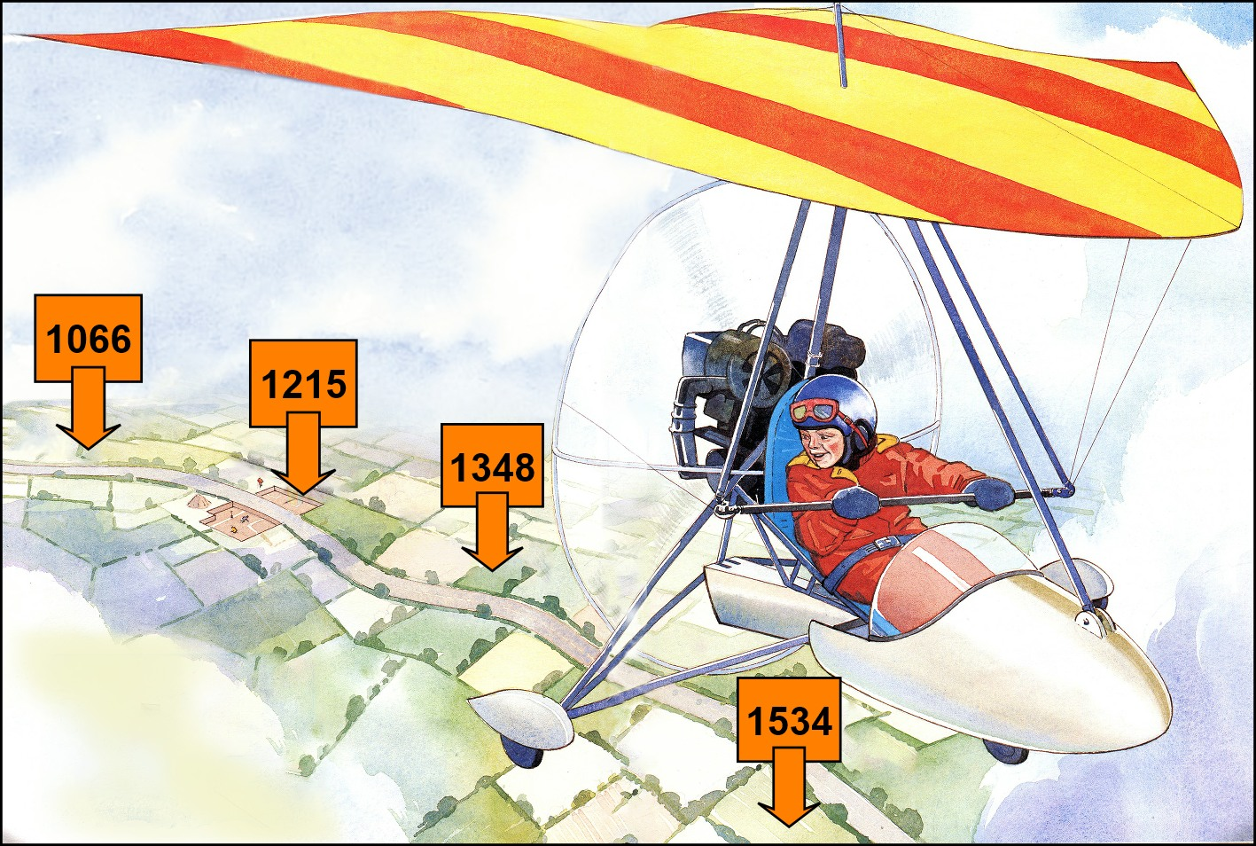
Your Big Story of Medieval Britain

Slide 2
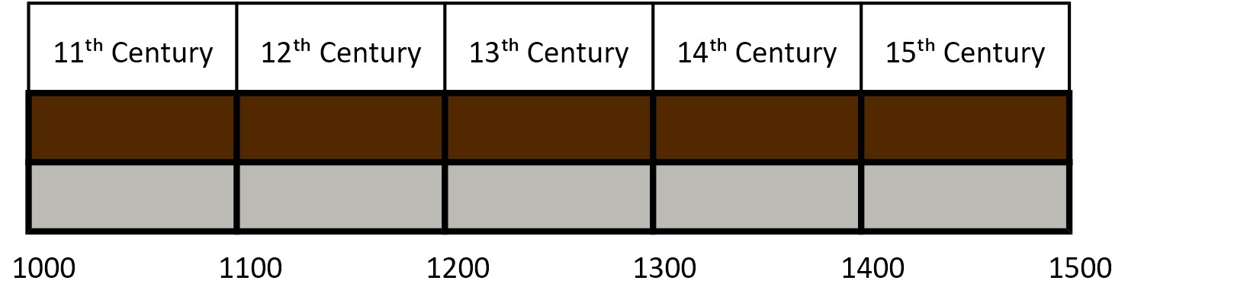
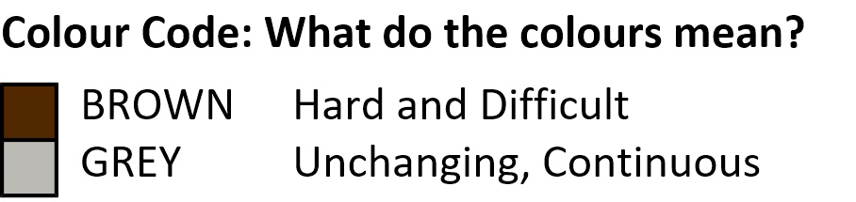
The Story of the Timeline
Life in the Middle Ages was always hard and difficult.
  This is shown by the muddy brown half of the timeline.
Life stayed the same throughout the Middle Ages. There were no changes.
  This is the story in the grey half of the timeline.

Slide 3
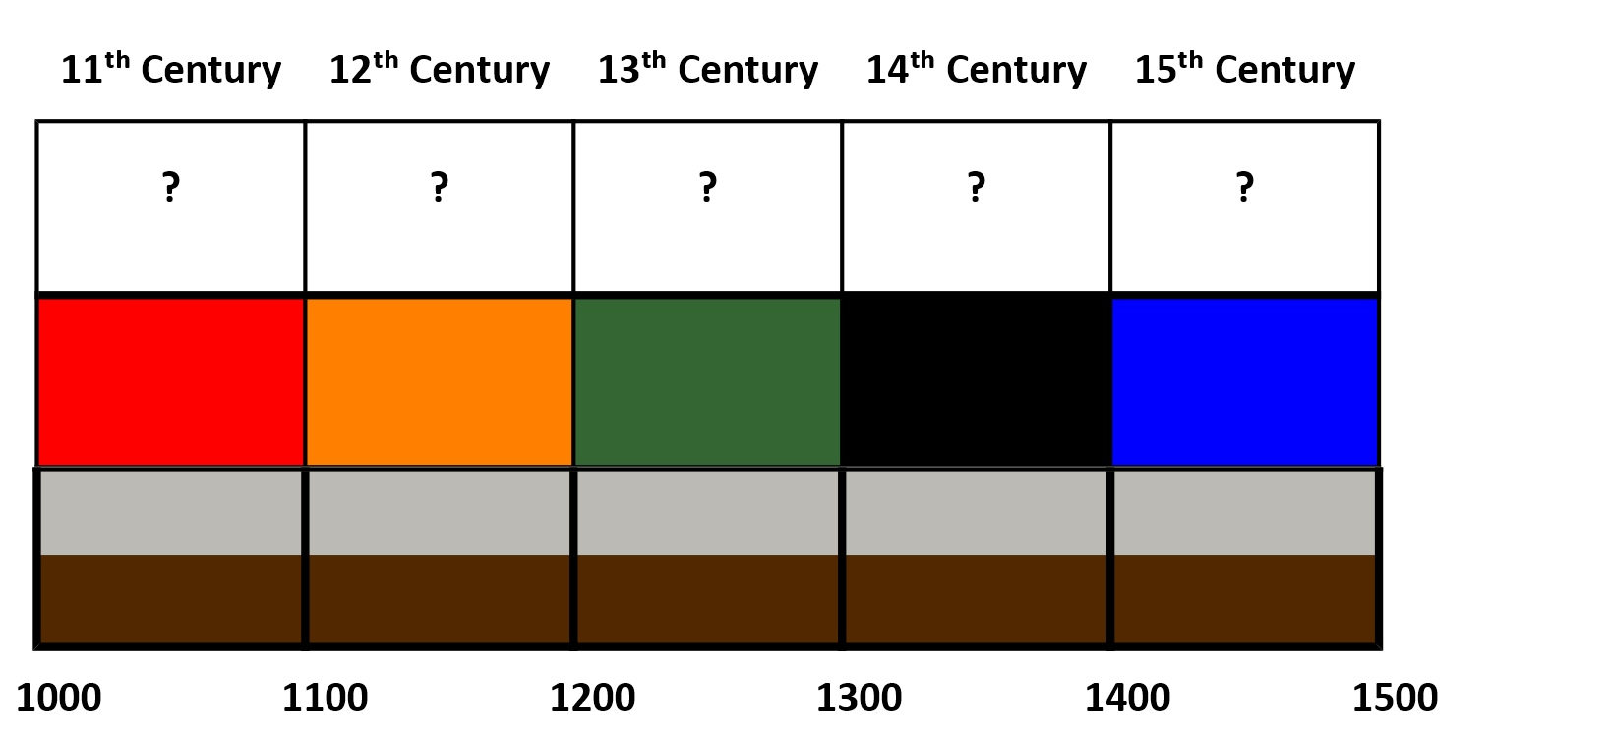
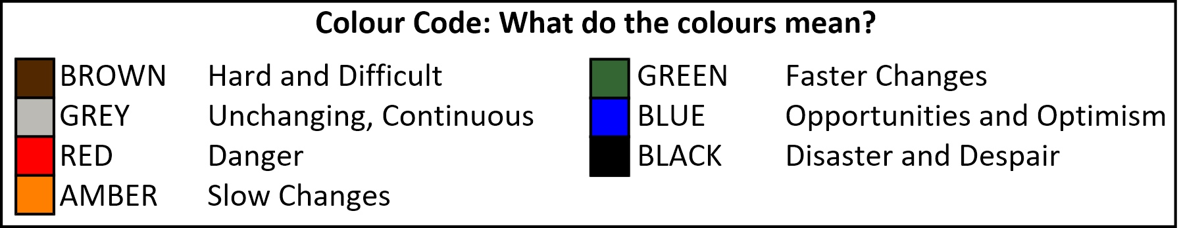
Choosing your colours for the Big Story

Slide 4
Choosing your colours
Your Tasks
1. Read the story of Eleventh Century on page 3. What evidence supports using red in the timeline?
2. Now chose one more colour which helps you to describe the Eleventh Century. Add that colour to the empty box, above the red box on the timeline. Then explain why you have chosen that colour.
3. Now repeat Tasks 1 and 2 for each of the other centuries, using the information on pages 4 to 7.

Slide 5
Using colours to challenge generalisations about the Middle Ages
1. A generalisation is a statement such as ‘life in the Middle Ages was hard and boring.’
  It’s called a generalisation because it’s very ‘general’.
2. A generalisation like this can be helpful – and dangerous.
  It’s helpful because it gives us a clear picture that’s easy to understand.
  But this generalisation is also dangerous because it’s too simple. Life wasn’t always hard and boring - there were times when people had fun and enjoyed life.
  This generalisation is therefore not giving us a realistic, accurate picture of life in the Middle Ages.

Slide 6
Using colours to challenge generalisations about the Middle Ages
3. Using colours in your Big Story timeline will help you decide how much you want to generalise about the Middle Ages.
  If you use just one colour for the whole Middle Ages then you are making a very simple generalisation.
  If you use one colour for each century then you are telling a more complicated story that’s less of a generalisation.
  If you use two or more colours for a century you are telling a more detailed story - but the danger is that the story may be less easy to understand.

Slide 7
What’s So Valuable About Big Stories?
We can see connections between events far apart in time and see which of the events were turning points which led to important changes.
We can see changes that only happened gradually over long periods of time. We can’t see that kind of change if we only study 10 or 20 years.
We can identify the long-term reasons behind events (such as population changes or the development of ideas) that we can’t see in a short-period Depth Study.
We realise that people’s emotions and feelings (like love for their family) don’t change much over time even if their clothes, homes and other things do.

Slide 8
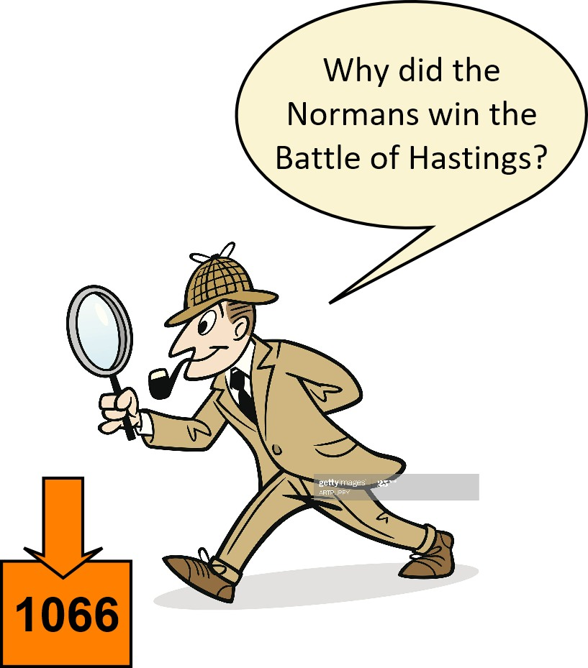
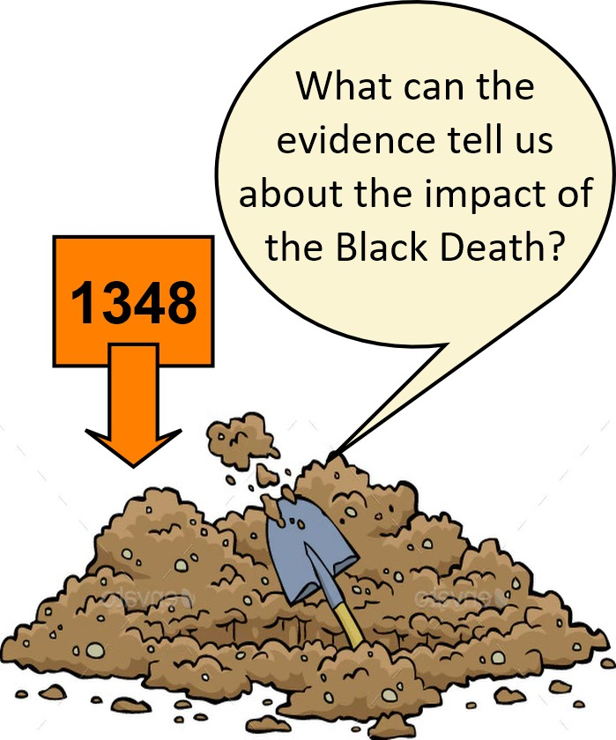
What’s So Valuable About Depth Studies
We can learn about individual people and their ideas and thoughts, their lives and decisions. This helps us understand their choices and actions.
We can use sources like letters or pottery that give us lots of detail about people’s lives and about individual events.
We can study one event and really get to know what happened and why it happened and all the people who were involved.

Slide 9

Choosing Your Takeaways
A. There were continuities in medieval life. These included some of the most important aspects of life such as the importance of the harvest every year for people’s health and welfare.
B. There were important changes that affected life for centuries in the future, such as the development of printing and gunpowder.
C. Many aspects of people’s lives had both continuities and changes. Religion remained very important but people did not just believe what they were told but had new ideas about how to worship God.
D. Some changes were the result of people finding intelligent ways to solve problems or wanting to make improvements for the sake of their families – as people have always done.
E. Increases and falls in the size of the population had huge effects on people’s lives.

Slide 10
Choosing Your Takeaways
F. Changes in the Middle Ages were very important even if they were not as great as many changes later during the Industrial Revolution.
G. We learn about the broad patterns of changes and continuities from Big Stories, things we can’t learn from studying topics in depth.
H. We have to use generalisations in Big Stories so that the stories stay clear but we also have to be careful not to make them too simple.
I. We have to use generalisations in Big Stories so that the stories stay clear but we also have to be careful not to make them too simple.

Slide 11
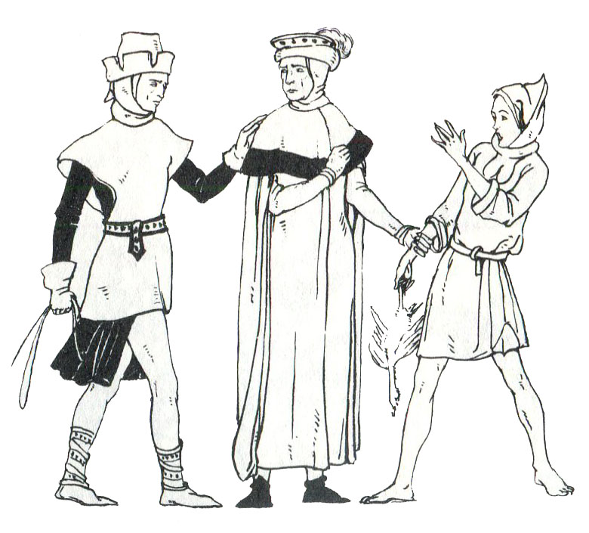
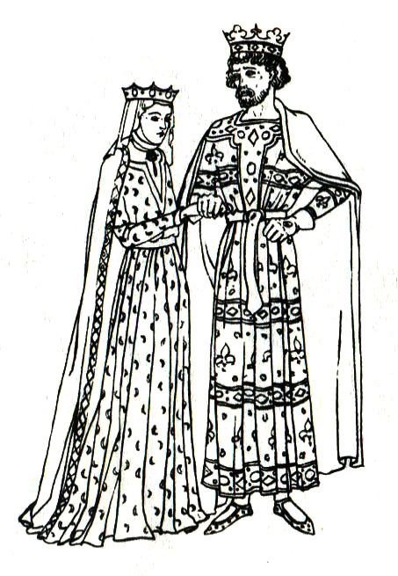
Your Overall Enquiry is:
Are people right to be so negative about the Middle Ages?
The final question to ask yourself is:
Has what you’ve learned from this chapter changed your view of life in the Middle Ages?

